Slide 1
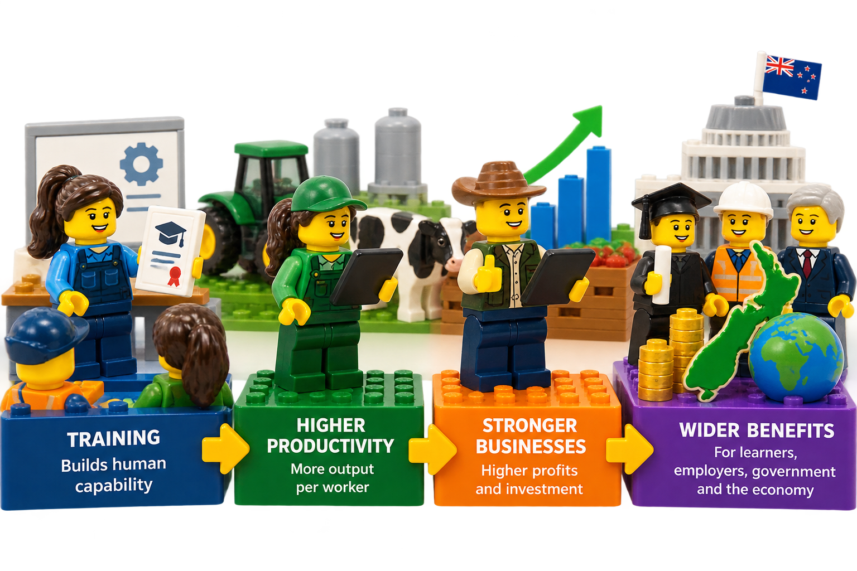
October 2026
Measuring how vocational education contributes to industry to productivity
A framework to bring together existing analyses and data into a useful tool

Slide 2
What this presentation is about
Notes:
This presentation shares some work where we took a different approach to training evaluation – specifically developing a modelling framework to characterise the impact that vocational training has on productivity

Slide 3


Thanks to…
Notes:
Thanks upfront to two organisations that were, at different times, sponsors for this work.

Slide 4
What we’d like to do
What we often measure
What we actually want to understand
What we could do with this
Enrol
Impact on productivity
Learner lifetime income
Current employer profits
Future employer profits
For TEC, ISBs and providers
Prioritise investment in training that has the most impact
Make a stronger case to employers to train
Inform the debate on who should pay for training
Complete
training
Impact on non-economic outcomes
Notes:
As Hannah talked about in her talk, we often measure enrolments and completions because that is what we can do relatively easily.
If we could predict the impact that training has on outcomes, we would be much better off.
Ideally we’d be able to measure the impact on both economic outcomes i.e. productivity as well as non-economic outcomes although the focus of this presentation is just the former.
If we had that, we could…
Prioritise investment in training that has the most impact
Make a stronger case to employers to train
Inform the debate on who should pay for training
Ideally the analysis and evidence to do this would :
Be shared – providers, ISBs, TEC – would all use the same tools
Have a common approach to compare training programmes across sectors, NZQA levels, programme types, delivery modes etc.

Slide 5







Analyses on the impact of training on productivity
Training Wages & salaries
Training Business profits
Notes:
There has been quite a lot of work over the last 10-20 years that have had a go at this.
Work that we are aware of includes that commissioned by the organisations show here. This is unlikely to be a complete list – and that is just the work from New Zealand.

Slide 6







Lots of useful data
Variation in productivity by industry
Variation in business profitability within an industry
Employer views on the trade-off between training and experience
Pay rates for different roles and occupations
Employee income and qualifications
Business profits and employee qualifications
Notes:
There is also a lot of data out there that can be used. Some of these sources have been used more than others.
However, to our knowledge, there is nothing that pulls all of this together into a tool that allows a provider, or an ISB, or TEC,… to describe a training programme, and the learners it is aimed at, and ask ‘what is the expected impact on productivity for each EFTS delivered?’
That is the gap that we aim to address (note the present tense – this as a work in progress not a finished product).

Slide 7




Some design principles
Broad / holistic enough to compare different types of training
Useful rather than right
Model first, data second
Evolve and improve over time
Notes:
Our approach is a modelling-led one rather than a data-led one. Some of the design principles that guide our approach include:
Broad / holistic enough to compare different types of training – Aim to provide that tool that can work across the sector / make comparisons
Useful not right – All models are wrong… if model is wrong at absolute values it can still be useful by comparing programmes
Model first, data second – Use existing models and frameworks, plus intuition and judgement, to form the ‘shape’ of the model. Then adjust model parameters to make outputs fit with observed data
Evolve and improve over time – Both model and calibration

Slide 8
A sequence of questions to drill down to training impact
  How much does productivity vary from person to person?
  What causes this?
  How much of the variation is explained by each cause? In particular, how much is explained by variation in human capability?
  How much of the variation in human capability is explained by variation in training?
  What effect do different attributes of training have?
  ….
Notes:
The model breaks the problem down into series of different parts.
One way to think about this is to think about a series of research questions that start with understanding why productivity varies and drills down to touch on the attributes of individual training programmes.
By chunking the problem down we can identify questions where we have some data or we can use expert judgment.

Slide 9
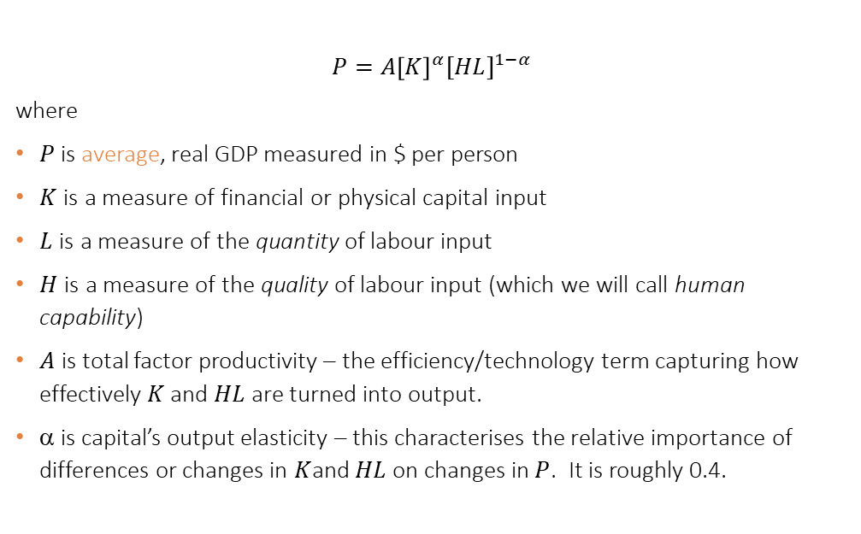
A good starting point
  $$P=A{\left[K\right]}^{α}{[HL]}^{1−α}$$
  where
  $P$is average, real GDP measured in $ per person
  $K \text{is a measure of financial or physical capital}$ input
  $L \text{is a measure of }\text{the }\text{quantity}\text{ of labour input }$
  $H \text{is a measure of }\text{the }\text{quality}\text{ of }\text{labour input}$ $\text{(}\text{which we will call} \text{human capability}\text{)}$
  $A$ is total factor productivity – the efficiency/technology term capturing how effectively$K$ and $HL$are turned into output.
  α is capital’s output elasticity – this characterises the relative importance of differences or changes in $K$and $HL$on changes in$P$. It is roughly 0.4.
Productivity
Training sits in here
Notes:
Our approach starts by looking at productivity for an economy as a whole.
If we pick up an economics text book and look up the chapter on productivity we find this equation – a Cobb-Douglas production function.
Essentially it says that productivity of an economy is the product of all the physical and financial capital in an economy, and the human capital that operates it. The thing that we’re interested in – training – sits in the human capital part.

Slide 10
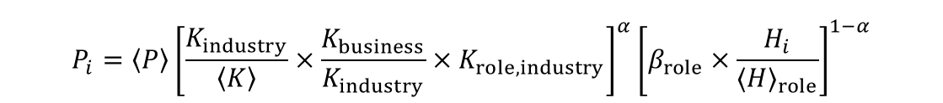
‘Unaveraging’ productivity
  $$P_{i}=\left\langle P\right\rangle {\left[\frac{K_{industry}}{\left\langle K\right\rangle }×\frac{K_{business}}{K_{industry}}×K_{role, industry}\right]}^{α}{\left[β_{role}×\frac{H_{i}}{{⟨H⟩}_{role}}\right]}^{1−α}$$
An individual’s personal productivity
Firm average vs industry average
Amount that human capability matters for a given role level
Industry average vs NZ average
Influence of the role on an enterprise
An individual’s human capability vs the average for their role
Notes:
Where our approach departs from the text book is by attempting ‘unaverage’ this equation to apply it to an individual rather than an economy as a whole.
I won’t try to go through all the terms in this equation. But the idea of this slide is to show that it we have been able to use a mathematical framework to break the problem down. The different terms in the equation relate to parts of a model that can be calibrated using data or expert judgement. For example, we can use data on the spread of profitability within firms in an industry as a reference to calibrate the model.

Slide 11
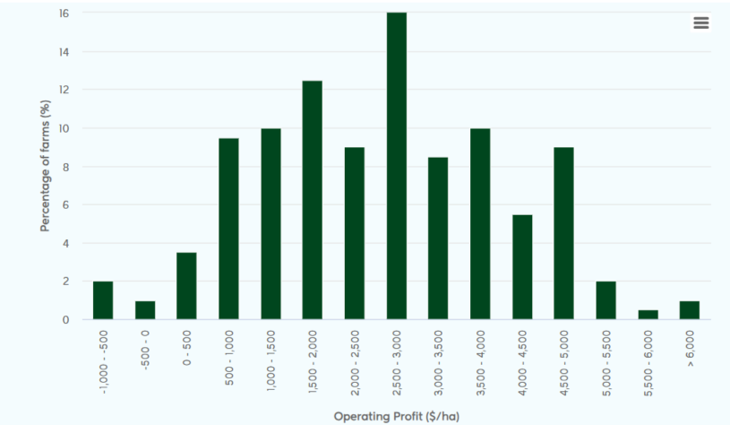
Spread of profitability of New Zealand dairy farms
Notes:
Here’s an example of such data.

Slide 12
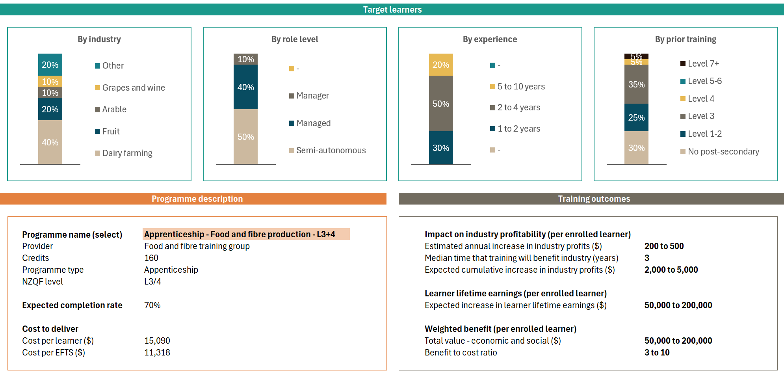
Dashboard for a training programme
Notes:
I’m going to jump to some of the outputs.
We have progressed this work to a point of having a working prototype in a spreadsheet
What we have on screen is one output – a dashboard for an individual training programme
The dashboard is currently showing an idealised qualification rather than a real one.
The green and orange panels show inputs to the model describing the target learners and the programme details
The grey panel in the bottom right shows the key outputs:
impact on employer profits,
impact on learner earnings,
benefit to cost ratio

Slide 13
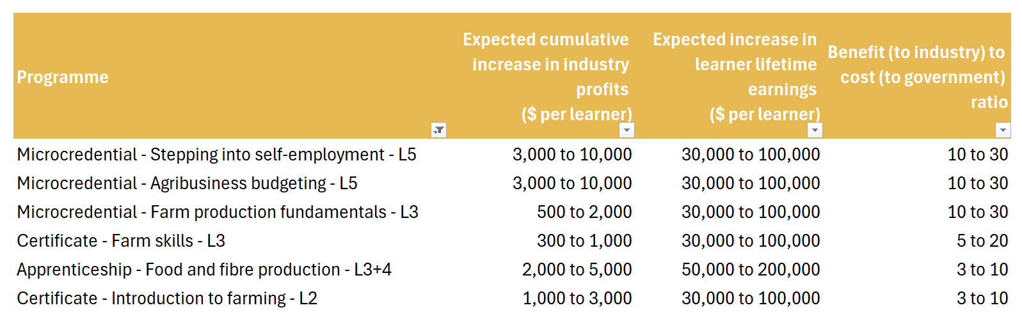
Comparing programme impacts on productivity
Notes:
Another output is a table comparing different programmes.
Made-up training programmes but illustratively right
Returns are positive and high – as they should be
Best returns in this case is from micro-credentials (but this is not always the case for real programmes – more mixed)
As the model currently stands, learners get most of the benefits. This is a function of the expected time that learners will stay with their employer.
But also highlights a gap in the current model. A future improvement is to model the expected benefits to future employers.

Slide 14

Where next?
Notes:
We’ve got a working prototype but there is a bit to go to turn it into the working tool that we think would be useful to providers, ISBs and TEC.
There is more that can be done to improve the modelling and the calibration.
We’d like to turn this into an online tool that can be widely accessed.
If you have any ideas on where this could go we’d love to chat.

