Slide 1

Beyond Consultation:
Values, trade-offs and accountability in qualification design

Slide 2

Qualification design is collaborative, not democratic
We seek advice from industry peak bodies, large employers, small employers, subject matter experts, recent graduates, Māori business, iwi Māori, campus-based providers, work-based providers.
We need to meet NZQA listing rules.
We must be mindful of deliverability constraints and TEC funding rules.
We must obey our Orders in Council and give effect to the Tertiary Education Strategy.
We are 'industry led' but government funded.

Slide 3

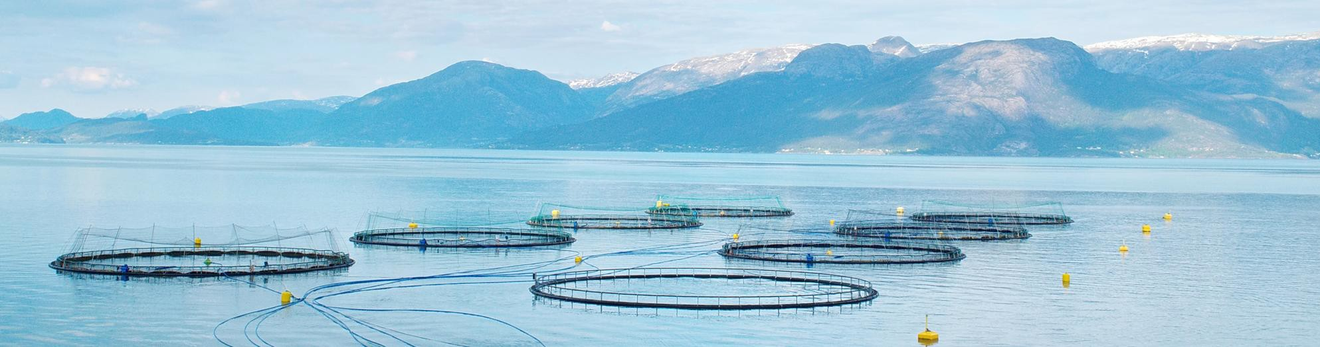
Seafood skills needs- a case-study in competing objectives
Technical expertise/broad competence
Work-based/campus based
Small components/large qualification
Changing demographics/static workforce
50/50 Māori to non-Māori ownership
New skill sets needed/existing sunk costs
What happens when no option satisfies every legitimate objective or partner?

Slide 4

Group role-play
You will be given a scenario to consider, and a role to play. You need to ensure that your perspective is heard. Elect someone to report back.
Did you reach agreement?
Was there one obvious solution? Were there winners and losers?
We will tell you what happened in the real project ☺

Slide 5

Decision-making framework
There may be no right decision, but that doesn't mean any decision will do.
People working with us need to know how we gather intelligence to inform decisions, how they can influence those decisions, who has authority and responsibility for the decisions.
The decisions need to be reasonable, defensible and transparent.
The decisions are subject to evaluation and review, so an account of the process is required.

Slide 6

The decision narrative: contributions and judgement
Mandate: the decision, discretion and authority.
Contributions: who participated and what they brought.
Agreement and disagreement: where views converged or differed.
Judgement: The criteria, values and obligations used

Slide 7

The decision narrative: trade-offs and consequences
Trade-offs: what credible alternatives protect or compromise.
Decision and reasons: who decided and why priorities prevailed.
Consequences: who benefits, who carries costs, what remains uncertain.

Slide 8
Takeaway question:
Are there decisions in your own organisation that would benefit from a clearer mandate and an explicit account of the judgement?

