Slide 1



Bridges, Not Islands:
A Connected Micro-Credential System
Using Micro-Credentials to support a connected learning journey across the education sector and the workplace

Slide 2
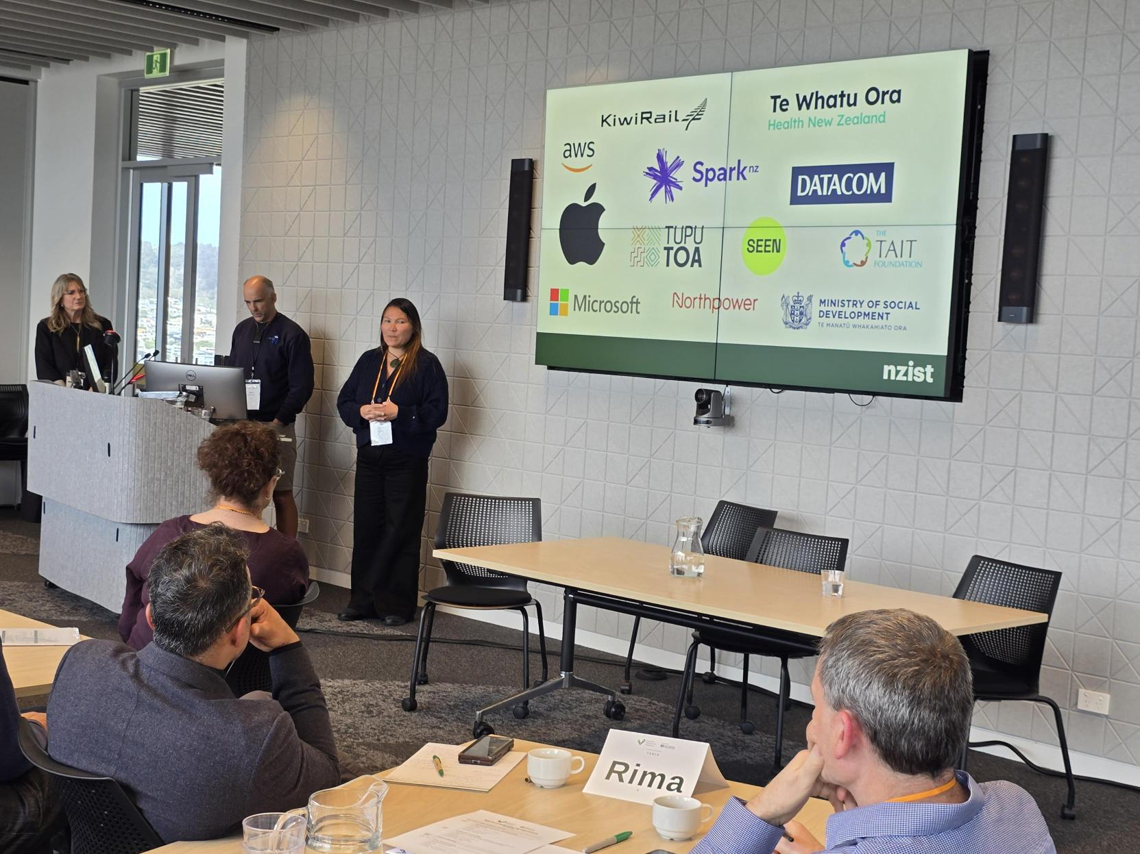
What are micro-credentials?
Why Micro-credentials
What are the drivers?
Bridges, Not Islands: A Connected Micro-Credential System
Jeremy Baker
Chief Executive | VUW-THW Kāpuhipuhi Wellington Uni-Professional
jeremy.baker@vuw.ac.nz | 021 377 791
Inaugural Micro-credential Symposium, VUW, September 2026

Slide 3
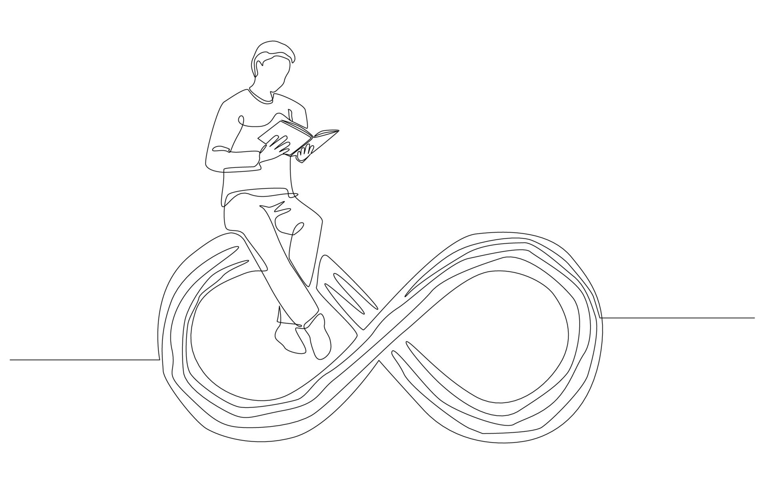
What are micro-credentials?
Lifelong learning
Lifelong Learning is the continuous development of skills, knowledge, and competencies driven by personal, professional or community goals, occurring across all stages of life.
Bridges, Not Islands: A Connected Micro-Credential System

Slide 4
Why Micro-credentials?
Changes in our demography
Fewer school leavers
People living and working longer
More Māori, Pacific people and migrants
Changes in our workplaces
Fluid and flexible careers, many role changes
Contractual and short-term jobs
Industry change, restructuring and downsizing
Automation and AI
Bridges, Not Islands: A Connected Micro-Credential System

Slide 5
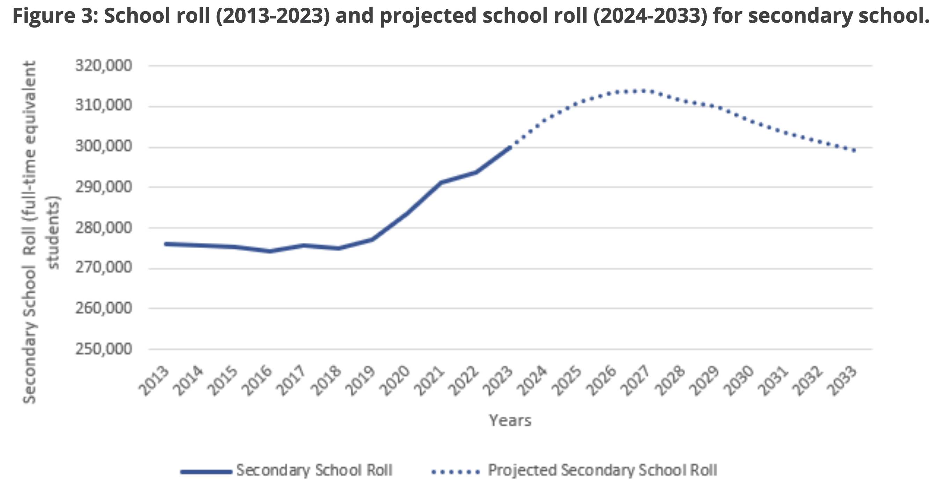
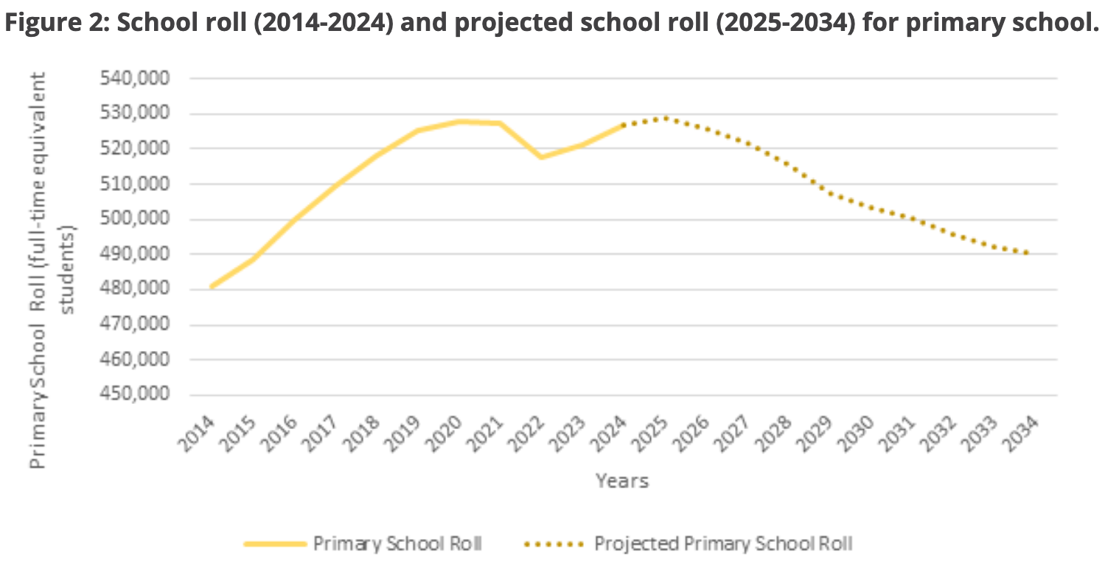
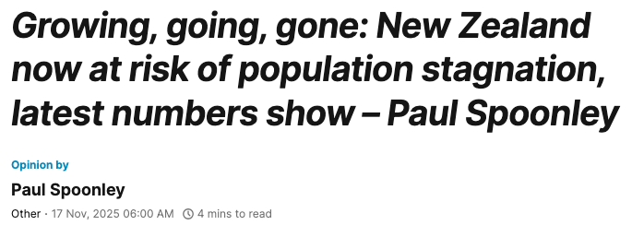
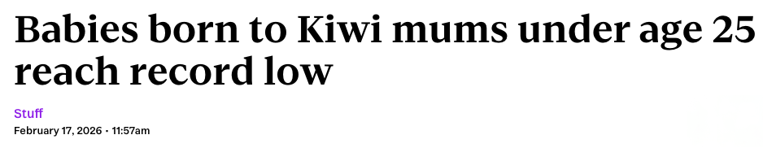
What are micro-credentials?
Why Micro-Credentials?
To prepare for scarily close demographic shifts in New Zealand (The future of formal learning is increasingly in the workforce)
- 17,000
Bridges, Not Islands: A Connected Micro-Credential System
- 33,000
Secondary
Primary
https://www.educationcounts.govt.nz/statistics/national-school-roll-projection

Slide 6
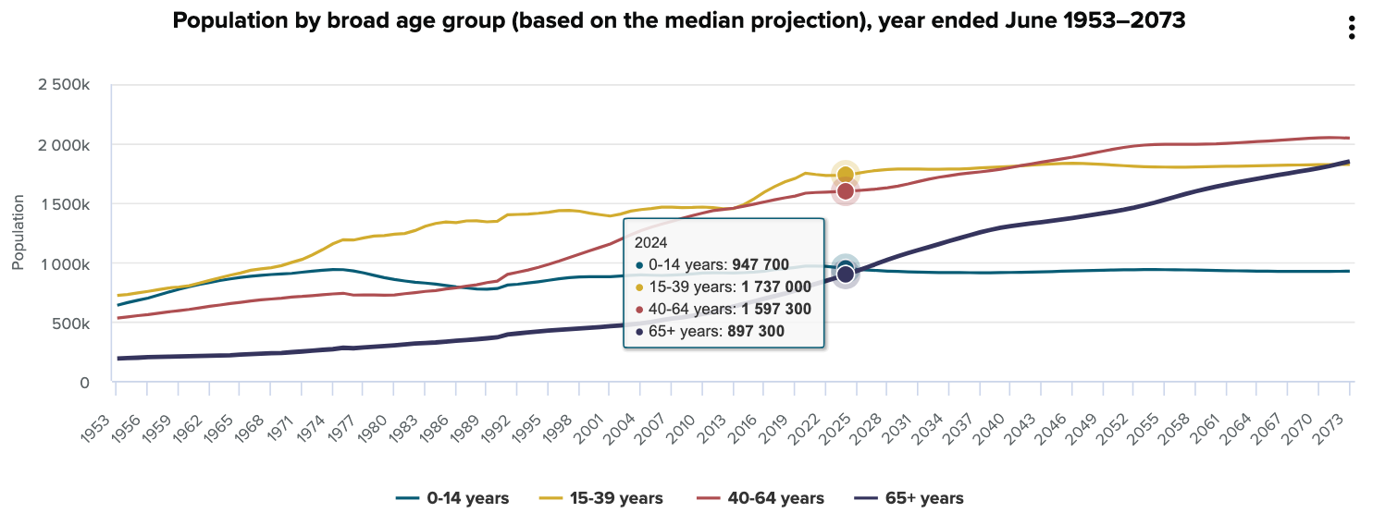
What are micro-credentials?
Why Micro-Credentials?
To provide a formalised life-long learning approach to support demographic shifts in New Zealand
Bridges, Not Islands: A Connected Micro-Credential System
https://www.stats.govt.nz/information-releases/national-population-projections-2024base2078/

Slide 7

What are micro-credentials?
Why Micro-Credentials?
With an older population staying in work longer as lifespans increase.
“In what seems a legacy of the Industrial Revolution, most people’s lives are divided into three stages:
roughly two decades of education,
four decades of employment and
one to two decades of retirement.
We need a new model better-suited to centenary life spans during which people might be in the labour market for an added 20 to 40 years — and not simply for economic reasons, but because their relationship to work has changed.”
WEF – Why we must plan lifelong learning for a generation that will live past 100
Bridges, Not Islands: A Connected Micro-Credential System

Slide 8

What are micro-credentials?
Why Micro-Credentials?
Our workplaces and sectors will be continuously disrupted by digital, economic, and geopolitical change.
Bridges, Not Islands: A Connected Micro-Credential System

Slide 9
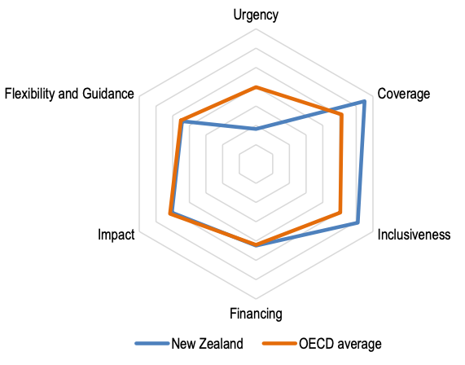
What are micro-credentials?
Why Micro-Credentials?
We need to start taking this seriously now to serve a future lifelong learning eco-system in Aotearoa New Zealand.
“The world of work is changing. Digitalisation, globalisation and population ageing are having a profound impact on the type and quality of jobs that are available and the skills needed to perform them. The extent to which individuals, firms and economies can reap the benefits from these changes will depend critically on the readiness of adult learning systems to help people develop and maintain relevant skills over their working careers.”
OECD Priorities for Lifelong Learning
Bridges, Not Islands: A Connected Micro-Credential System

Slide 10
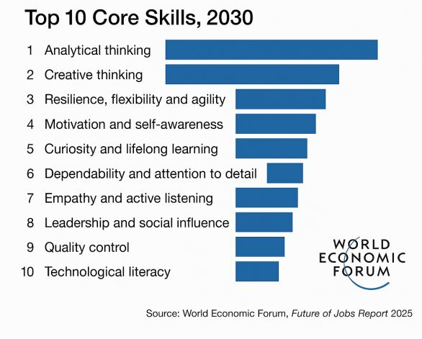
What are micro-credentials?
Why Micro-Credentials?
They are an agile solution to building personal or workplace skills as they are needed without the need for long-form study
Bridges, Not Islands: A Connected Micro-Credential System

Slide 11
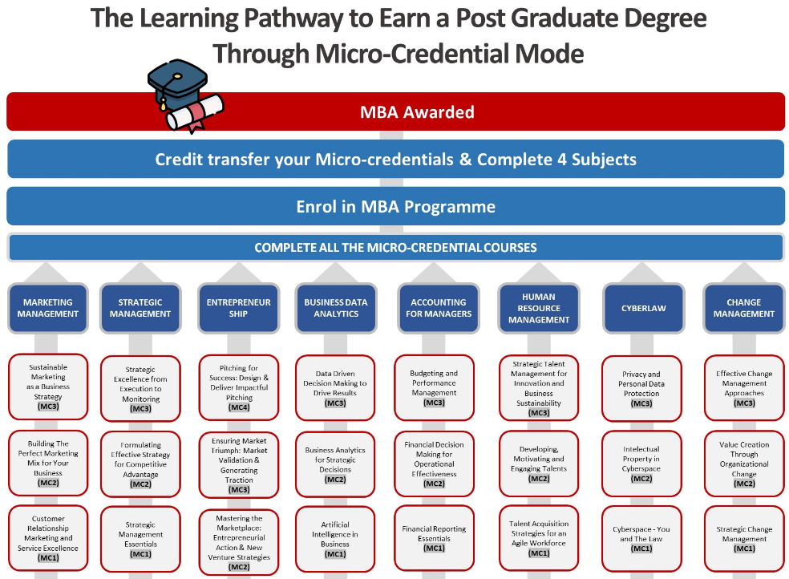
What are micro-credentials?
Why Micro-Credentials?
For organisations or individuals to design capability pathways that are:
sector relevant and
transferable to other learning contexts
Bridges, Not Islands: A Connected Micro-Credential System
https://www.mmu.edu.my/microcredential/#mba

Slide 12
Micro-credentials enable:
more flexibility and options
people to get the skills they need
stronger recognition of specific skill sets
recognition of existing skills and skills gained
credit transfer
people to start their learning journey with something manageable
pathways to further learning, including long-form learning options and qualifications
Bridges, Not Islands: A Connected Micro-Credential System

Slide 13
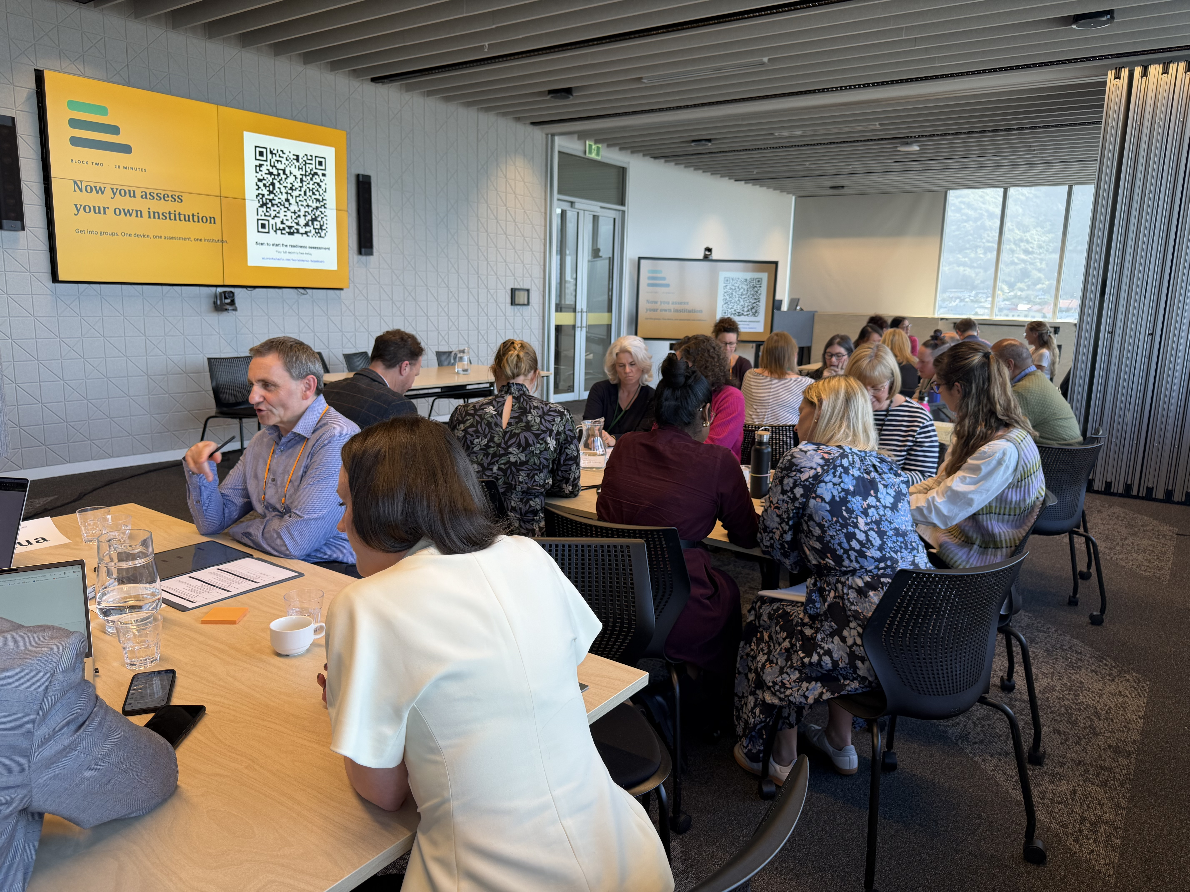
What are micro-credentials?
The current state
Bridges, Not Islands: A Connected Micro-Credential System
Jonny Flutey
Future Learning and Capability | VUW-THW Kāpuhipuhi Wellington Uni-Professional
Jonathan.Flutey@wellingtonuni-professional.nz | +64 29 200 6914
Inaugural Micro-credential Symposium, VUW, September 2026

Slide 14




What are micro-credentials?
So then, what are micro-credentials?
Micro-credentials are skill based. They are designed to teach a skill, allow the learner to apply the skill, then assess and reflect on the impact of using the skill in a professional or personal context.
Micro-credentials are small, stand-alone awards with set learning outcomes and defined learning hours. They're part of Aotearoa’s education and training system.
Micro-credentials recognise learners' skills, experience or knowledge, while meeting demand from employers, industry, communities, and personal contexts.
Micro-credentials are designed to be continuously attained, stacked (create pathways of credentials from individual or multiple sources) and be recognised by tertiary institutions, workforce sectors, individual employers, and wider community organisations (plus more!)
Bridges, Not Islands: A Connected Micro-Credential System

Slide 15
What are micro-credentials?
Evolution of the rules from limiting -
2018 – 2022: A micro-credential certifies achievement of a coherent set of skills and knowledge; and is specified by a statement of purpose, learning outcomes, and strong evidence of need by industry, employers, iwi and/or the community.
They are smaller than a qualification and focus on skill development opportunities not currently catered for in the regulated tertiary education system.
At a minimum, micro-credentials will be subject to the same requirements as training schemes or assessment standards and will also be required to:
be 5–40 credits in size
have strong evidence of need from employers, industry and/or community
not duplicate current quality assured learning approved by NZQA
be reviewed annually to confirm they continue to meet their intended purpose.
Bridges, Not Islands: A Connected Micro-Credential System

Slide 16
To Enabling (and more wordy) -
2022 – present: Micro-credentials are small, stand-alone awards with set learning outcomes. They're part of New Zealand's education and training system.
Micro-credentials recognise learners' skills, experience or knowledge, while meeting demand from employers, industry and communities.
Micro-credentials listed on the New Zealand Qualifications and Credentials Framework (NZQCF):
are up to 40 credits in size (standard 10 hours per credit)
are at any level of the NZQCF
have an assessment component (should focus on application of skills and professional practice)
are delivered by accredited education providers
are developed because there's evidence they're needed.
Although they're stand-alone awards, some micro-credentials may also form part of a programme that leads to a qualification.
Bridges, Not Islands: A Connected Micro-Credential System

Slide 17
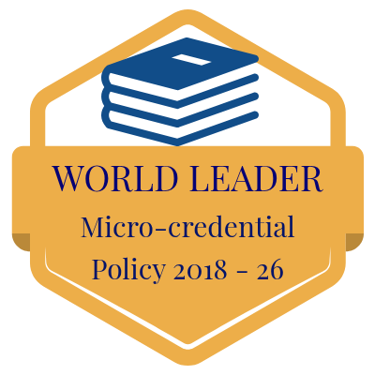
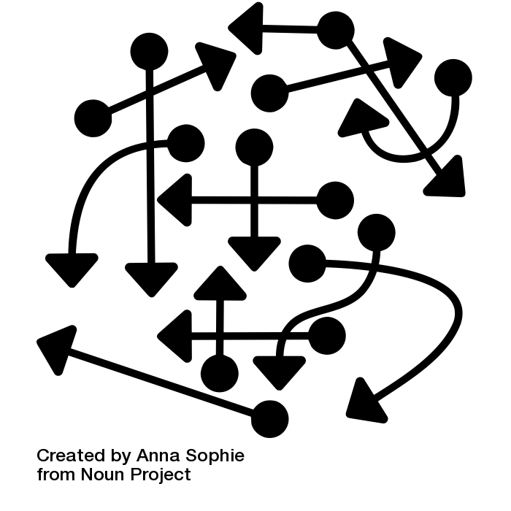

What are micro-credentials?
Due to this being part of our Act and System -
Bridges, Not Islands: A Connected Micro-Credential System
ONE
OTHER

Slide 18
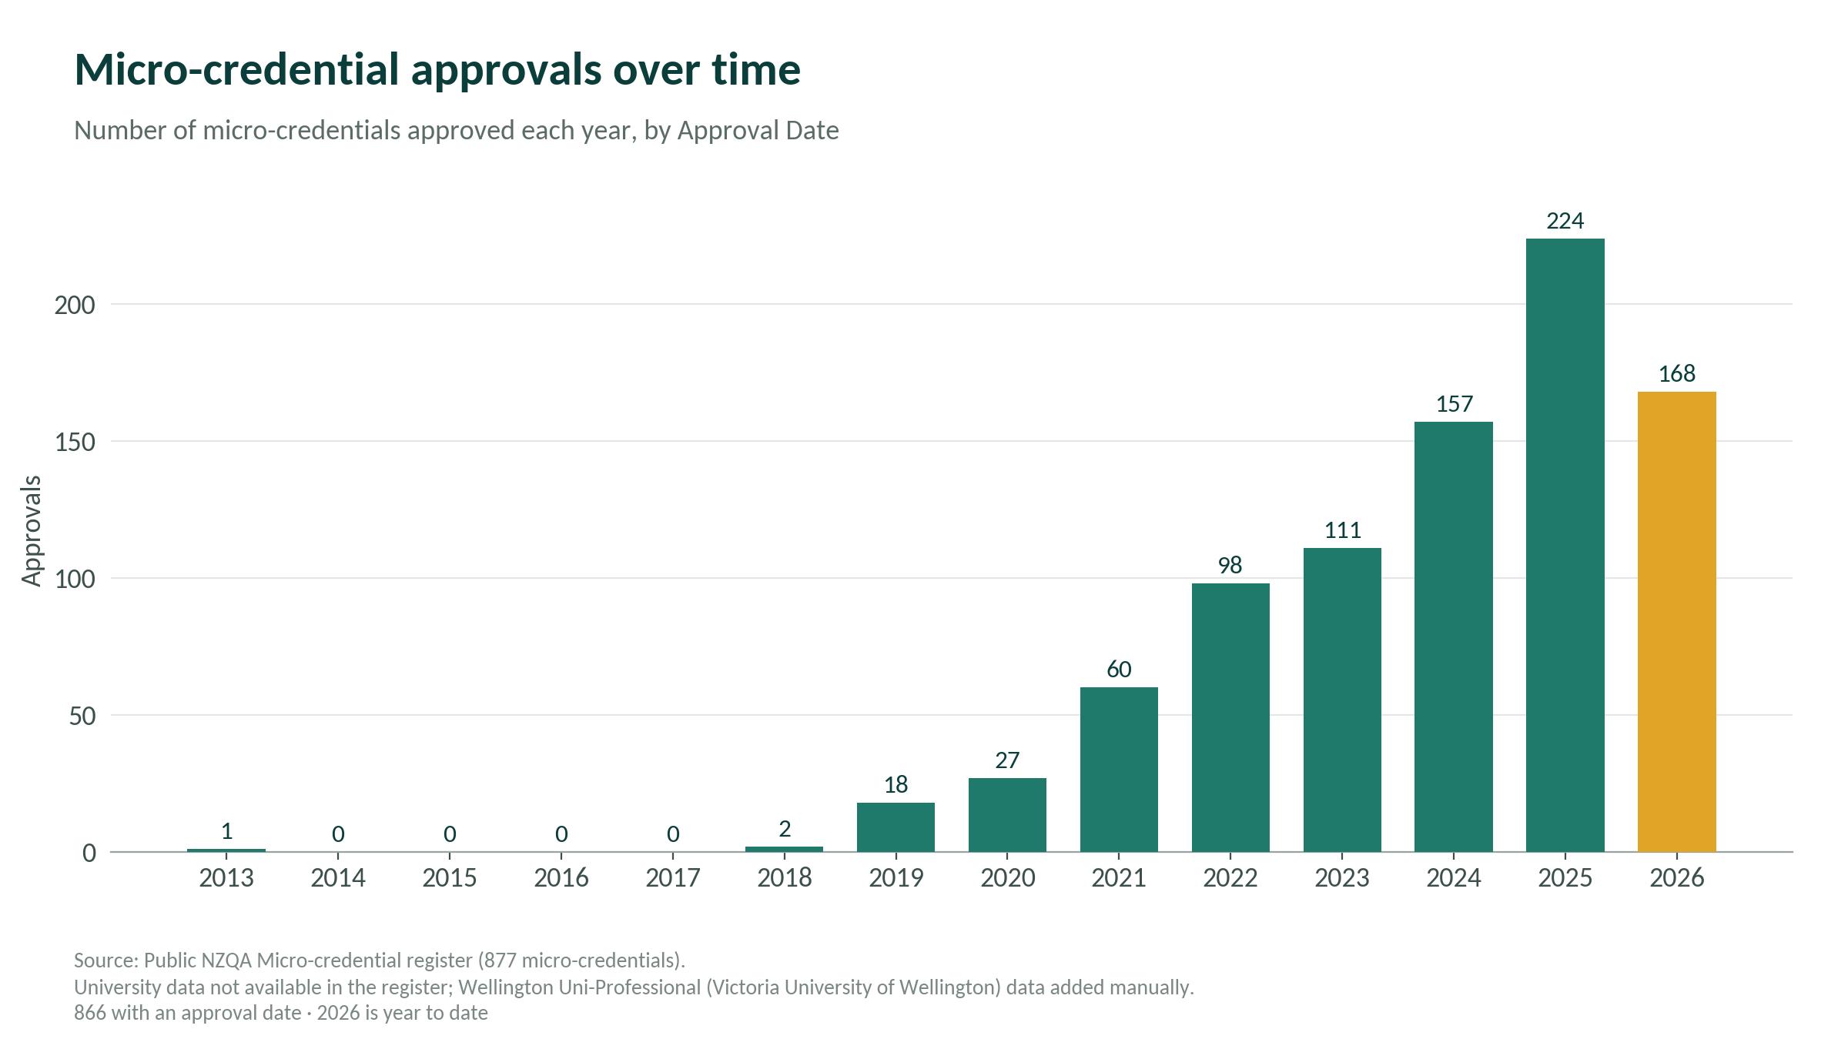
What are micro-credentials?
The State of the Nation! (or NZQA MC Register…)
Bridges, Not Islands: A Connected Micro-Credential System

Slide 19
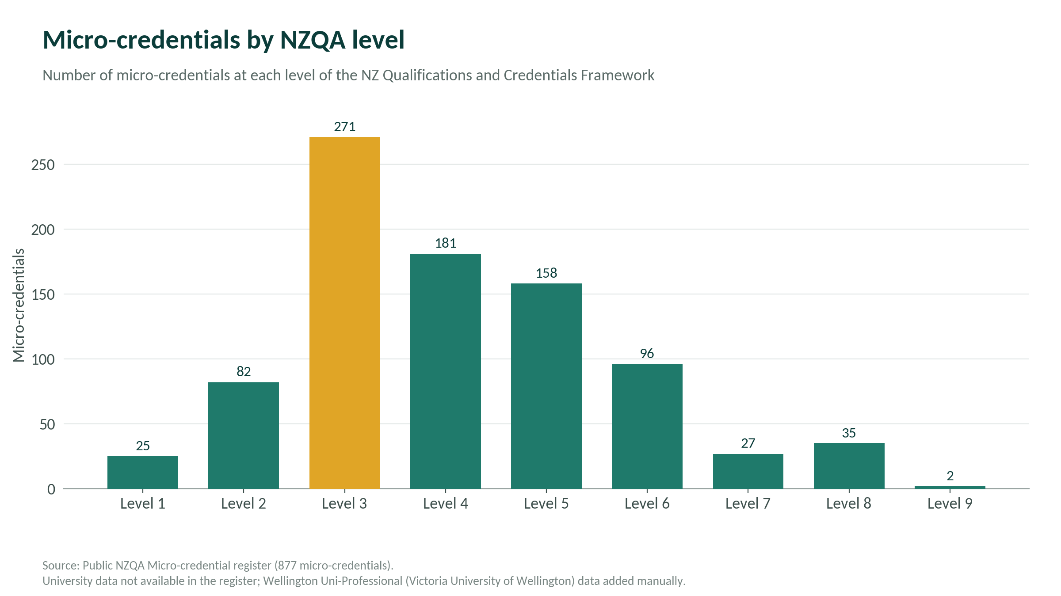
What are micro-credentials?
The State of the Nation! (or NZQA MC Register…)
Bridges, Not Islands: A Connected Micro-Credential System

Slide 20
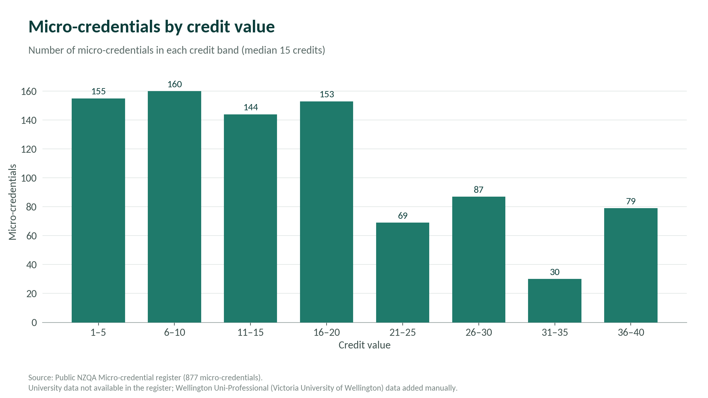
What are micro-credentials?
The State of the Nation! (or NZQA MC Register…)
Bridges, Not Islands: A Connected Micro-Credential System

Slide 21
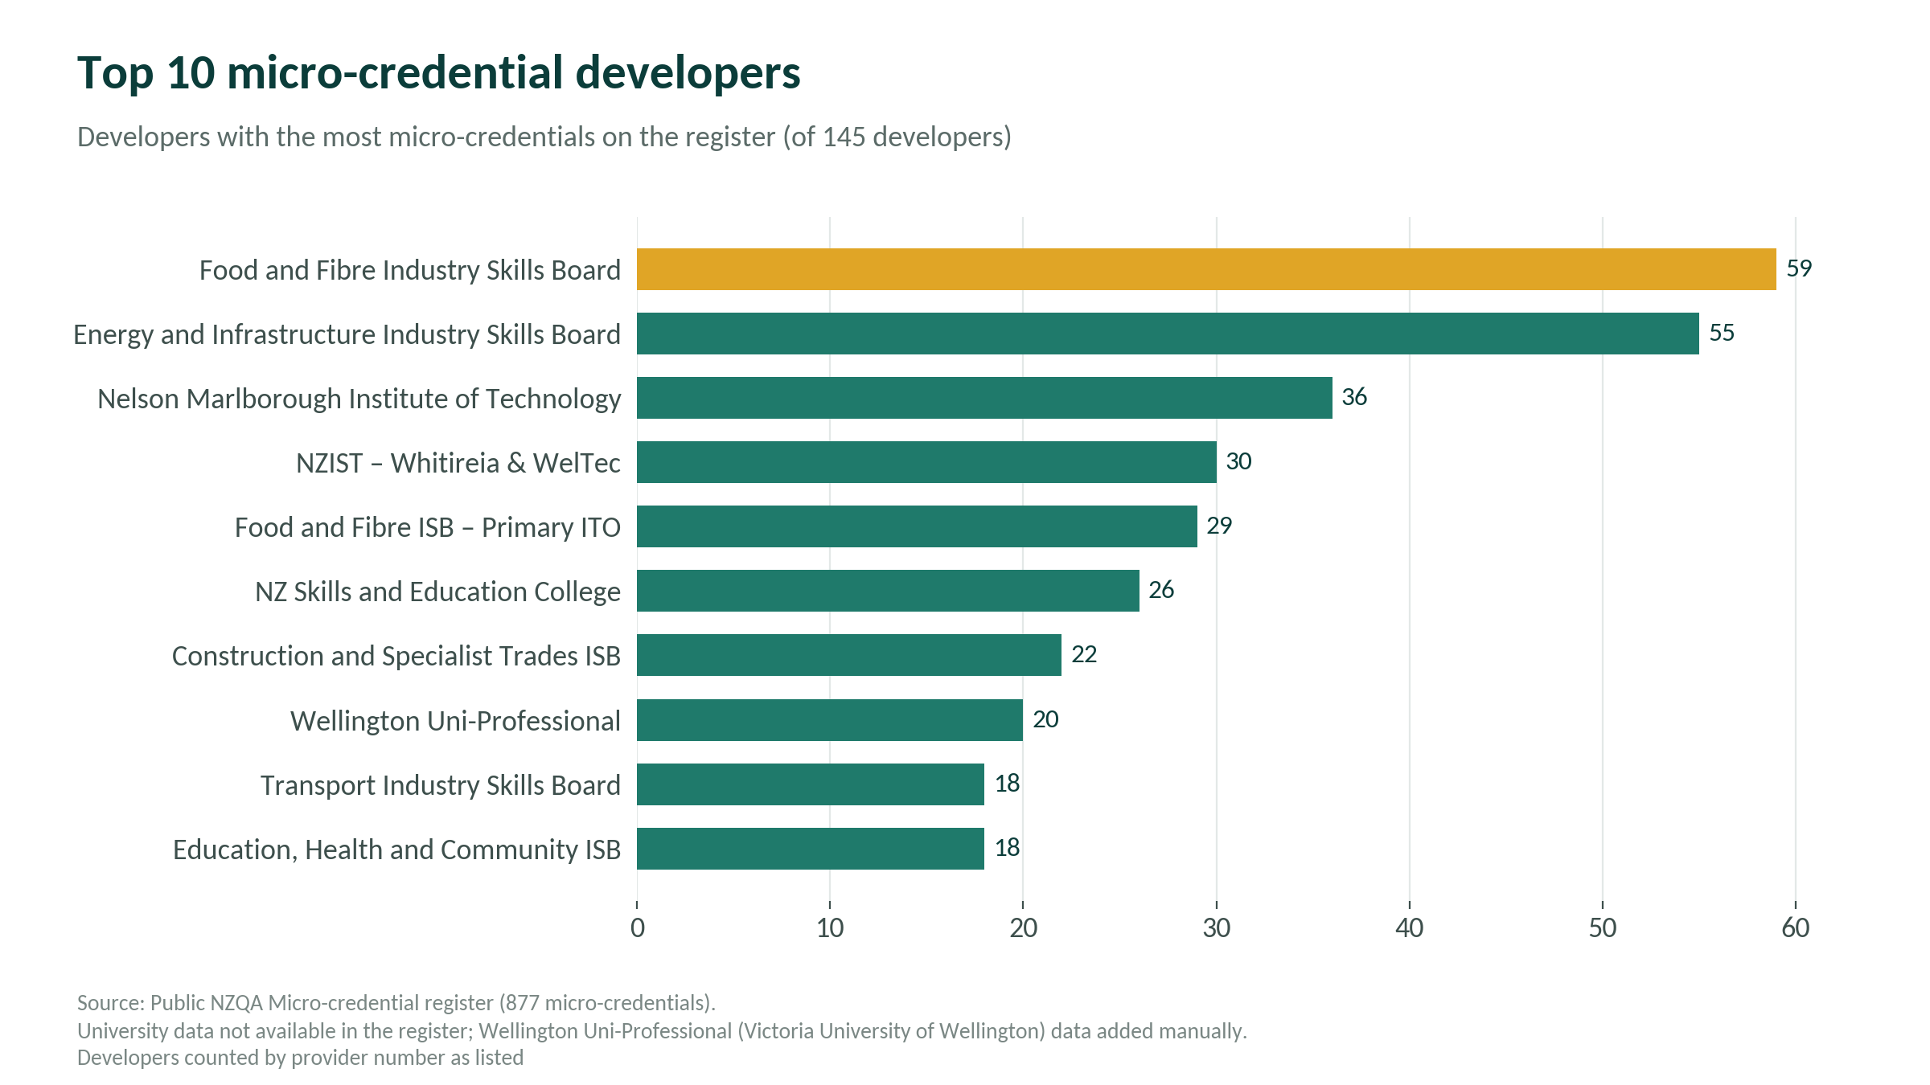
What are micro-credentials?
The State of the Nation! (or NZQA MC Register…)
Bridges, Not Islands: A Connected Micro-Credential System

Slide 22


What are micro-credentials?
Industry Partnership Model
WHO: Partnership between Wellington Uni-Professional and Post Primary Teachers Association, funded by MoE.
WHAT: Professional development pathway for teachers focusing on top-up skills and developing capabilities to support new curriculum requirements. If learners complete 3 out of the 5 micro-credentials, 15 points of credit is transferred towards the VUW Master of Education qualification.
HOW: Micro-credential’s approved by University. 5 x 5 point level 7/8 credentials.
Developing personal pathways through Micro-credentials
Developing personal pathways through Micro-credentials
OUTCOME: Easier bite-sized learning for time-poor teachers while building a network of practitioners as they meet other teachers from across NZ as they progress through the credentials.
NEXT PHASE: Negotiating with other tertiary providers on credit transfer into Masters programmes, and adding their credentials to pathway options.

Slide 23

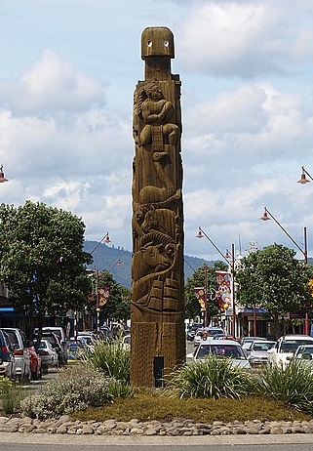
What are micro-credentials?
Shared Framework Model -
WHO: Co-design between Te Whakatōhea Iwi (Ōpotiki), and Muka Tangata Workforce Development Council.
WHAT: Co-designed with one Iwi, but shared as an open framework to be used by any Iwi in their own regional context. Provides a package of learning distinct to the mātauranga of hapū and/or iwi and a framework to empower learners within their own iwitanga as they enter the work-based learning environment.
HOW: Iwitanga, 15 point micro-credential made from 1x3 and 3x4 point modules/components. Submitted to NZQA for approval via Muku Tangata as an open framework.
Developing personal pathways through Micro-credentials
Developing personal pathways through Micro-credentials
OUTCOME: Learners have their iwitanga knowledge formally recognised, and are provided with a framework and pathway into further training. Learners can for apply mātauranga within future workplace learning, and in the development of their own career and personal aspirations.

Slide 24


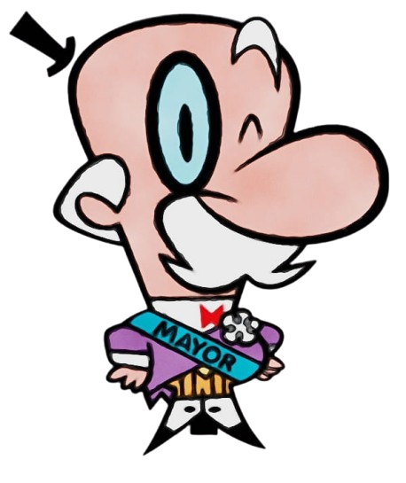
What are micro-credentials?
Industry Pathway Model -
WHO: Local Government NZ (LGNZ) – Support, champion, and develop capability within local government across Aotearoa.
WHAT: LGNZ work with WUPL to develop internal PD programme, add formalised workplace assessment, and accredit the programme as micro-credentials. LGNZ deliver the programme over 3 years.
HOW: 6 x 5 point level 7/8 credentials delivered as professional development for elected members of council, around 1000 each election cycle. Covers Leadership and Governance, Finance and Risk, and Communications and Engagement.
OUTCOME: Micro-credential pathway contributes 30 points via credit transfer to 3 PGCert qualifications in Wellington School of Business and Government. For some this will be their first university qualification.
Developing personal pathways through Micro-credentials
Developing personal pathways through Micro-credentials

Slide 25

What are micro-credentials?
Trusted Partner Model – McDonalds Australia
McDonald’s Australia has today launched the national roll out of ‘Archways to Opportunity’, an innovative new program offering more than 20,000 Macca’s employees nationwide the opportunity to transform workplace skills into university credits with some of Australia’s leading universities.
Each micro-credential counts for up to one subject credit in an undergraduate degree. Stacked together, they can also ladder up to direct entry into a Master of Business Administration.
4th November 2025
Partners in delivery:
McDonalds Australia (Employee development and engagement)
Capability.Co (Credential developer and University negotiation)
Universities (UTS, Torrens, AdelaideU, James Cook, Curtin, Charles Darwin, UTas, Canberra, UNE, Swinburne)
Developing personal pathways through Micro-credentials
Developing personal pathways through Micro-credentials

Slide 26








What are micro-credentials?
So, there is a lot happening, but how can we realise the potential of micro-credentials?
Credential Partners
Tertiary Education Providers
Workplace & Sectors
Bridges, Not Islands: A Connected Micro-Credential System
Secondary Schools
Level 4 - 7 Skill Based Credential Partners
Level 4 - 8 Workforce and Sector focus & Skills Specialisation
Level 7 – 10 Disciplinary Specialisation and Qualifications
Level 1 – 3 Workforce and Tertiary Transition Credentials

Slide 27
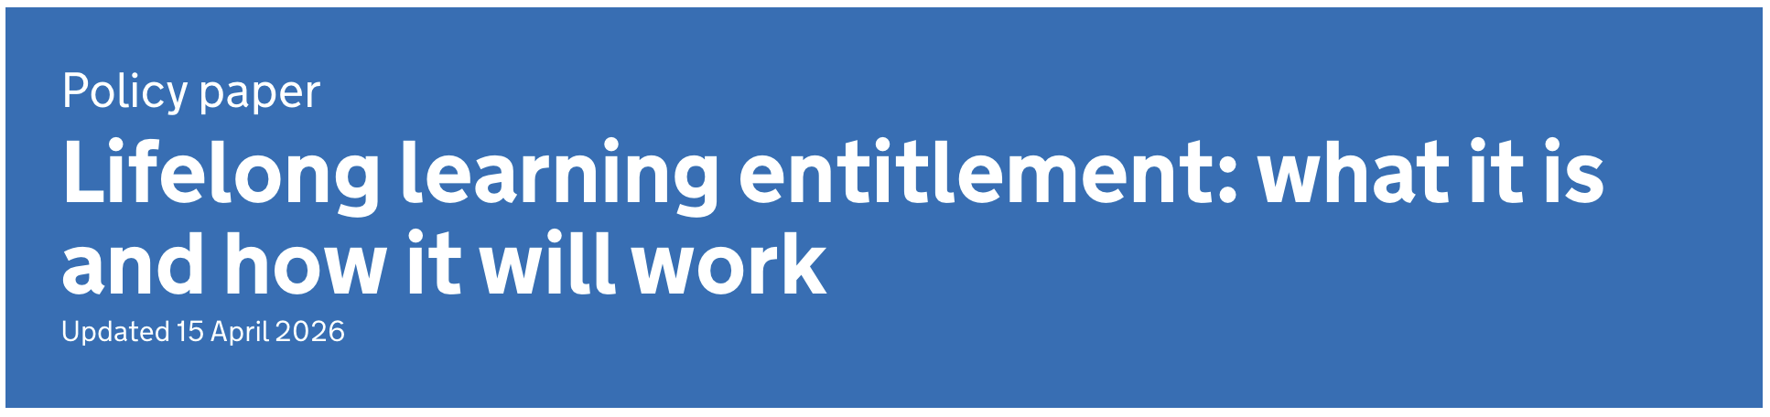



What are micro-credentials?
There are now national and state level strategies being developed to create connected lifelong learning systems
Bridges, Not Islands: A Connected Micro-Credential System

Slide 28
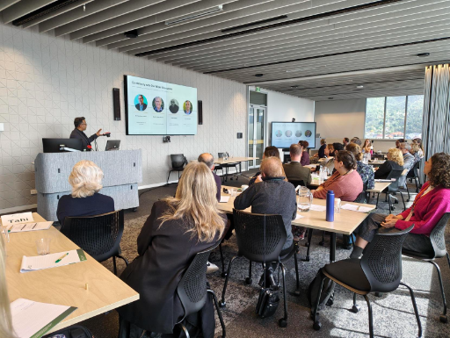
What are micro-credentials?
What is the future?
Bridges, Not Islands: A Connected Micro-Credential System
Tania McGowan
General Manager, Programmes | VUW-THW Kāpuhipuhi Wellington Uni-Professional
tania.mcgowan@vuw.ac.nz | +64 22 563 6561
Inaugural Micro-credential Symposium, VUW, September 2026

Slide 29
What are micro-credentials?
Moving the MC conversation from ‘should we’ to ‘how do we’
The value of micro-credentials is no longer the central question. The symposium focused on the system conditions required for micro-credentials to work in Aotearoa
FUNDING
That supports priority learners and collaboration
RECOGNITION
By providers, employers and professional bodies
COHERENCE
Across an increasingly crowded landscape
COLLABORATION
Across institutional and sector boundaries
Bridges, Not Islands: A Connected Micro-Credential System
Constraints are not just institutional they are systemic.
23 of 26 proposed actions were directed at the sector or national system rather than individual institutions.
Notes:
“The symposium showed that the conversation has matured. People were not debating whether micro-credentials have value. They were asking why the system still makes it difficult to collaborate, recognise learning and build coherent pathways.”
Timing: 1–1.5 minutes

Slide 30
What are micro-credentials?
Four tensions we must resolve
A connected system requires us to confront real trade-offs.
Collaboration ↔ Competition
How do we co-develop and share when funding and enrolment models reward institutional competition?
Robust ↔ Responsive
How do we protect quality while responding quickly and affordably to workforce needs?
Bridges, Not Islands: A Connected Micro-Credential System
Choice ↔ Clarity
How do we expand relevant and accessible learning without creating duplication and confusion?
Professional learning ↔ Funding priorities
How do we serve teachers, health professionals, health and safety, and other priority workforces when current settings may not support their professional development?
These tensions cannot be solved by tertiary providers acting alone.
Source: Symposium Workshop — What We Heard.
Notes:
“The problem is not a shortage of good ideas. It is that our current incentives can work against what we say we want. If we want collaboration, portability and responsiveness, funding, quality assurance and recognition settings must enable those outcomes.”
Timing: 1.5–2 minutes

Slide 31
What are micro-credentials?
What a connected micro-credential ecosystem requires
Four functions for a connected micro-credential system.
CONNECT
SHARE
ADVOCATE
MAKE VISIBLE
A national community of practice
Co-development across providers and sectors
Stronger links with industry, iwi and communities
Evidence, research and operating models
Design standards, policy and good practice
Case studies and practical lessons
Coherent funding and policy settings
Recognition of micro-credentials across all NZQCF levels
A stronger collective voice with government
A navigable view of available micro-credentials
Common language and information
Clear pathways,
Consistent recognition and learner outcomes
Bridges, Not Islands: A Connected Micro-Credential System
Connected does not mean centralised. It means coordinated action around shared problems.
Notes:
“These are the four functions the sector asked for. They give us a practical organising framework without assuming that every provider should use the same model or surrender institutional autonomy.”
Timing: 2 minutes

Slide 32
What are micro-credentials?
Start with building own shared capabilities
From discussion to coordinated action.
1. Build the community
2. Build the evidence
3. Test the connections
Establish a cross-sector community of practice
Include providers, industry, professional bodies, iwi, learners and government
Agree shared priorities and initial measures of progress
Create a shared research and practice repository
Establish an institutional readiness baseline
Collect completion, progression and outcome evidence from the start
Pilot shared or transferable pathways
Test recognition between providers and workplaces
Identify where policy, funding or quality settings block implementation
Bridges, Not Islands: A Connected Micro-Credential System
Begin with shared capability and evidence, then use pilots to identify what needs to change nationally.
Notes:
“We do not need to begin by creating a new national organisation or redesigning the whole system. We can begin with shared infrastructure, develop evidence together and test a small number of real pathways. A more formal coordination mechanism can follow once the collaborative model has demonstrated value.”
Add verbally: “Our Wellington Uni-Professional examples show that pathways and partnerships are possible. The next challenge is to make them easier to create across organisational boundaries.”
Also acknowledge the silences: employer and learner voice, digital credential infrastructure, equity and Te Tiriti were thin in the workshop outputs and should not be presented as symposium consensus.
Timing: 2 minutes

Slide 33
What are micro-credentials?
The bridge we need to build
The next stage is collective.
Aotearoa does not need more isolated micro-credential innovation. We need the shared capabilities that enable learning that is connected, transferable and scaleable.
What knowledge or capability could we share?
(https://microstackable.com/workshop/ )
What learner or workforce pathway could we connect?
What system barrier should we address together?
Bridges, Not Islands: A Connected Micro-Credential System
The future will not be determined by how many micro-credentials we create, but by where they enable learners to go.
Notes:
“The symposium gives us a mandate to move from conversation to coordinated action. The challenge for each of us is to identify one bridge that we are prepared to help build.”
Timing: 1 minute

Slide 34
Additional resources
NZQA Micro-credential Information
NZQA Micro-credential Homepage
NZQA Levels and Standards
NZQA non-TEO micro-credential equivalency info and form
Frameworks, studies, and articles
Making Micro-credentials work for learners, employers, and providers – Deakin University 2019
Micro-credentials for youth and work – ILO 2025
Micro-credentials impact report – Coursera 2025
WEF retraining displaced workers
Designing Micro-credentials for the future of work
Provider examples
Wellington Uni-Professional , UC Online , Auckland Online , Toi Mai | Workforce Development Council
Open Polytechnic , Massey University , Speech New Zealand
Bridges, Not Islands: A Connected Micro-Credential System

Slide 35

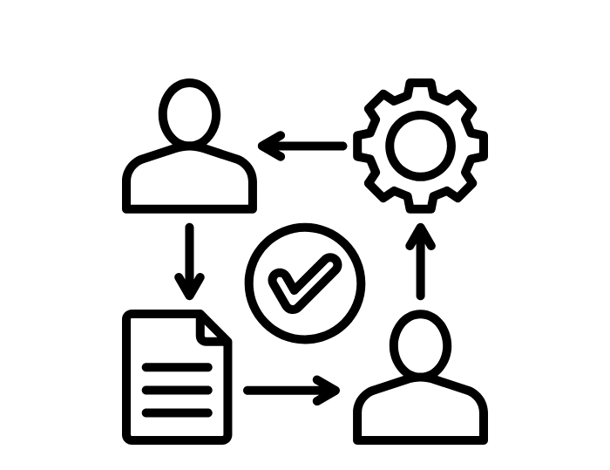



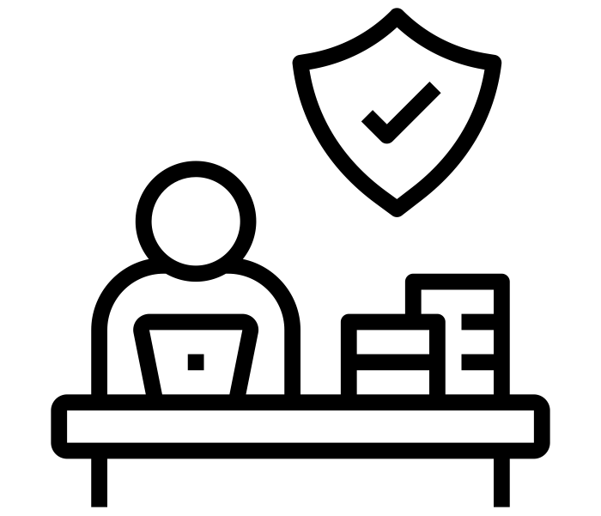
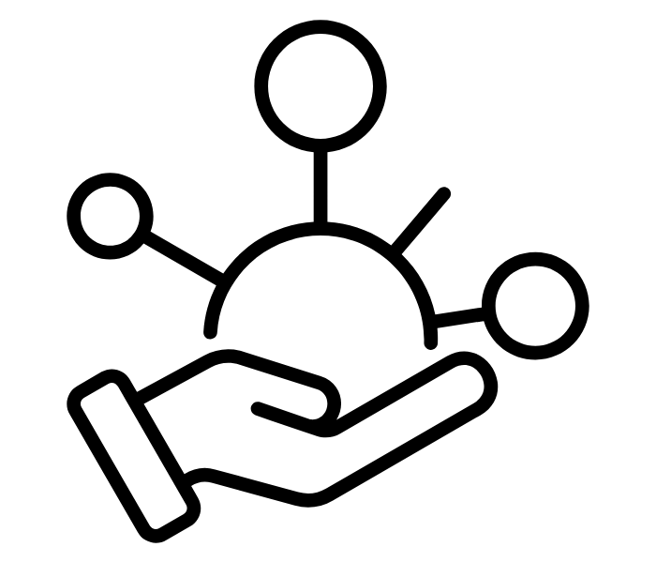

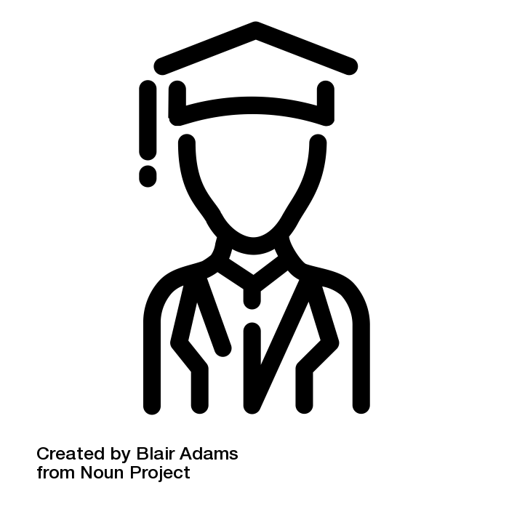
Image Attribution:
Image | Source
 | institutions by WEBTECHOPS LLP Noun Project (CC BY 3.0)
 | Icon by Mada Creative from Noun Project (CC BY 3.0)
 | Institution by K 30 JUZZ from Noun Project (CC BY 3.0)
 | degree by Maan Icons from Noun Project (CC BY 3.0)
 | certifier by Foodicons Collection from Noun Project (CC BY 3.0)
 | workplace safety by Kamin Ginkaew from Noun Project (CC BY 3.0)
 | approval by muhammad rokhis muktafa from Noun Project (CC BY 3.0)
 | facilitation by Sulistiana from Noun Project (CC BY 3.0)
 | dead end by krisna arga muria from Noun Project (CC BY 3.0)
 | Chaos by Anna Sophie from Noun Project (CC BY 3.0)
 | Workplace Learning by Blair Adams Noun Project (CC BY 3.0)
Bridges, Not Islands: A Connected Micro-Credential System

