Slide 1
VET in Australia
Reform, opportunities and challenges from the industry perspective
Dr Caroline Smith
Executive Director

Slide 2

About us
Australian Industry Group’s Centre for Education and Training drives bold new thinking on education and training in the context of work.
Through research, thought leadership and advocacy, we explore new ways to build skills and capabilities of companies to succeed now and into the future.​

Slide 3
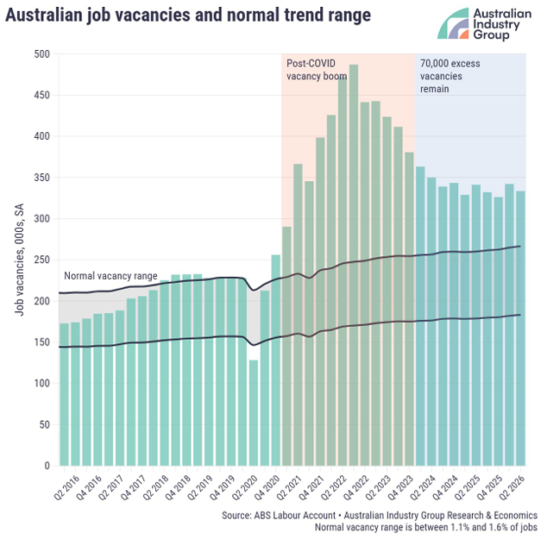
Skills and workforce shortages are widespread across the Australian labour market
Australia’s post-pandemic labour market has been the tightest in a generation.
Unemployment (4.6%) and underemployment (6.2%) are low by historical standards.
While some easing has occurred, workforce shortages remain prevalent across many industries, especially for skilled workers.

Slide 4
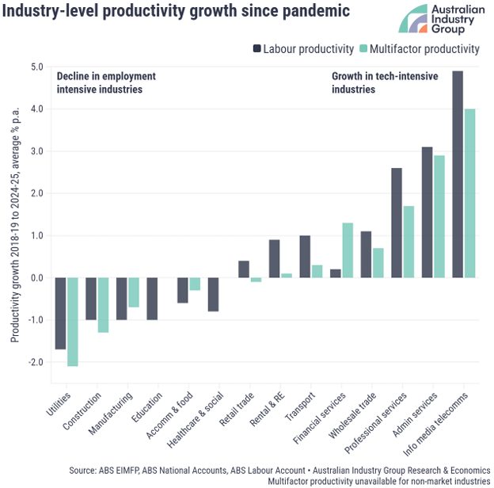
Productivity growth (or lack thereof) is a major challenge
The Australian economy has delivered zero overall productivity growth since 2019. It had previously grown by 1.2% per year.
Within this overall stagnation lies a clear differential between technology-intensive and employment-intensive industries.
The skills and capabilities of the workforce are a critical enabler of productivity across many industries.

Slide 5
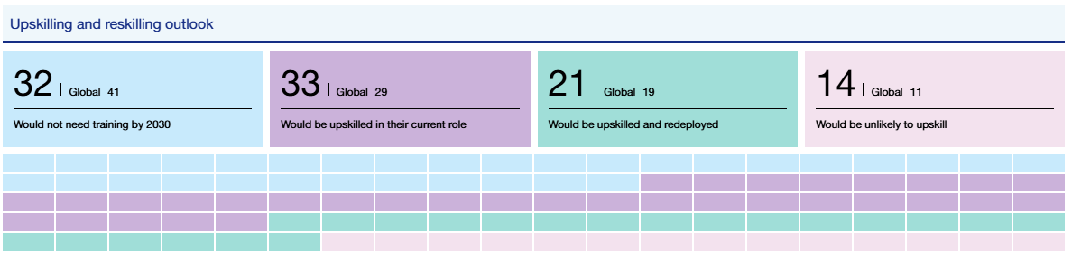
Workforce skills underpin productivity, competitiveness and prosperity
The average worker can expect about 40% of their existing skills to be transformed or become outdated between 2025 and 2030
Around 7 in 10 Australians working today will require upskilling and/or reskilling by 2030
This is higher than the global figure (around 6 in 10)
Source: World Economic Forum, Future of Jobs Report 2025

Slide 6
Substantial VET system reform has progressed in recent years
National focus on skills: National Skills Agreement between the Australian Government and all States and Territories underpinned by approx. $30 billion investment over 5 years
Reduced financial barriers to training: Substantial increase in availability of free qualifications across a range of priority areas through Free TAFE initiatives
Tertiary harmonisation: Progress towards a connected and coherent tertiary system across VET and higher education, including through Australian Tertiary Education Commission and increased focus on higher-level apprenticeships
Innovation to meet industry needs: 20 TAFE Centres of Excellence delivering high-priority, industry-aligned skills for critical and emerging sectors, artificial intelligence (AI) capability agenda
New system architecture: Tripartite advisory arrangements through Jobs and Skills Australia and 10 Jobs and Skills Councils, new National Skills Taxonomy

Slide 7
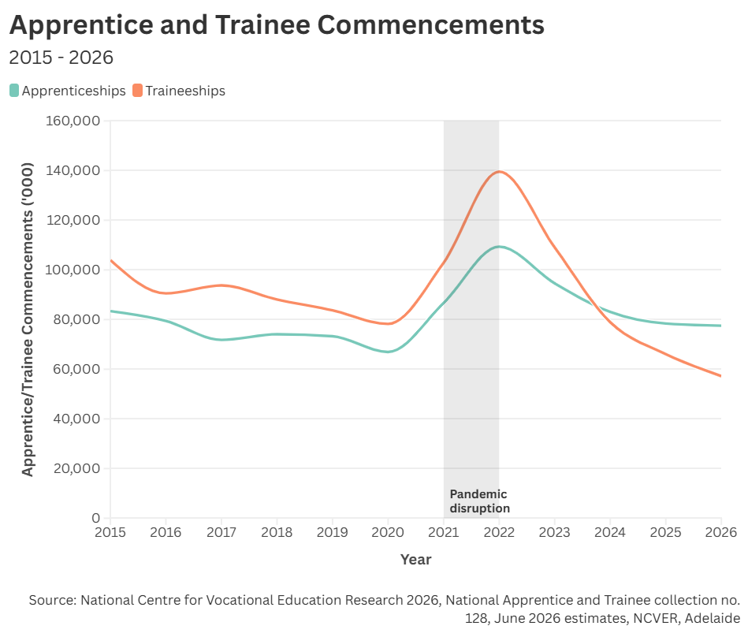
Yet... Falling apprenticeship and traineeship commencements exacerbate skills shortages
Commencements across a wide range of apprenticeships and traineeships have been in structural decline for several years – despite significant shortages and projected future demand for these skills.
A major driver of falling commencements is system cost and complexity experienced by employers – exacerbated by recent and upcoming reductions in employer incentives.

Slide 8
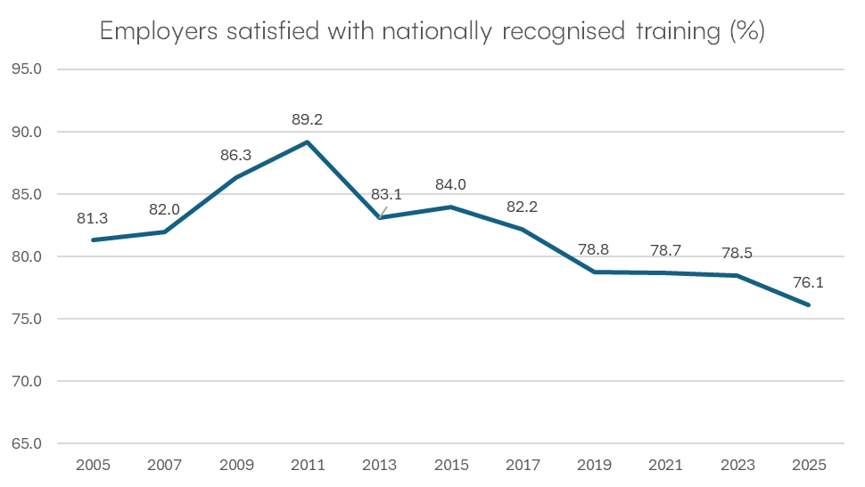
Employer satisfaction with VET is declining
Employer satisfaction has been declining for more than a decade
Student satisfaction has also declined, but to a lesser degree
Source: NCVER Employers' use and views of the VET system, 2025, data tables

Slide 9
Three evidence-based priorities to strengthen VET
Strengthen apprenticeships and traineeships as the skills pathway to many jobs in demand
Boost lifelong learning in the workplace context
Improve productivity through learning at work & better linking skills policy with economic development

Slide 10
Apprenticeships and traineeships: The employer perspective
Key survey findings include:
More than 8 in 10 employers of apprentices and trainees surveyed identify them as important or very important to their business.
  96% of employers surveyed face barriers when hiring apprentices or trainees, with the most commonly reported barriers being difficulty finding suitable candidates and difficulty supervising and training on-the-job.
  Around half of employers surveyed report that their employment of apprentices and trainees would reduce if they no longer received financial incentives.
The apprenticeships and traineeships system is not currently producing sufficient numbers of skilled people to meet Australia’s skill needs.
The cost and complexity of employing apprentices and trainees is increasing and employers’ satisfaction with the system is decreasing.
Financial incentives do not solely drive decision making for employers, but they represent an important part of the overall economic equation.
To grow apprenticeships and traineeships, focus should be placed on ensuring the system is viable for new employers and for existing employers to maximise the apprenticeships and traineeships they provide.
Source: Australian Industry Group CET, Apprenticeships and Traineeships: The employer perspective, 2025

Slide 11
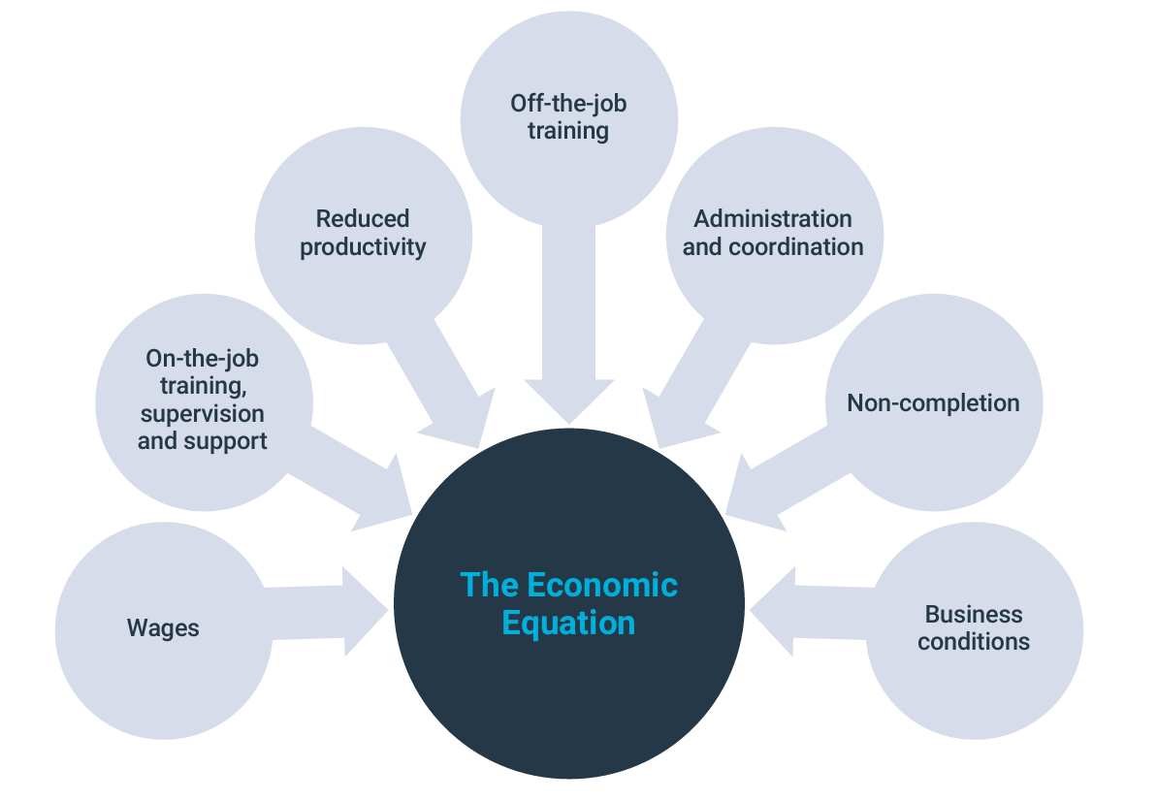
The economic equation for employers is at the heart of apprenticeship commencements
Source: Australian Industry Group CET, Apprenticeships and Traineeships: The employer perspective, 2025

Slide 12
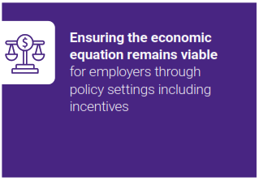
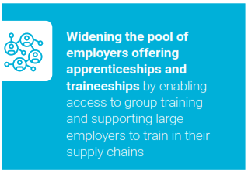
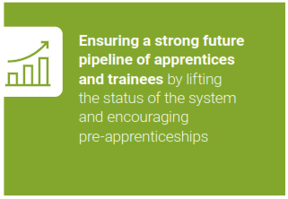
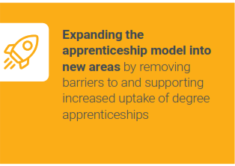
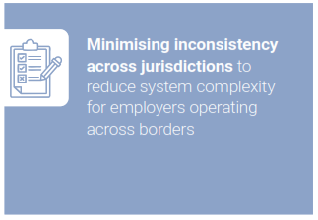
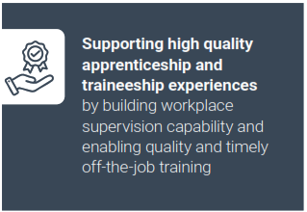
Six areas of priority to strengthen Australia’s apprenticeship system
Source: Australian Industry Group CET, Apprenticeships and Traineeships: The employer perspective, 2025

Slide 13
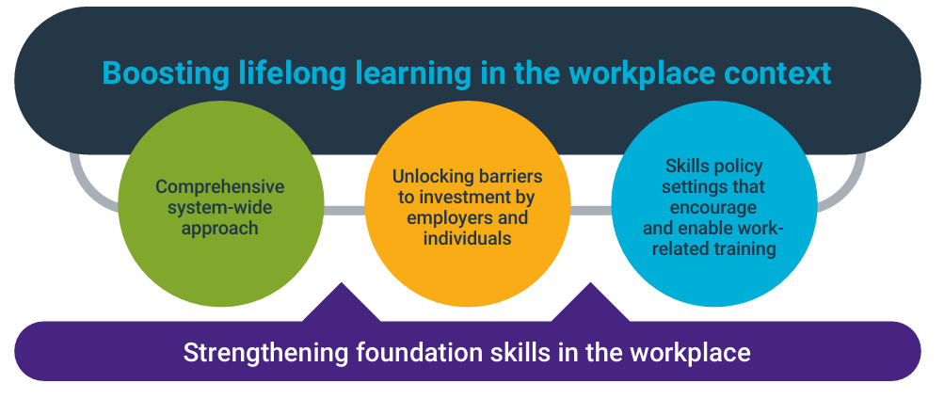
Enabling lifelong learning in Australia through workplace learning
The workplace is an important site for successful, context-driven learning but policy settings increasingly support institutional pathways.
While governments are not solely responsible for workplace learning, policy settings need to drive a coordinated and system-wide approach that unlocks barriers to participation and investment.
Source: Australian Industry Group CET, Learning that works: Skills for today and tomorrow, 2025

Slide 14
Priority actions to strengthen lifelong learning in the workplace context
System-wide approach
Barriers to investment
Strengthening foundation skills
A comprehensive national strategy for lifelong learning which includes:
A strong focus on productivity enhancing training delivered in the workplace
Improved data collection on work-related training
A clear framework for quality careers information and advice.
Review specific federal and state policy settings that may be constraining investment by individuals and employers in work-related training.
Including, but not limited to:
The collective weight of compliance training
Fringe Benefits Tax
Low uptake of self-education tax deduction
Improve availability and accessibility of training focussed on developing foundation skills in the workplace context.
E.g. Within Adult Migrant English Program, Skills for Education and Employment Program, National Skills Agreement initiatives.
Source: Australian Industry Group CET, Learning that works: Skills for today and tomorrow, 2025

Slide 15
Productivity through workplace learning
Skills policy
Australian Government and State and Territory Governments increase investment in VET to deliver the skills uplift Australia needs, with a focus on encouraging and enabling training in the workplace context.
This should include, but not be limited to:
Creating and encouraging workplace delivery options within relevant existing funding settings and programs;
Re-introduction of programs that directly support productivity-enhancing workplace training;
Ensuring policy and regulatory settings are conducive to viable Enterprise-based Registered Training Organisations; and
Driving more widespread use of Recognition of Prior Learning.
Despite substantial reform, the focus on workplace training has diminished in VET policy settings and associated funding arrangements over the last decade
Source: Australian Industry Group CET, Learning that works: Skills for today and tomorrow, 2025

Slide 16
Boost productivity by better connecting skills policy with economic development
Economic Development
E.g. attracting investment, supporting industry growth, building infrastructure, enabling export opportunities, supply chain and industry cluster development
Workforce Development
E.g. workforce attraction and retention, strengthening workforce pathways and supply, workforce upskilling and reskilling, industry-education partnerships
Workforce skills and capabilities are a critical enabler of many key economic priorities.
Economic development and workforce development priorities need to be designed and delivered in tandem.
This principle applies at the national policy level and also for individual industries and regions.

Slide 17



Learn more
Subscribe
cet.aigroup.com.au
Join our Centre Network and receive our monthly newsletter
Follow us on LinkedIn

