Slide 1

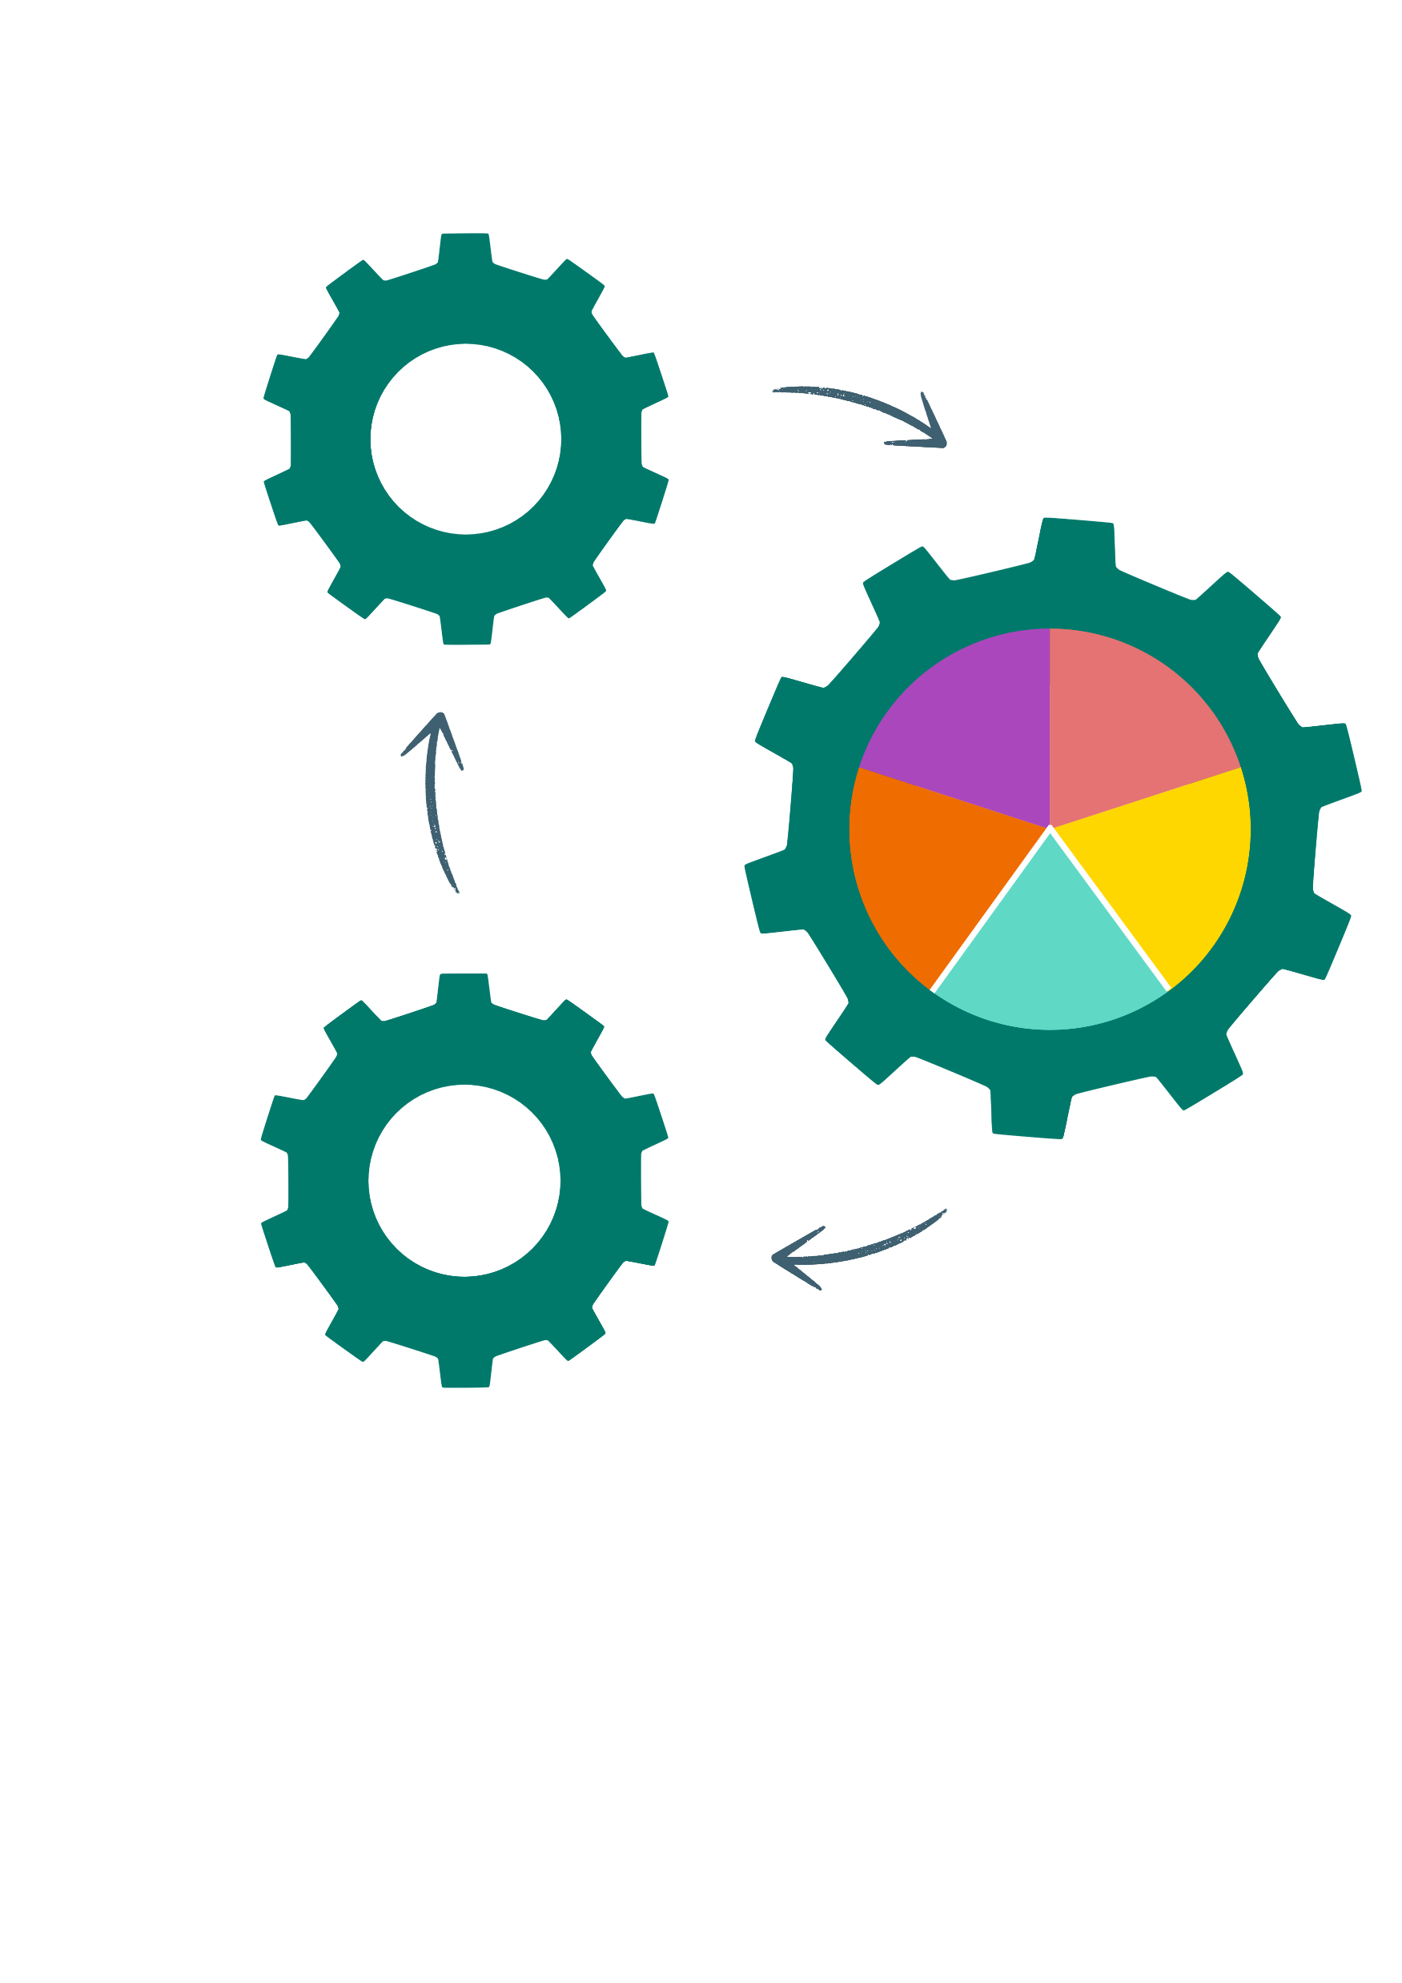
Cognify
TEACHING FOR LEARNING
(Background image generated by Adobe Express)

Slide 2
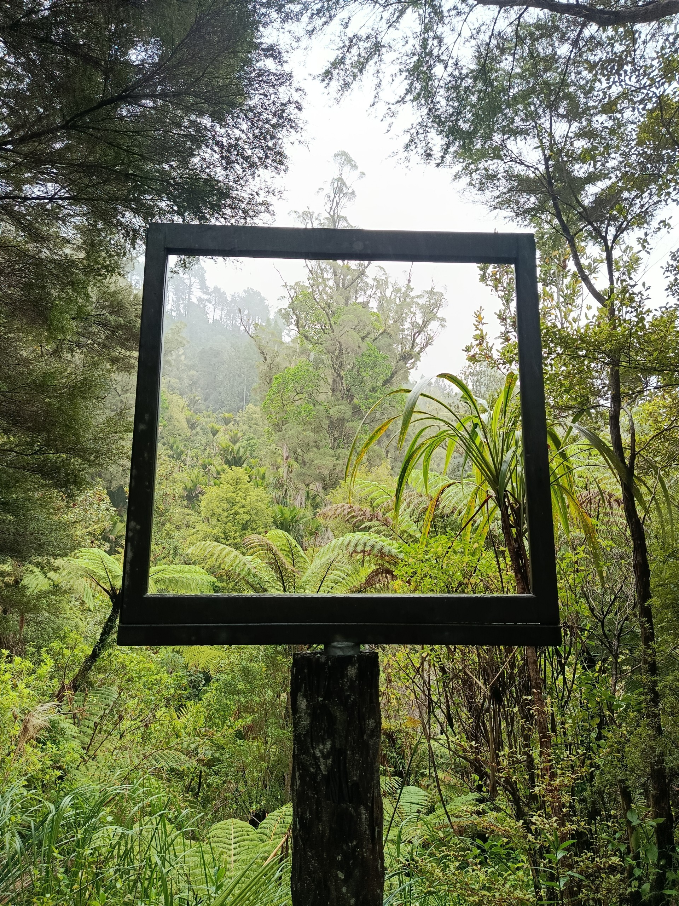
Whakatauki
Te tōia, tē haumatia.
Nothing can be achieved without a plan and way of doing things.

Slide 3

(Image generated by Gemini)
Notes:
Wintec | Teaching & Learning Coach
21 years at Wintec, from ākonga to kaiako to Teaching & Learning Coach
Vocational education is my focus
Work across health, veterinary nursing, hospitality, trades and media arts
Teaching, learning and learner engagement are at the heart of my work

Slide 4


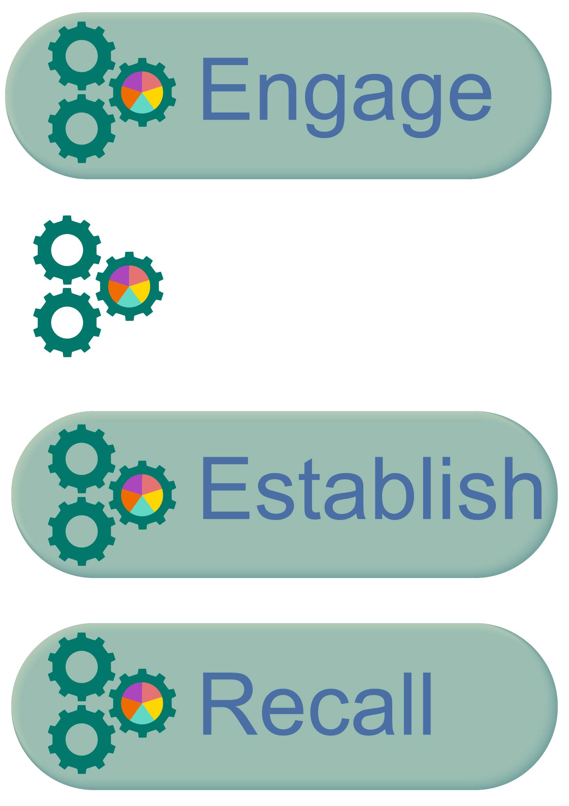
Affirm or Inform
(Images by Canva)
Notes:
For all workshops I usually begin by saying - As we go through this session, you’ll probably hear some things that affirm what you already know and do, and some things that inform you of something new or give you a different way of looking at things you already know.

Slide 5

Prediction Questions
(Image by Canva)
Notes:
Before we get into Cognify, I want to start with a few prediction questions. There are no trick questions. They’re simply a way to get you thinking about what you already know about the brain and learning. You will have 10 seconds to choose each answer.

Slide 6

How much raw sensory data is your brain receiving every second?
10,000 bits
1 million bits
11 million bits
1 trillion bits
(Image generated by Copilot)
Notes:
The brain receives millions of bits of sensory information each second, but cannot process it all. This means teaching needs to filter, focus and scaffold information to avoid overwhelming ākonga.

Slide 7

Out of all the information coming in, how much can we consciously process?
10 bits
10-50 bits
10,000 bits
1 million bits
(Image generated by Copilot)
Notes:
The brain filters information aggressively.
Learning needs to trigger attention, relevance or emotion to get through those filters.
Kaiako may need to make relevance explicit when ākonga do not see it immediately.

Slide 8

When something new appears in your environment, roughly how quickly does your brain decide whether it is relevant and either focus on it or ignore it?
10 milliseconds
100 milliseconds
500 milliseconds
1 second
(Image generated by Copilot)
Notes:
Ākonga brains constantly filter massive sensory input, quickly deciding what to attend to
Instruction needs to signal relevance immediately
Context, cues and meaningful framing can help capture attention

Slide 9

Your brain only makes up a small percentage of your body weight. What proportion of your body’s energy do you think it uses?
2%
5%
10%
20%
(Image generated by Copilot)
Notes:
The brain is only about 2% of body weight but uses around 20% of the body’s energy at rest
The brain is metabolically expensive
Thinking is biologically demanding
Attention, fatigue and cognitive load matter for learning
Active engagement can help manage mental fatigue

Slide 10

Which learning activity strengthens memory the most?
Re-reading notes
Highlighting text
Listening again to the explanation
Trying to recall the information
(Image generated by Copilot)
Notes:
Actively retrieving information from memory strengthens the neural pathways associated with that knowledge. This supports stronger retention than passive review, such as re-reading. Quizzes, summaries and recall exercises provide opportunities for active retrieval.
"Curiosity and the act of making a prediction activate the brain's reward system, which fuels attention, motivation, and sustained effort."

Slide 11
What is learning
Learning involves:
permanent changes in behavior or knowledge
long-term retention - maintaining knowledge and skills over time
transferability - applying what's been learned to various relevant situations, not just those present during teaching
If a student can’t retrieve the new learning when they need it, and apply it to new situations, then learning has not taken place.
(Doyle & Doyle, 2020; Pan & Bjork, 2021)

Slide 12
Cognify - What? and Why?
What is it?
The Cognify process outlines five key stages for any teaching session, supported by practical resources for planning and facilitation.
Why?
Ākonga engagement
Knowledge and skill retention
Practical planning and teaching resources
Teaching expectations across multiple sources
Cognify combines these elements into a practical resource for kaiako, streamlining planning and supporting effective teaching practice.
Notes:
Wintec Teaching and Learning Directions, job descriptions, Academic Staff Member responsibilities, performance appraisal process etc.

Slide 13
Where did it come from?
Ākonga voice
Desirable practice statements were developed from learner feedback – for example:
“Teaching sessions feel well-paced.”
Draws directly from:
“The information in class can be rushed…”
“The first few weeks were infuriatingly slow…”
Theory & neuroscience
Learning theory, including adult learning and student-centred learning and neuroscience principles
Employability
Skills valued by employers in Aotearoa New Zealand

Slide 14
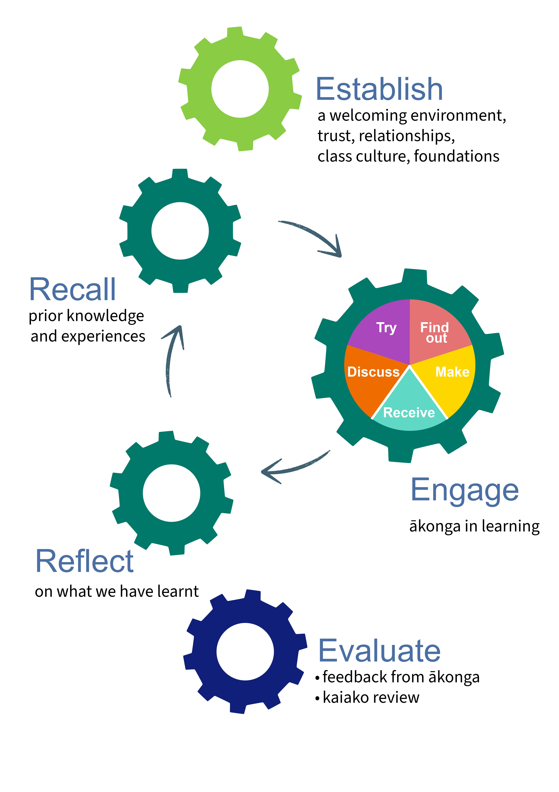

Cognify

Slide 15





Establish
Ākonga-to-ākonga relationships are fostered.
“Appropriate relationships between educator and learner are at the heart of the learning process.” (Ako Aotearoa, 2023).
Supports attention and readiness to learn.
Icebreakers, whakawhanaungatanga, sharing learning outcomes for the session.

Slide 16
Recall
New skills and knowledge connect to and build on what we already know.
“Adult learners are not blank slates and they come with a wealth of experiences”
(Ho & Lim, 2020)
More connections to prior knowledge → more memory pathways → more permanent learning (Doyle & Doyle, 2020).
Ask ākonga: “What do we already know about…?”

Slide 17
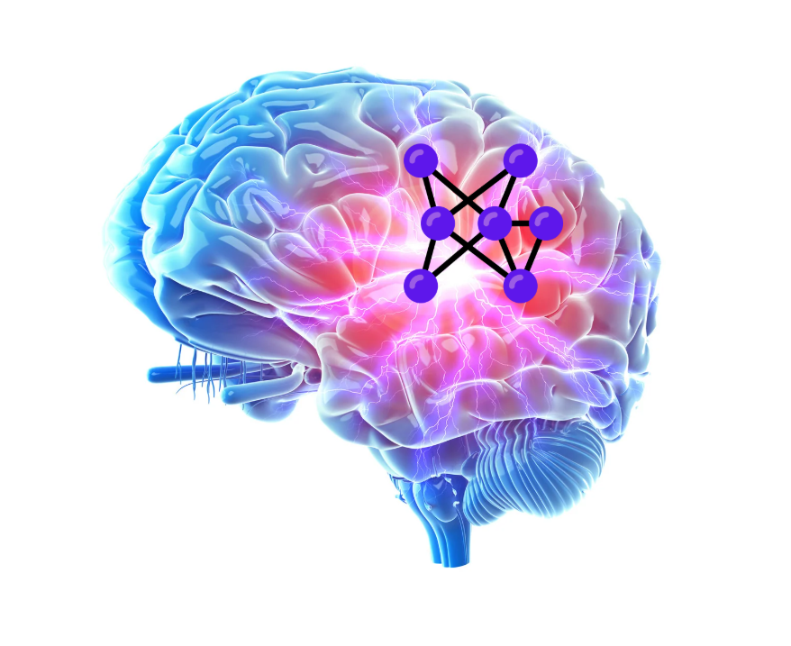

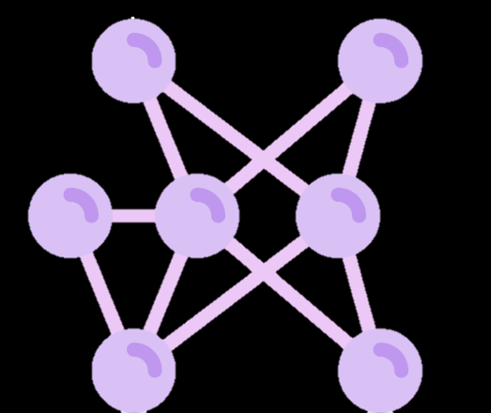
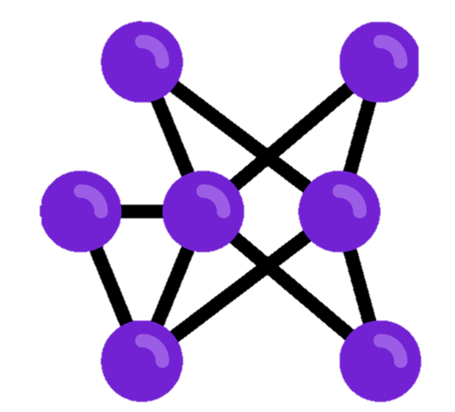


How does it work?
(Images by Canva)
Notes:
The brain learns in patterns: chunking information.
The human brain is a pattern seeking device (Ratey, 2001). “The brain works by relating whole concepts to one another and looks for similarities, differences and relationships between them”

Slide 18
Think of something you learned that has stayed with you. What made that learning stick?
(Image by Canva)
Notes:
You might have thought of repetition, years of practice, a great teacher, a significant experience or simply something that mattered to you.

Slide 19
Engage
Kaiako and ākonga play an active role in the teaching and learning.
“…usually after listening for 10 to 15 minutes to a lecture students’ minds start to drift away”(Hoidn & Reusser, 2020).
“the one who does the work does the learning” (Doyle 2008, p. 63).
Plan for active participation, not just listening.
Notes:
(i.e. not relying on Powerpoint, video, or self-directed learning).
“Twenty years of neuroscience and evolutionary biology findings about how the brain learns have taught us that

Slide 20
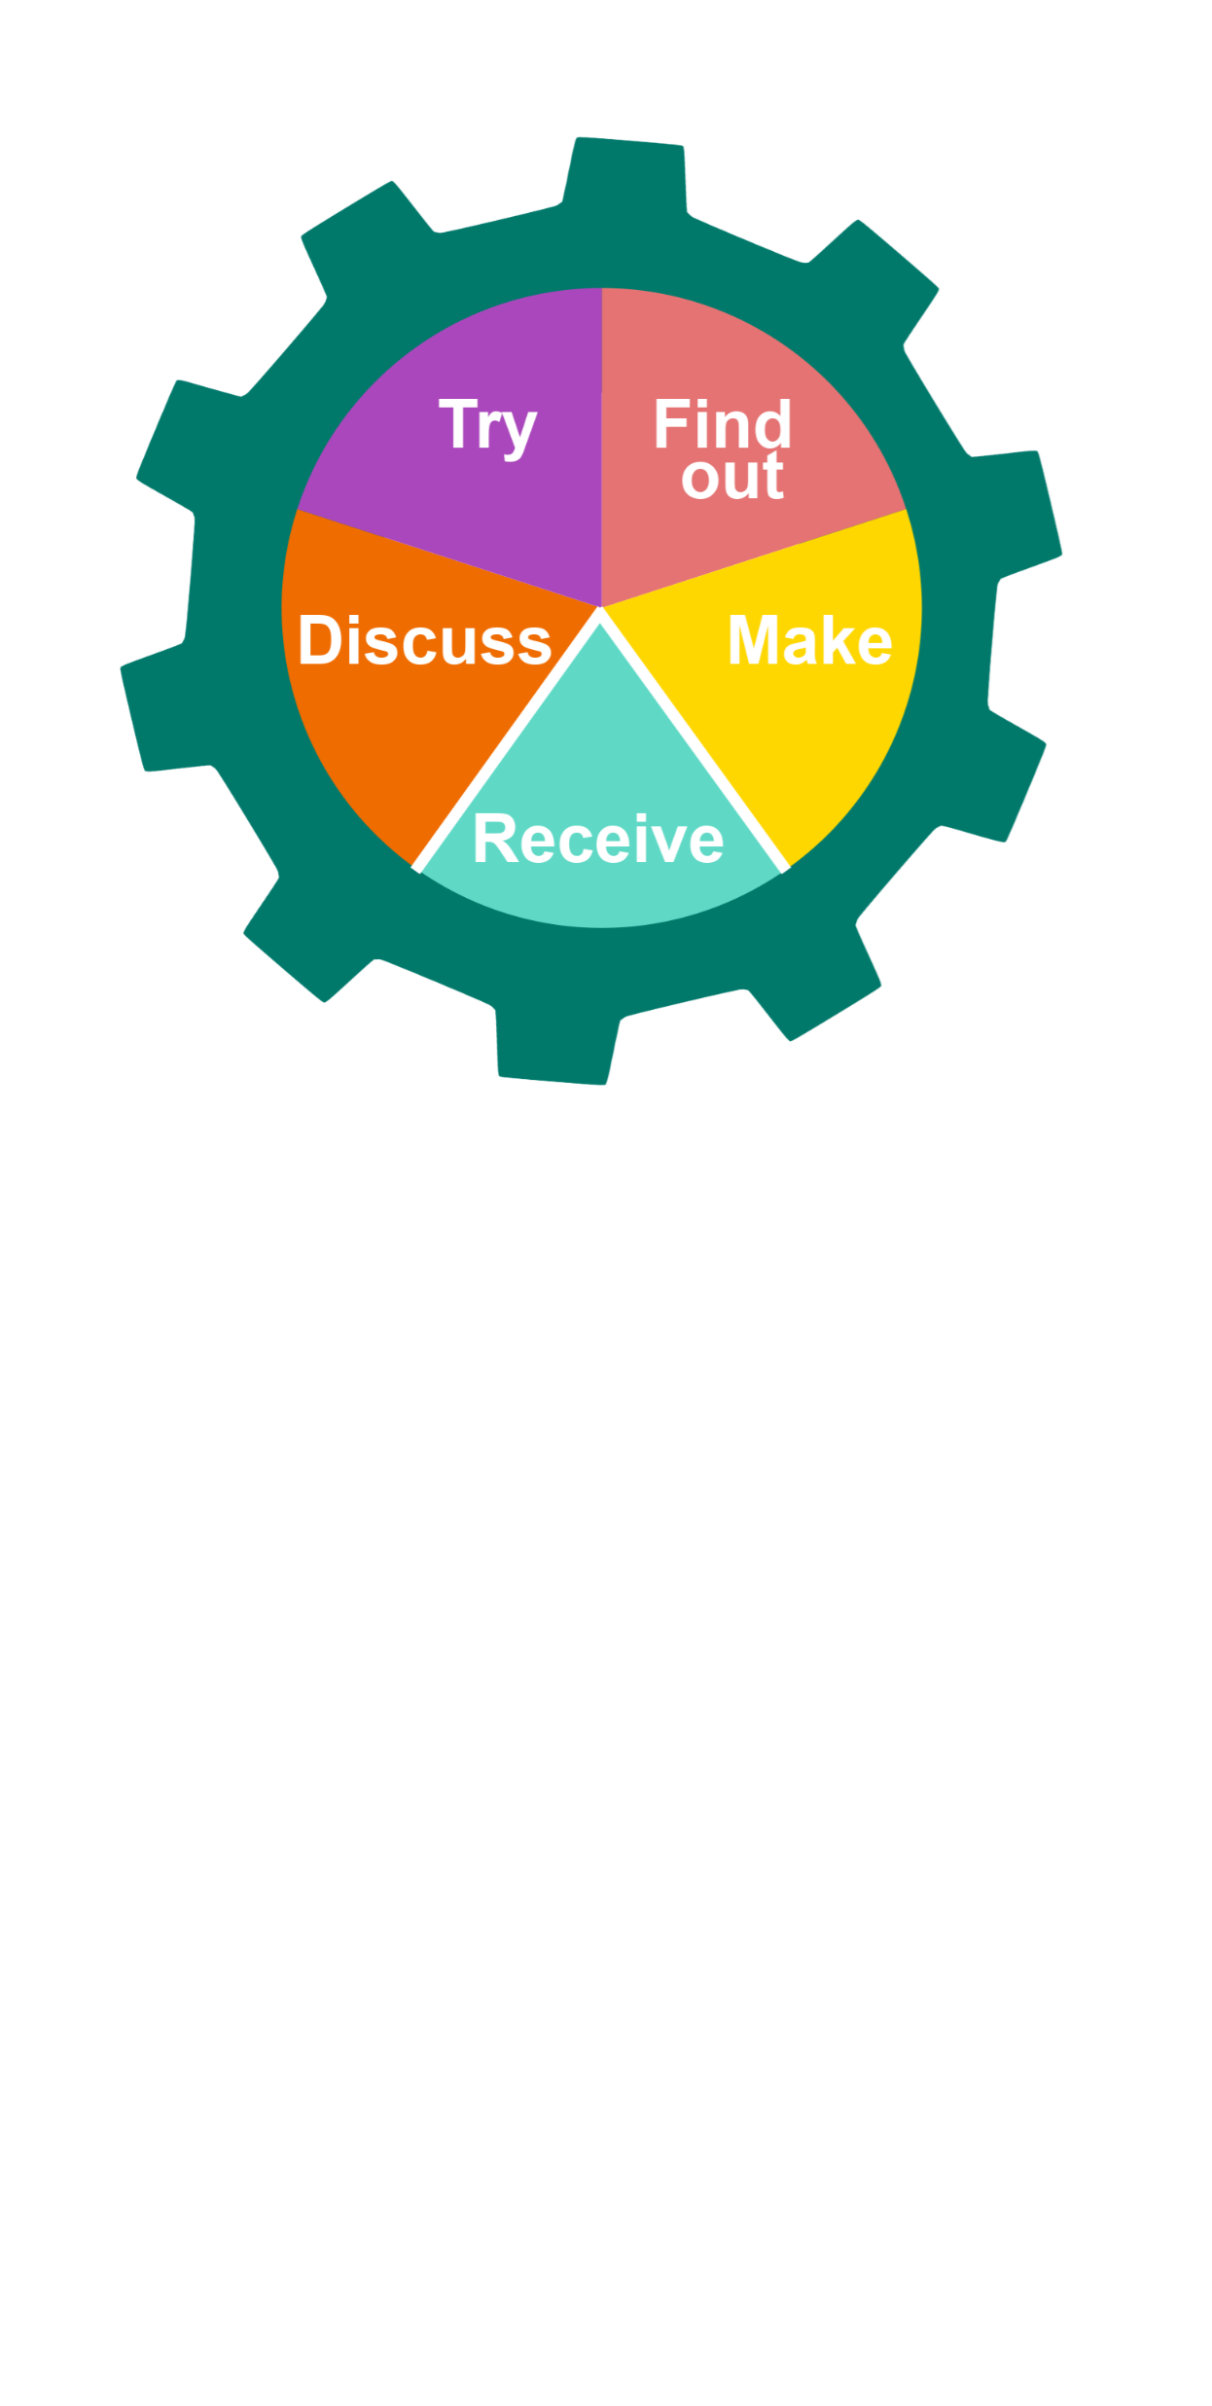
Engage
Practice using new information and/or skills
Discover new information through searching
(internet, books, manuals…)
Share ideas, thoughts and questions about new information and/or skills
Use new information and/or skills to create something
Access new information
(reading, watching videos, listening to the kaiako…)
Notes:
Why use active learning - Memories are formed and strengthened during sleep. During sleep the brain will search every memory a student has ever made to find connections for the new learning (Walker, 2017). The working memory sends important information to the more stable short-term memory of the brain for safekeeping. Only the memories that ākonga tell the brain are important to keep get sent on for safekeeping. Ākonga tell the brain through their actions. Information that is practiced and repeated sends a message to the brain that it is important and should be kept. The brain removes all other information not classified as important. (Doyle & Doyle, 2020).

Slide 21
Match each example to the type of activity
​Ākonga use the internet for research about acts and regulations
​Ākonga watch a video on diagnosing engine problems
​Ākonga role-play working with customers
Ākonga create a new hairstyle using techniques learned in class
Ākonga talk about how to adapt recipes for dietary restriction

Slide 22
Reflect
Ākonga are confident they are making progress.
Reflection helps ākonga make sense of new learning, connect it to prior knowledge, and develop deeper understanding (Kolb, 1984).
More connections to prior knowledge → more memory pathways → more permanent learning (Doyle & Doyle, 2020).
Ask: What did you notice? What surprised you? What questions do you still have?
…next new topic…
Notes:
Ākonga – from Recall - New skills and knowledge connect to and build on what we already know.

Slide 23
Evaluate
Ākonga feedback is responded to, and responses are communicated to ākonga.
“When feedback is given by students and that feedback is then acted upon, it demonstrates to the students that their opinions and experiences are taken seriously and fosters a more trusting environment”
(MacHost & Stains, 2023).
Gather feedback from ākonga on what went well and what could be improved.

Slide 24
The Cognify Resources
Process
Cognify Process
Cognify: Rationale and Literature
Planning
Course/Semester Planning template
Weekly/Individual Session Plan templates
Session Planning Microsoft Form
Resources
How to Write Session Outcomes
Strategies to Engage and Focus Ākonga
Supporting ākonga who are neurodivergent
Micro-Activities (2-5 mins)
Ākonga-centred Activities Microsoft List
Notes:
An example of one of the strategies is - Share the why - The human brain constantly prioritises, which means to make learning a priority over all the other things that students could be doing or thinking about teachers must make a clear case for why this learning should matter.

Slide 25
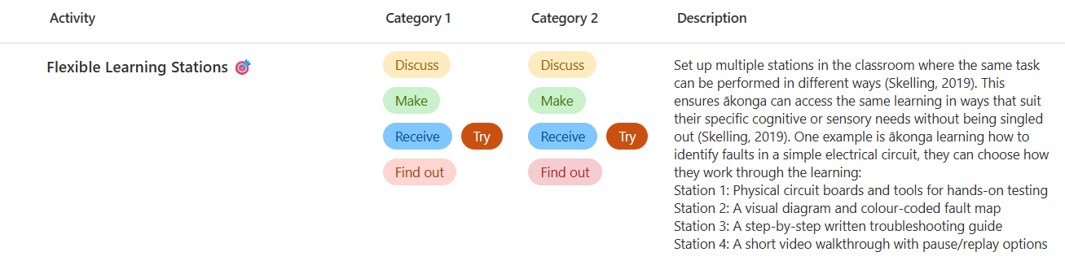
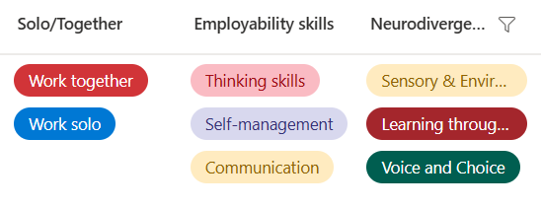
The Cognify Resources
Neurodivergence-informed strategies

Slide 26
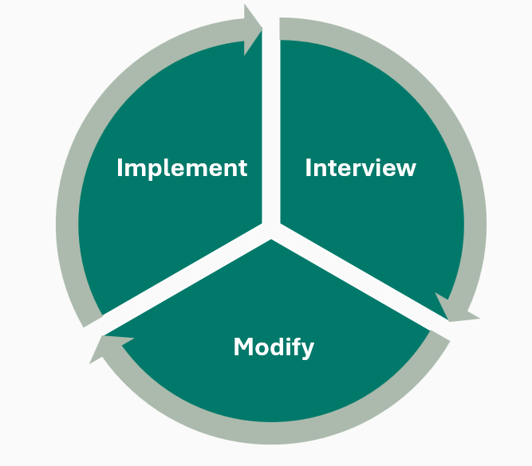
Outline of research project
Purpose / Aims:
An action research project with two key objectives:
To support kaiako in the effective implementation of Cognify.
To collect and analyse feedback on the framework, using insights to guide improvement.
9 kaiako
Across different disciplines and with varied teaching experience
3 interview stages
Semi-structured interviews
18-month research project
Notes:
Media Arts, IT, Animal Care, Design and Communication, Hairdressing,

Slide 27

Adopting Cognify
Kaiako used Cognify in different ways, from planning their teaching to adapting existing practice.
Used by new kaiako to plan and develop their teaching
Used by an experienced kaiako when writing session plans for a new tutor they were mentoring
Overlaid onto existing session plans by experienced kaiako
Applied to break up long sections of talking with activities
Implemented overtly with ākonga by explaining the approach, showing the Cognify stages on PowerPoint slides, and using the stages to structure Moodle courses
Cognify plans also supported continuity of teaching, as they could be used by other kaiako when someone was away sick or when a new kaiako took over a teaching role.
Notes:
“We'd have the words establish, recall, engage, evaluate, reflect, on the overview slide for the students. And we just introduced it as ‘You know, this is good teaching theory. We're using this process.’ Q
“We'd have the words establish, recall, engage, evaluate, reflect, on the overview slide for the students. And we just introduced it as ‘You know, this is good teaching theory. We're using this process. And one of the ways we can check that we're doing the process, is putting them in there so you could see what we doing’
“It makes me feel more like a teacher, because I have a structure behind me. It's not just based what I think should be done and heavy on content and knowledge… there is proper ways to do in a way they will learn more, they will remember, they actually will engage...”K
L explained to ākonga what she had changed and why:
"I went to this workshop and I got shown these things to try and help make your learning more engaging, and so all of the activities that you're seeing on Moodle now, and what we're doing in class is as a result of that"

Slide 28
Adapting Cognify
Kaiako adapted the process to suit their context and ākonga rather than using every stage in the same way every session.
Establish - adapted when cohorts were in their 2nd or 3rd year and already knew the kaiako.
Evaluate - adapted particularly when kaiako saw their cohort more than once a week. Concerns about survey fatigue led to more informal evaluation.
Evaluate stage
“Evaluate was not something that I did formally every session. I think it was more like I tried to include them in decisions that I was making for following sessions. So I would say, did that work today? What worked? What didn't? What would you like me to do next time? L
Notes:
Was not using a formal approach such as a Ticket out of class.

Slide 29

Main challenge - Time
“I would say initially, it probably just took a little bit of extra time to set things up how we wanted from the classes, to make sure that we were incorporating each of these. After doing it a few times, it felt more like second nature, but the first few times, yeah, it just took that extra time to think through it.” Q
“…for the most part it's just made things easier. Probably the challenge is when implementing it for the first time, it is quite a lot of work. Yeah, and we are busy people…but it's so very rewarding.” L
Notes:
Although participants indicated time as the main challenge, they all saw value in putting the time in.
“Ah barriers, yep, you need time to adopt “ I
“…a lot of thought has to go into writing them [session plans], and for someone else to be able to understand what I'm actually writing as well, that's important.” O

Slide 30

Feedback and changes
Feedback from kaiako led directly to changes to Cognify.
“I wonder if there’s a way of going, ‘Is it a form? Is it an input thing?’ What do you do here? What would you do to set the scene at the start of the session? What do you do to check what people already know? What are some of the key activities? How many of these?”D
Microsoft Form guides kaiako through the five Cognify stages to create a session plan
Automated workflow formats the plan and emails it directly to the kaiako
Searchable Microsoft List stores a copy of the plan
A dedicated Microsoft List and workflow can be created for each team at Wintec
Notes:
I used ChatGPT to teach me how to build the Power Automate workflow and troubleshoot it along the way. It helped me work out how to structure the workflow, write and adapt the expressions to handle the data, and fix things when they didn’t work as expected.

Slide 31
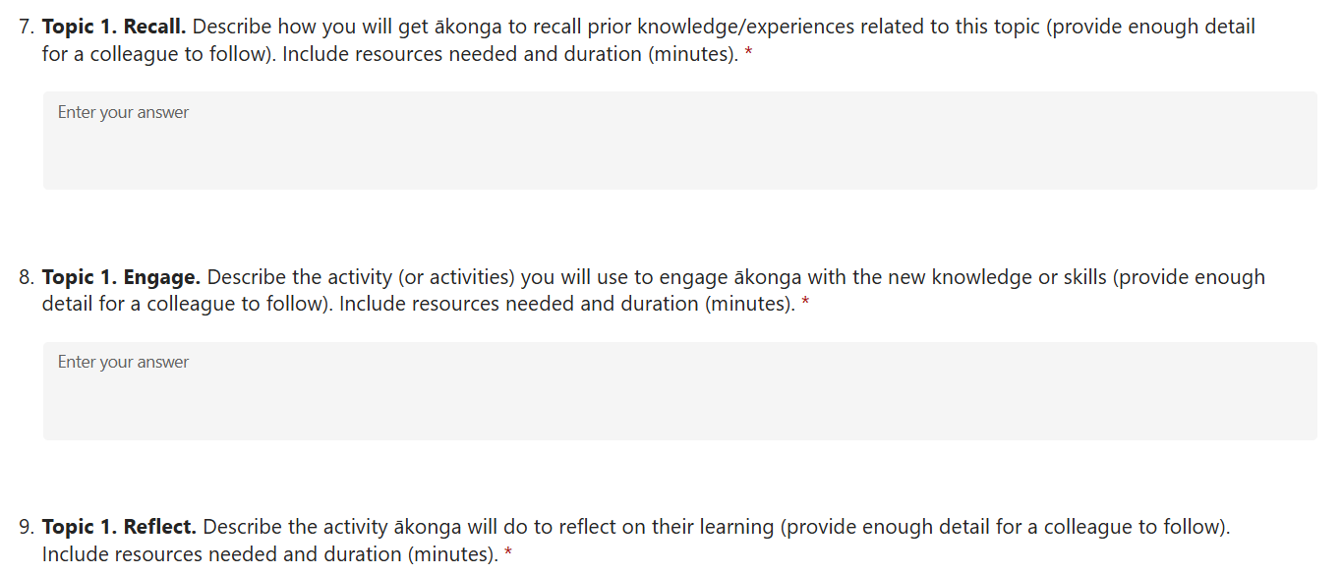
“I’ve used the Cognify [referring to the Microsoft Form process].
That’s the electronic one. I love that, and I copy and paste from other lesson plans into it as well and then change it. Then you can print it, add to it, and take it with you. Oh, it’s great! It just gives you a one-stop shop.” M
Feedback and changes

Slide 32
Feedback and changes
“I like the visual and the colors, but I wonder if there is a way to make a sort of smoother diagram.” Q
Cognify process diagram redesigned.
Improved layout, colour and readability.
Title changed to Cognify: Teaching for Learning.
Shorter, more user-friendly and avoids confusion with other Wintec frameworks.
Ākonga cohort description added to support planning.
‘Learning outcomes’ changed to ‘Session outcomes’.

Slide 33

Impact on teaching
Kaiako described changes in how they approached teaching and learning.
“It helped me to decrease the amount of PowerPoint, because that was the biggest complaint I had in the first year overall. ‘Kate’s preparing too much content. I'm getting lost. It's just too much, blah, blah, blah, blah.’ …I don't feel like I have to talk all the time. Instead, I can focus my energy on what activities are going to work really well to embed this.” K
“You'd think that after 15 years, I would be like, ‘Eh, doing that already.’ But I think probably just put a bit of a fire in the old belly… All of the pieces just slotted into place during that workshop, and I was like, ‘I see now the big picture.’ …thinking about what I'm actually trying to achieve, as opposed to the content that I need to get through.” L

Slide 34
Impact on teaching
Sometimes Cognify prompted kaiako to revisit practices they had used previously but were not always using consistently. The two stages commonly revisited were Establish and Recall.
“I think when you've been doing it for so long, you tend to just get into a bit of a routine: chit chat, attendance, let's get into it, overview for the day. So yeah, a few little warm-ups and things. Yeah, it was good.” O
“That Recall section I have done before. I probably didn't do it every teaching session, but definitely have done it before… I think hearing that there's a strong link between being able to build on knowledge in the brain by doing that made me recognise how important it was.” Q
Notes:
Discuss Recall quote.
Confidence and clarity - Having a structure for planning and teaching gave some kaiako greater clarity and confidence in their practice.
One kaiako used the colour coding from the Engage cog to code her activities in her session plan.
“I actually went through and I colour coded them for myself. There's a whole lot of ‘Discuss’, in various formats, but they're all actually in that colour. What can I get them to do different? Or how can I shift one of those, at least one of those, to be a different type of Engage activity.”E or add this to an impact slide
“It makes me feel more like a teacher, because I have a structure behind me. It's not just based what I think should be done and heavy on content and knowledge… there is proper ways to do in a way they will learn more, they will remember, they actually will engage...”K

Slide 35

Team manager perspective
“Seeing the way in which the team buys into it is hugely beneficial. Something like this provides a really robust and rigorous underpinning for feeling confident to upskill in their teaching practices, because it's not just someone coming in and telling them how they have to teach, but it's giving them a set of tools.” M
“I think the team has felt more energised and excited about teaching with these kinds of tools. Because it’s such a simple, direct and clear model, it’s not an imposition or a demand on the teacher… it’s accessible… and it’s not threatening, so it’s an empowering tool. It’s much more about how to make it work better for you, which I think is what people really like.” M
Notes:
Strong team buy-in
A robust and rigorous underpinning for developing teaching practice
Greater confidence to upskill in teaching practice
Increased energy and excitement about teaching
An accessible, non-threatening and empowering approach
Practical tools rather than prescribed ways of teaching

Slide 36

Impact on relationships
“I think I’m connecting with a larger number of students. Because I have these motivated people that like my way to teach and pay attention.”K
“And I think it [Evaluate stage] does help with building trust when you're referring back to ‘Here's the type of feedback we had from you, here's how we're addressing it’ Q
“I can actually get around the room a lot more because I can see and facilitate in terms of provide mentorship and feedback. Because I'm not focused on delivering content, so the impact is massive from that perspective.” L
Notes:
THEY READ.
“probably the main thing is the ability for me to actually help shape their practice in class by having some form of learning activity that I can go and sit next to each one of them, and they can show me what they're doing, and I can suggest something, or be like, ‘Hey, try that.’ Because it's not an assignment, it's low stakes. And so, one of the things that we have is ‘fear of handing in’ [assessments] it's almost as if that gets eliminated because we've done practicing on all of this low-stakes stuff, where they get used to sharing their draft. So I think that's probably a good trust building.” L
“I think it's been helpful in more ways than one. It's not just in the classroom. It's like in terms of building that relationship and getting this culture of collective learning happening.” L

Slide 37
Impact on energy
“…overall, I feel less tired in the end of the process, and I feel less tired when I have this nice activity. Because your energy, you feel better when you do something and people actually engage.” K
“When I did give it a go, the change was immediate. Suddenly I had a session where nobody was exhausted by the end of the session, and I didn't have people checking their phones and their watches, being like, ‘I need to go now.’ I think it probably surpassed my expectations.” L
“I do remember in that first semester the classes felt livelier and going through content wasn't a chore.”M
Notes:
THEY READ.

Slide 38

Impact on ākonga
Kaiako reported positive responses from ākonga, including feeling supported and having their learning needs met.
“But I had really good feedback from the students…So I'm like, okay, it's landing okay. Yeah, across the board, it's okay.” D
“I think with the ākonga overall, they have had everything that they need to meet the learning outcomes if they've been attending, because of the way that Cognify works.” O
“I noticed that ākonga were a lot more relaxed. They were open to come and see us. We could see that we were meeting the needs of individual ākonga.” O

Slide 39
Learner Pulse feedback
“I suppose that comes back to the Learner Pulse surveys, so ‘Amazing.’ Just everything we're doing is great. Nothing, they don't want to see anything different.” O
Learner Pulse responses to ‘What does this tutor [L] do well?’
“preparing well and making class engaging”
“engaging the class by making us do practical work of a topic after an explanation of it”
“The class structure of: teaching + activity + more teaching + activity 2, etc. was really great for solidifying learning and setting me up to do assignments. It kept me engaged during class and pushed me to apply theoretical knowledge.”
Notes:
“I got the Learner Pulse. They said it was very... engaging, engaging, engaging. And that was what we were trying. That's what I was trying to do.” L

Slide 40
Engagement
“I did feel like those classes felt more successful in terms of retaining attention and engagement for longer, as well as having more opportunities for different students to engage. You're not reliant on the same ones engaging or seeing some switching off.” M
From ākonga:
“D, you make us work hard in this class. Like, you actually make us think and talk and do. But we kind of don't mind, because we can chat and hang out. We talk a lot, we do a lot more. And yeah, we learnt it.” D.
“You made our experience in your class really, really engaging, really, really fruitful.” I

Slide 41
Attendance
“I was shooketh.”L
“They turn up. They turn up every day, yeah, which is great. The attendance is really high, yeah. So that shows that they're enjoying it…”O
Notes:
One kaiako recalled a particular afternoon class. Knowing the ākonga would have a three-hour class in the morning of the same day, with some pretty demanding content, the kaiako gave them an option the week before: “If you have submitted your draft for my course to Moodle, you don’t have to come to class.”They had all submitted their drafts. So, they were free to skip the afternoon class.But they all came.“I was shooketh.”For the kaiako, that was the moment they realised just how invested the ākonga had become.

Slide 42

Assessment
From experienced kaiako with 13+ years’ teaching experience:
“The assessment results have been really, really high. So, with the resits, especially with the theory side, has been quite minimal. So, it's telling me that the results of all the students passing is definitely evidence for the Cognify lesson plans.” O
“they felt that they were way more engaged in their learning, and then obviously as well, when it came assessment time, I had excellent assessments, like they sounded like actual film scores, which, at a second-year level, is remarkable.” L

Slide 43
Overall Perceptions
From newer kaiako with 0–2 years’ teaching experience:
“it takes time to adopt to, but intuitively, it makes sense. The framework makes sense. That's the most important thing…This is one of the few frameworks I've encountered that really makes sense.”I
“I think it's really valuable. Because in the end of the day, everybody is on the same boat. People come from different backgrounds and we think we know what teaching is… because everybody has been in the classroom, and we have people that we like more, the style of the professor or the teacher, and then we kind of try to mimic that thing. But there is a proper way to do it.” K
Notes:
“the overall reflection that they're very very useful, helpful, and it doesn't matter, you know, how much experience you have. Yeah, it's still useful. Still helpful.” Meg
“I just tell everyone about the Cognify framework. I just loved it. It was so good. So good. I just knew that I was covering everything. Whereas before I would have been second guessing myself.” O

Slide 44
Overall Perceptions
From experienced kaiako with 13+ years’ teaching experience:
“I felt before that there was something missing in my teaching... Not having any lesson plans, I'm like, am I missing anything? I'm not covering everything. So for me, I just feel like I've achieved a lot, and I feel really proud of all the lesson plans that I wrote.”O
“I don't know that it's changed my view of my role as a kaiako, but I think it probably has enabled me to achieve what I have known that I wanted to do for a long time.” L
Notes:
I started off as a lecturer, kind of traditional university, but now it's more engaging…I've embedded that culture of having a learner centered teaching” I
“I think what I realized is actually there are some very useful, very quick ways to get feedback. And I started using those in my other classes as well, because I found it really helpful, and it helped us a lot for the following week.” Q
“It made me less overwhelmed... So first I sit down, ‘Where would I start?’ Yeah, but now at least I have, oh, I need to structure. How would I engage?”I

Slide 45
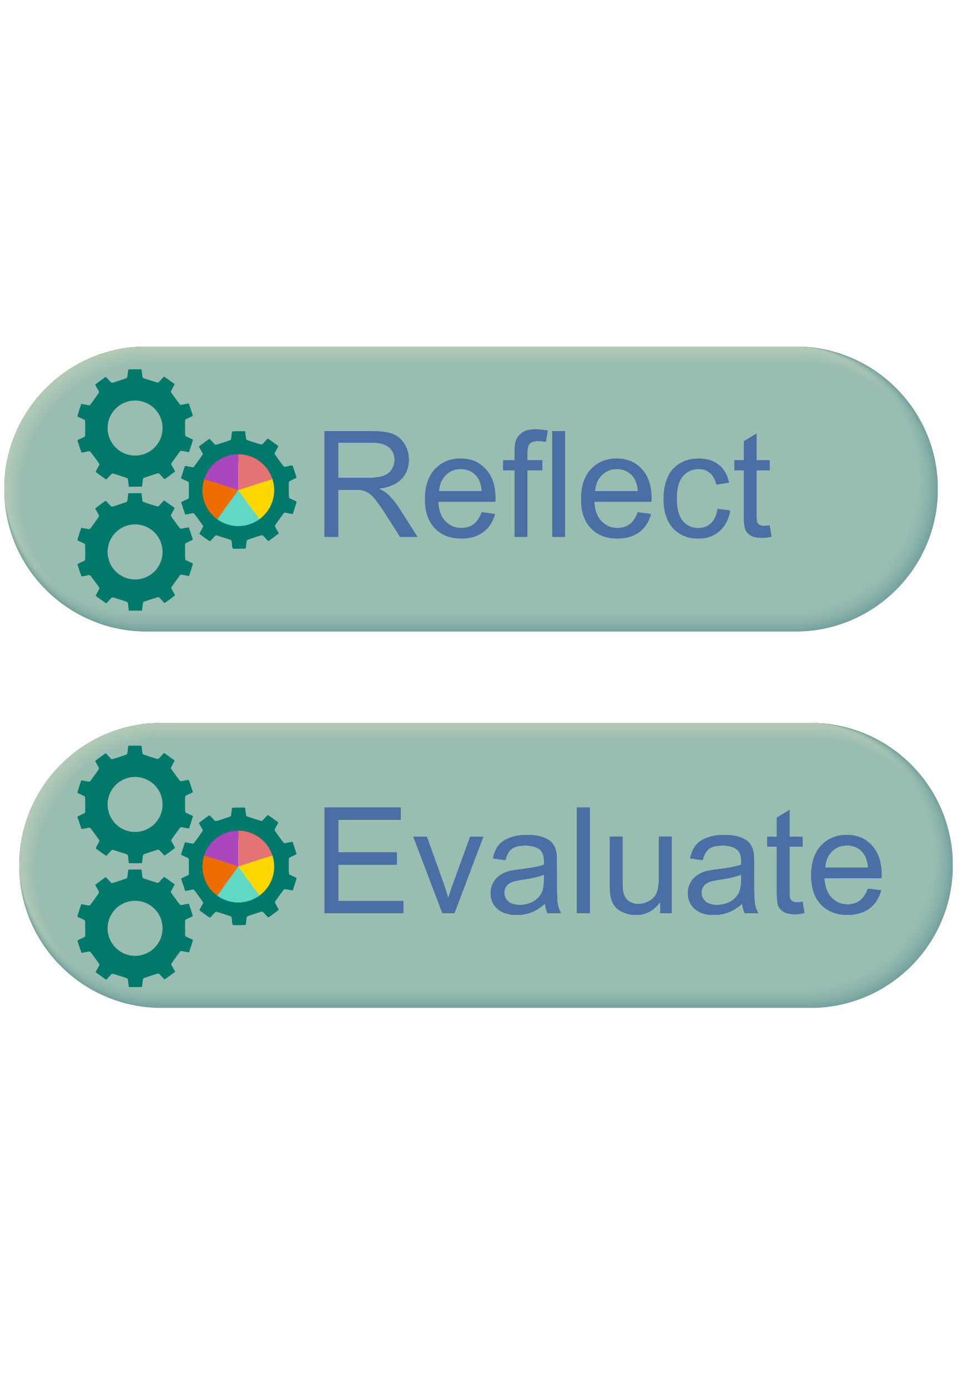
In pairs reflect on one of the following…
CONNECT
What connection are you making between something you’ve heard in this presentation and something you already know or do?
RETHINK
What has made you think differently about learning, teaching, or engagement?
APPLY
Is there something from this presentation you could take back to your own context?

Slide 46
Questions?
Thoughts?
Connections?
(Image by Canva)

Slide 48
References
Ako Aotearoa. (2023). Ako explored: Evidence-based learning and teaching practices that enhance quality of outcomes in tertiary education in Aotearoa: The kaiako’s role. https://ako.ac.nz/assets/Knowledge-centre/Ako-Explored/Ako-Explored-WEB.pdf
Doyle, T. (2008). Helping students learn in a learner-centered environment: A guide to facilitating learning in higher education. Stylus Publishing.
Doyle, T., & Doyle, B. (2020). Learning and teaching in harmony with the brain: Insights from neuroscience, biology, cognitive science and psychology. In S. Hoidn & M. Klemenčič (Eds.), The Routledge international handbook of student-centered learning and teaching in higher education (pp. 75–91). Routledge.
Hoidn, S., & Reusser, K. (2020). Foundations of student-centered learning and teaching. In S. Hoidn & M. Klemenčič (Eds.), The Routledge international handbook of student-centered learning and teaching in higher education (pp. 17–46). Routledge.

Slide 49
References
Ho, Y. Y., & Lim, W. Y. R. (2020). Educating adult learners: Bridging learners’ characteristics and the learning sciences. In C. Sanger & N. Gleason (Eds.), Diversity and inclusion in global higher education. Palgrave Macmillan. https://doi.org/10.1007/978-981-15-1628-3_4
Kolb, D. A. (1984). Experiential learning: Experience as the source of learning and development. Prentice-Hall.
Laurillard, D. (2012). Teaching as a design science: Building pedagogical patterns for learning and technology. Routledge.
Machost, H., & Stains, M. (2023). Reflective practices in education: A primer for practitioners. CBE—Life Sciences Education, 22(2), 020148. https://doi.org/10.1187/cbe.22-07-0148
Pan, S. C., & Bjork, R. A. (2021). Acquiring an accurate mental model of human learning: Toward an owner’s manual. In E. Tulving & C. Fergus (Eds.), The Oxford handbook of memory (Vol. 2). Oxford University Press.

