Slide 1

Strengthening work-based learning outcomes through accessible educational interventions and partnerships
PRESENTED BY
Katja Fossett
Learning Support Administrator, BCITO
Maureen Hamahona
Pou Whakahaere / Business Operations Manager, Education Unlimited

Slide 2
Karakia
Welcome to the session
Tukua te wairua kia rere ki ngā taumata
Hai ārahi i ā tātou mahi
Me tā tātou whai i ngā tikanga a rātou mā
Kia mau kia ita
Kia kore ai e ngaro
Kia pupuri
Kia whakamaua
Kia tina! Tina! Hui e! TĀIKI E!

Slide 3
Session overview
We will aim to answer these questions throughout our presentation
What barriers do apprentices face in engaging with work-based learning in 2026?
What skills do learners need to succeed in vocational education?
How have BCITO and Education Unlimited undertaken review and improvement?
Case study
How can we begin to measure the impact on learners and key stakeholders?
Session Close

Slide 4
Learner attributes in 2026
What barriers do apprentices face in engaging with work-based learning in 2026?
15%
Of learners have disclosed an impairment or learning barrier
65%
Of impairments disclosed include Dyslexia and/or ADHD
22%
Of learners speak English as an additional language
34.5
Requests per month on average for English language support
*Jan-August
51
Learners have disclosed both a learning barrier and an English language barrier
*Figures are based on learners who began their apprenticeship in 2026
Learners also require:
Digital literacy skills
Study skills/ Learning strategies
Time management skills

Slide 5
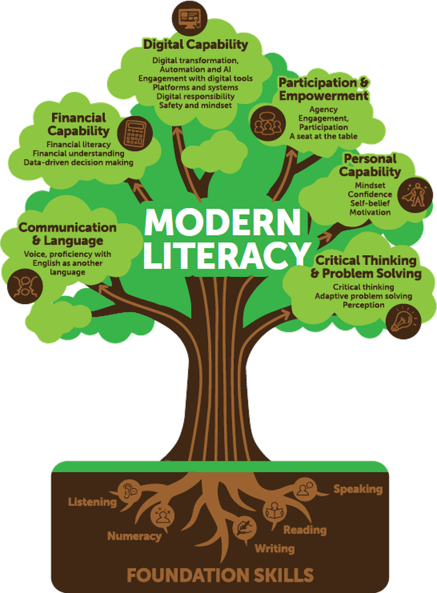

Modern skill requirements for learners
What skills do learners need to succeed in vocational education?

Slide 6
Timeline of review and improvements
How have BCITO and Education Unlimited undertaken review and improvement?
Reviews and Service updates
LLN Review
Learner Success Framework
Learning Support Interventions Review
Progress update to TEC
2020
2022
2023
2024
2025
2026
Improvements and updates
Partnership from 2023
● 1:1 tuition
● Monthly tuition updates
● Tuition from course content
● Enhanced mid-tuition review and assessment. Learner self assessment
● First Critical Skills workshop
●Support requests at sign-up
●Increased data collection
341
409 so far
76
131
Learner Engagements
*2026 figure is year to date

Slide 7
The support loop
How have BCITO and Education Unlimited undertaken review and improvement?
1
BCITO
The learner indicates at sign up that they have a learning barrier and would like support.
2
BCITO
Tuition information is sent to the TA to discuss with the learner at the first meeting. Referral is made.
3
EDUCATION UNLIMITED
The learner is matched with an appropriate tutor, who assesses’ the learners LLN levels.
4
BCITO
The tutor is linked to the learners MyBCITO account.
11
BCITO + EDUCATION UNLIMITED
Learner gains the skills required to independently complete their qualification.
Learners can access support
at multiple points
5
EDUCATION UNLIMITED
The tutor provides monthly updates of tuition, progress and engagement
Referrals come from
10
EDUCATION UNLIMITED
A final report on assessments, outcomes and skills gain is shared with the Learner and Training advisor.
Training Advisor (TA)
At Sign-up
Employer
Self referral
6
BCITO
Updates are provided to the TA. The TA can communicate with the tutor to further direct learning.
BCITO step
Education Unlimited step
9
EDUCATION UNLIMITED
Learner is assessed post-intervention through the LNAAT. Learners are self assessed on skills gained.
8
BCITO
The request is reviewed with:
- Tutor comments
- Learner voice
- TA support
7
EDUCATION UNLIMITED
Before the first 20 hours, the tutor can request further tuition on behalf of the learner. TA input requested.

Slide 8
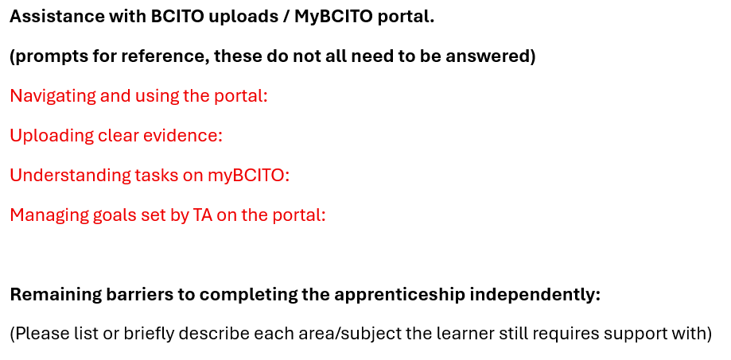
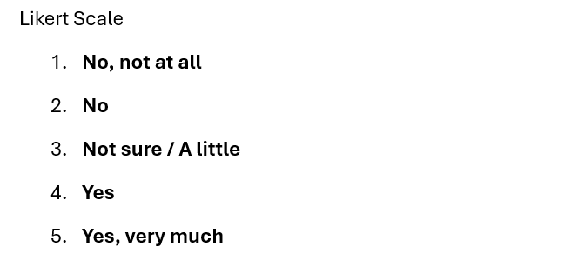
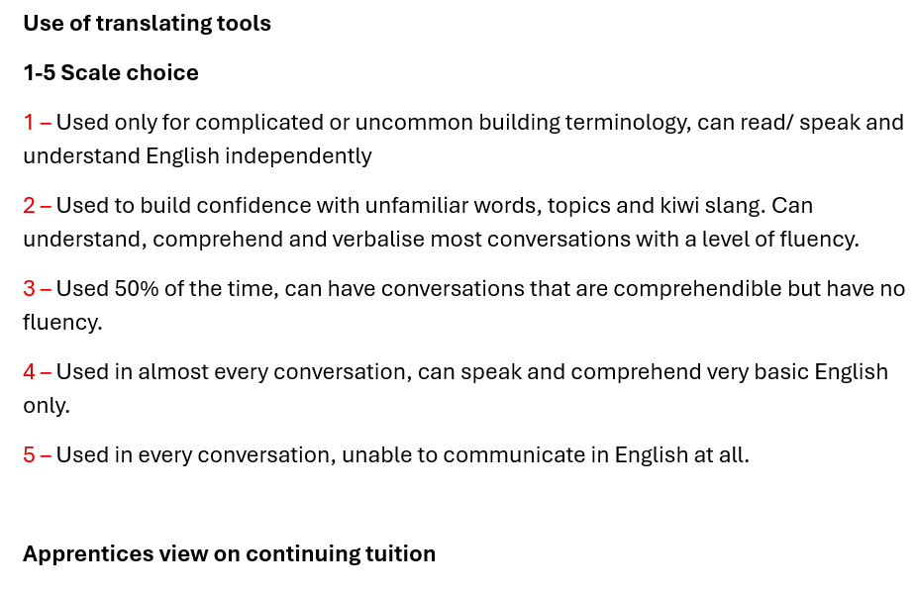
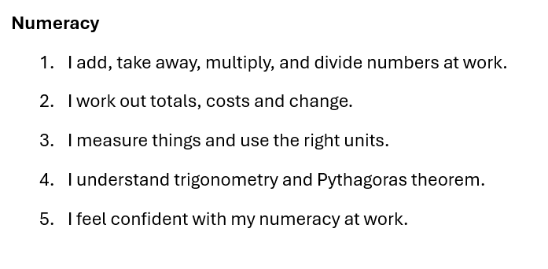
Measuring impact and learning transfer
How can we begin to measure the impact on learners and key stakeholders?
To measure at the end of 2026:
Pre and post assessment of skills gains
Planned to collect 2027:
Withdrawal and no-show reasons
Currently collecting and measuring:
Starting points/LNAAT assessments
Learner voice
Tutor progress updates
Training advisor comments on progress

Slide 9
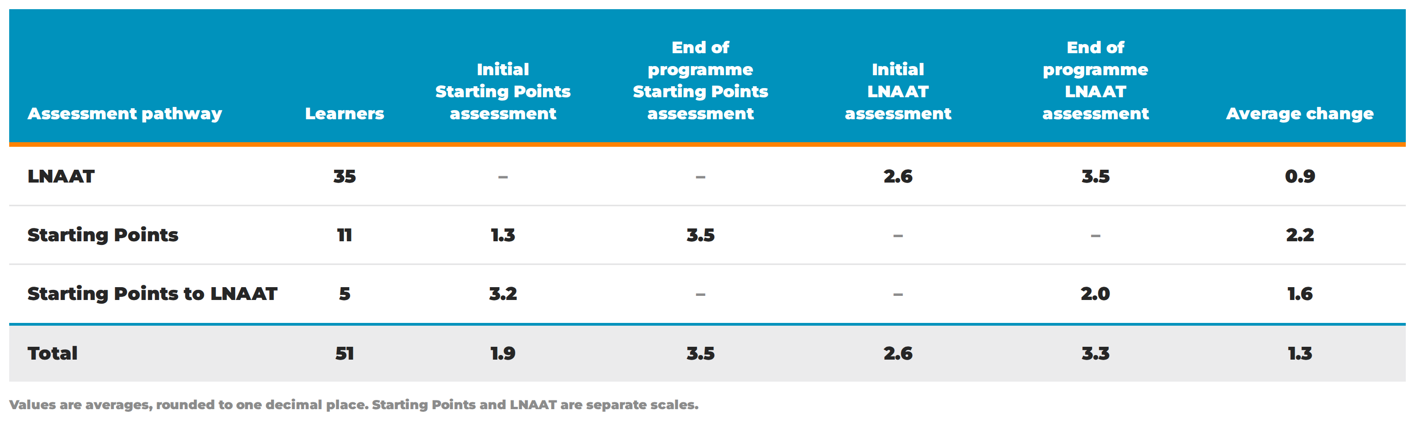
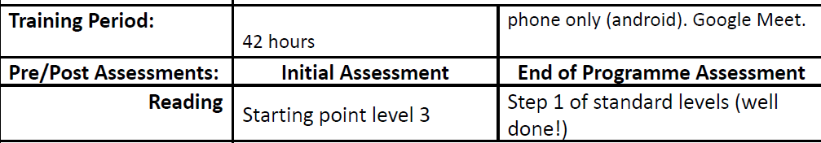
Quantitative data – Assessment skills gain
How can we begin to measure the impact on learners and key stakeholders?
3
EDUCATION UNLIMITED
The learner is matched with an appropriate tutor, who assesses’ the learners LLN levels.
9
EDUCATION UNLIMITED
Learner is assessed post-intervention through the LNAAT. Learners are self assessed on skills gained.

Slide 10
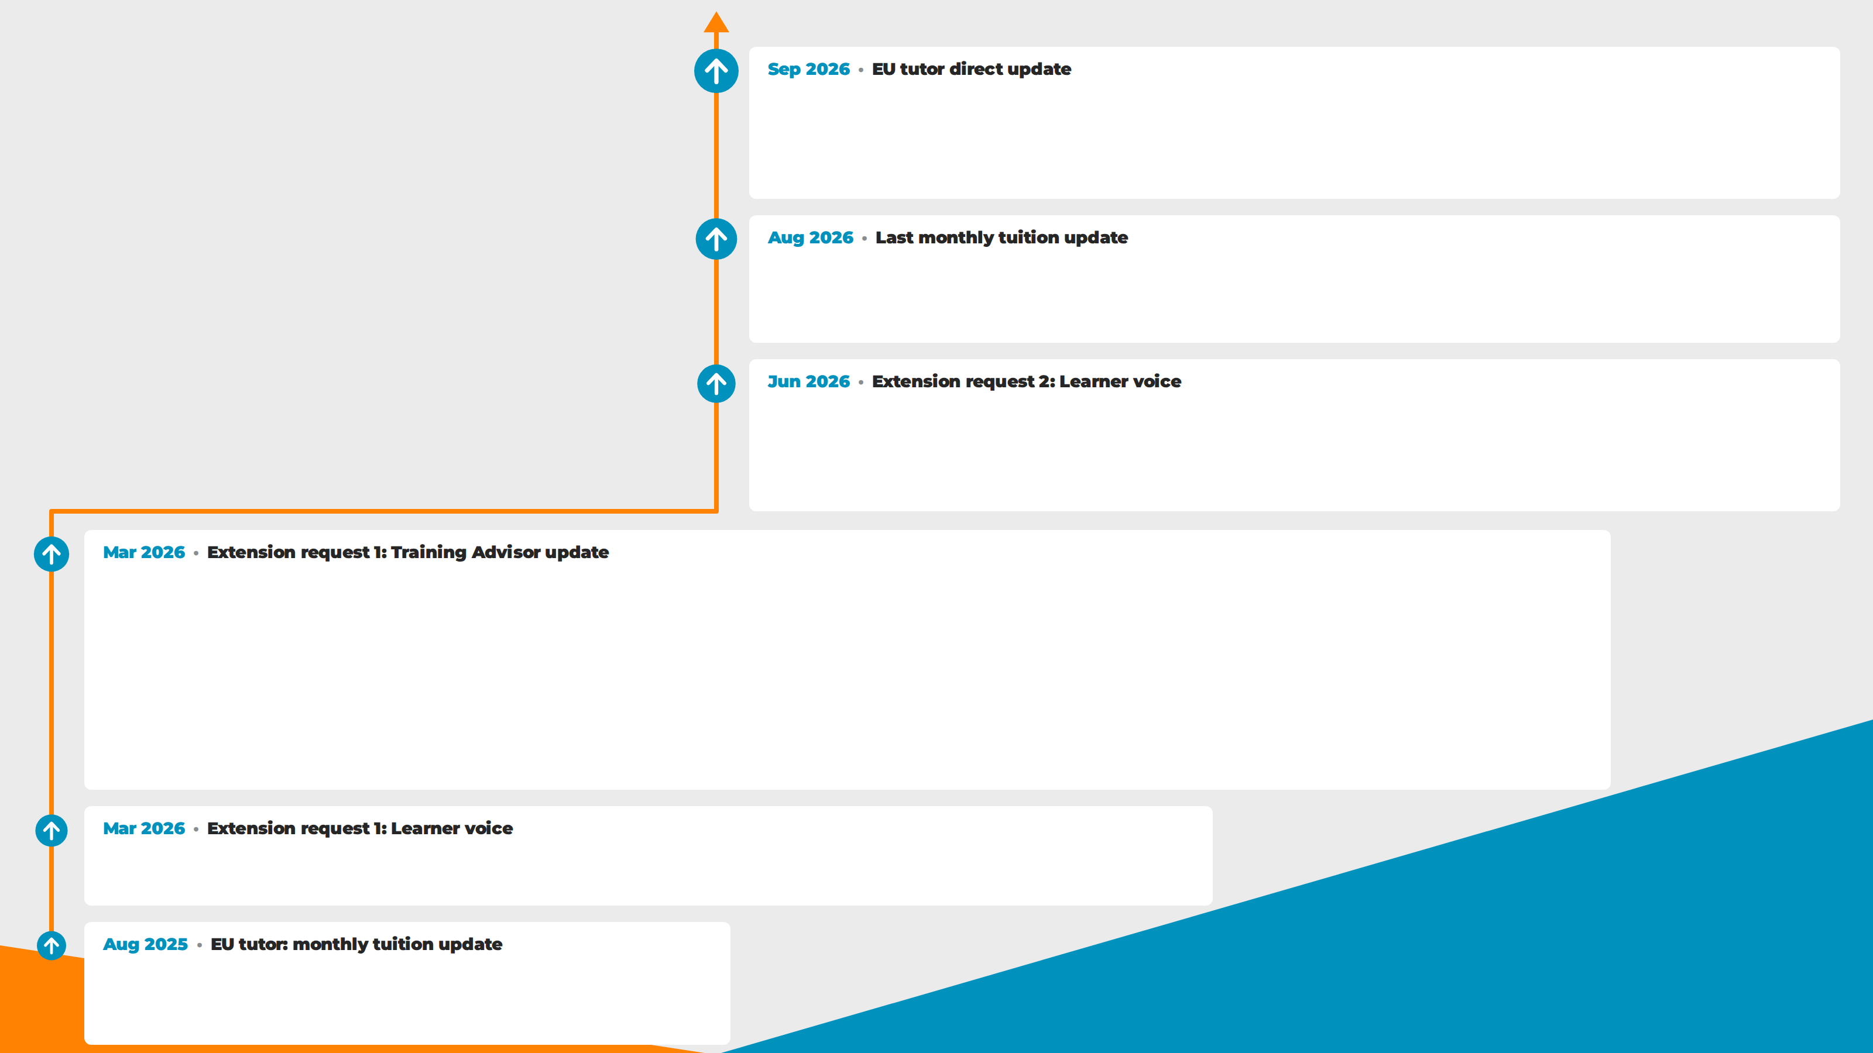
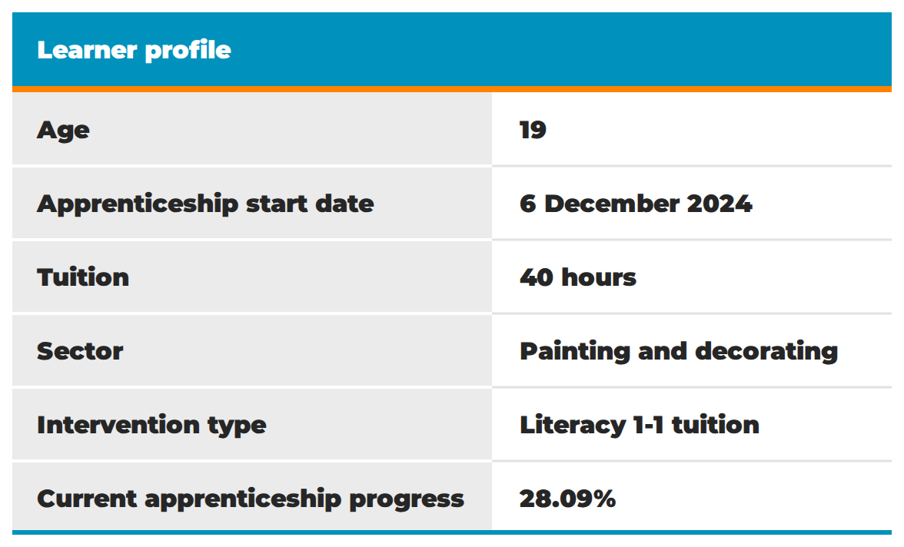
Case study: C
C got his report from the painting Block Course and he’s feeling really good about it. He reckons it’s the first time since primary school that he hasn’t had an “insufficient” grade in some part of a course. Out of 24 measures, he got 13 excellents and 11 sufficients, and the sufficients were in things he hadn’t really studied yet. Lovely to see him feeling recognised and agreeing with grades from a place of strength.
C is confidently working through course content and learning goals, almost independently. He’s starting to develop habits that help him focus. After this week’s block course, we’ll have 4 sessions left to turn those into habits he can maintain independently.
“I’m getting better at putting my thoughts on paper but I’m still learning how to think of questions I could answer. My tutor helps by prompting when I get stuck. I find it much easier to focus on the work when T is there. I get really distracted by cool information and it’s hard to pull back into doing my entry. She also helps with understanding spelling and grammar when I get stuck editing.”
C is consistently uploading evidence of value most weeks, which is really positive to see. I believe this progress is directly linked to the additional assistance he receives. His knowledge retention appears to improve when he can verbally discuss topics during these sessions, and the support in helping him put information into his own words is clearly beneficial.
I would like to see this assistance continue, with a couple of suggestions to further strengthen his …..development:
Increase focus on building C’s learner agency - supporting him to recognise his strengths and weaknesses within his apprenticeship, and to take a more active role in directing his learning.
Goal-setting and preparation for quarterly meetings - encouraging C to identify his own goals, plan what he wants to discuss at his face-to-face reviews, consider which milestone movements may need adjusting, and think about key evidence that supports those changes.
Overall, the support is helping C stay engaged and progress through his apprenticeship, and I believe continuing this assistance will further strengthen his confidence and independence.
‘It's useful to have someone ask questions while I write which helps me find more to write about. Useful to have T check or explain what Grammarly says, and have a set time to do my work. Without her I don't think I would do the work.’
‘C is getting into the swing of thinking about BCITO as he works so he can take photos and document ideas. During our sessions we find where to enter his knowledge into the portal.’

Slide 11
Qualitative measures – Extension request data Learners
How can we begin to measure the impact on learners and key stakeholders?
‘Learner has said that ‘having the weekly meetings has helped him hugely with the theory side of the apprenticeship. He appreciates having a structure to work to and says that the meetings are very beneficial in helping him to focus on step-by-step tasks.’
‘Learner has requested extra hours specifically because he missed some weeks of sessions due to an injury. ‘He works hard and says his manager is very impressed with his progress in the workplace.’
‘Learner mentions that he has improved significantly in his English and finds learning English interesting. He wants to become more confident when speaking English with his clients and business partners, e.g., suppliers.’
‘I need to continue support with trigonometry and Pythagoras. I take work my tutor gives me and review it between each session, I forget the concepts sometimes and have to go over it again. I did not learn these at school so it has been hard.’

Slide 12
Qualitative measures – Extension request data Learners
How can we begin to measure the impact on learners and key stakeholders?
‘Learner has told me these lessons have really helped him. "Because my BCITO TA was very happy last time because I could talk with him and I learn more. Now I can speak when I'm talking to other people, especially my workmates. They are very happy. So I want to continue to get better and understand more.’
‘He'd attended a school where he was not supported and left with little knowledge of basic maths, e.g. how to round decimals. He's greatly appreciative of the opportunity to have one-to-one support for his maths. He would like as many lessons as possible to maximise his learning during his apprenticeship. At work, his boss has praised him for taking maths lessons and applying them to his work.’
‘Learner has said that ‘having the weekly meetings has helped him hugely with the theory side of the apprenticeship. He appreciates having a structure to work to and says that the meetings are very beneficial in helping him to focus on step-by-step tasks.’
‘It helps me a lot in so many ways like the terminologies and mathematics and I learn more from the books. I find it useful practicing conversations and develop the communication. I find it easier to remember the technical terms when I have practiced speaking. I remember easier when I teach T about the work. The time together gives me confidence to try uploads.’

Slide 13
Qualitative measures – Extension request data
Training Advisor
How can we begin to measure the impact on learners and key stakeholders?
‘Thank you for the detailed update about Learner and how he's getting on. He's struggling more than I realised so I will spend some more time with him to help him through his apprenticeship expectations. I fully support any extra assistance available that Learner requires.’
‘When visiting him at our last site meeting, I couldn't believe the improvement with his English overall, and it was so much easier for the both of us to communicate effectively. I believe that further support would only help with a successful apprenticeship in the future.’
‘I believe the additional tuition hours will continue to make a real difference to his progress. The extra support helps bridge the gap between what he knows and what he is able to demonstrate in an assessment environment. I fully support this request for additional hours. Learner is committed to completing his apprenticeship and the continued language support will give him the best opportunity to successfully complete his qualification.’
‘I can confirm that Learner has shown a huge improvement since starting the additional support with you. He is more engaged and has shown a better understanding of his theory work. I would definitely support an extension to his sessions if this is possible to help him through his apprenticeship.’

Slide 14
Qualitative measures – Extension request data
Training Advisor
How can we begin to measure the impact on learners and key stakeholders?
‘Thanks for your tuition with Learner, Learner has been a slow shy learner, but I have seen some good recent progress which has been great, I have passed this on to his employer, Learner is a shy learner even on site says his boss, Learner finds your tuition very helpful and is gaining a great learning structure, which is what he needs to continue with to gain his qualification.’
‘Thanks for the update. I conduct regular visits with Learner, and he came into the office the other day for a quick chat. He mentioned the tuition and how it is helping him. He is doing better, and his confidence, and with that his decision-making, is growing. He is now on the way to being qualified, and the extra tuition will be a significant contributor to that.’
‘I believe the additional tuition hours will continue to make a real difference to his progress. The extra support helps bridge the gap between what he knows and what he is able to demonstrate in an assessment environment. I fully support this request for additional hours. Learner is committed to completing his apprenticeship and the continued language support will give him the best opportunity to successfully complete his qualification.’
‘I can confirm that Learner has shown a huge improvement since starting the additional support with you. He is more engaged and has shown a better understanding of his theory work. I would definitely support an extension to his sessions if this is possible to help him through his apprenticeship.’

Slide 15
Qualitative measures – Extension request data
Training Advisor
How can we begin to measure the impact on learners and key stakeholders?
‘Learner told me S has helped a lot; she has been going over different cladding types with him and helping him use the Canvas app for uploading record of work submissions and using the quizzes. Learner would like to continue with these classes. In my opinion these classes have been very beneficial for Learner and his learning, and if he is able to continue that would be great. He is making some good records of work submissions and is also starting to be able to explain why he is doing something as well as how, which has been great to see.’
‘Learner understood the requirement to improve communication by developing language skills. He has shown very tangible improvements from visit to visit. He is now able to name many components of framing, hardware, and tools. At the last visit was beginning to unpack process as well. I believe the ongoing language training to be essential for learner’s ability to complete a New Zealand carpentry qualification. Not only has his language improved but his practical and leadership skills have grown so that his employer is now able to leave him with minimal supervision for long lengths of time. He has the potential to be a very competent builder and English language is essential for communicating his knowledge and ability to myself.’

Slide 16
Strengthening work-based learning outcomes through accessible educational interventions and partnerships by:
Communication and co-working
Both PTEs bring specialist skills
Multiple points of communication throughout the learner journey
Training Advisors and EU tutors working in tandem
Shared ownership of support
Learner first interventions
Support available from sign-up and at multiple points
1:1 tuition matched to the learner's needs and schedule
Learner voice informs reviews and further tuition
Building learner agency and independence
Industry/Apprenticeship relevance
Outcomes and skills gained
Interventions are tailored to apprenticeship-specific content
LLN interventions translate into strengthened workplace skills
Training Advisors direct tuition towards on-site needs
Employers see tangible improvements
Tracking qualitative and quantitative data
Multi-stakeholder assessment of learning
Skills gains evident in assessments and on site
Greater capacity to measure impact as the data set grows

Slide 17
Closing Karakia
Kia whakairia te tapu
Kia wātea ai te ara
Kia turuki whakataha ai
Kia turuki whakataha ai
Haumi e, hui e, tāiki e!

