Slide 1

Building the Whole Bridge – what needs to sit alongside Industry Led subjects.
Evidence from the Protecting Flexible Pathways survey.
Tuesday 13th October 2026

Slide 2

One Span of the Bridge

Slide 3
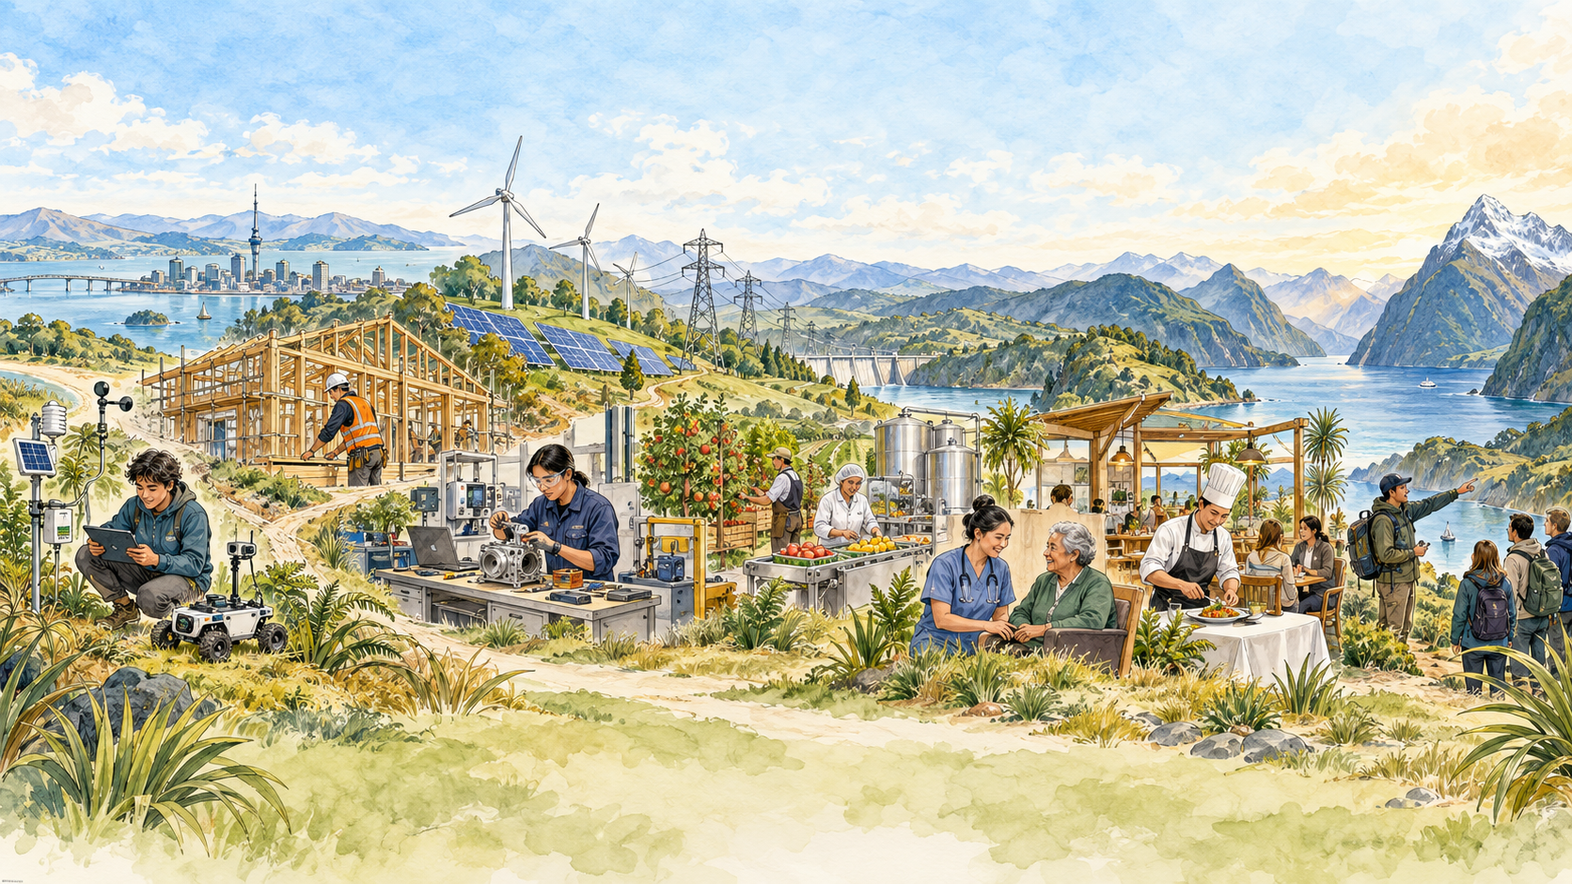
Industry Led Subjects
Applied Intelligent Systems
Construction and Built Environment
Energy and Infrastructure
Engineering Technology
Food and Fibre Systems
Health Services and Care
Hospitality Food and Beverage
Next-Gen Manufacturing
Tourism
tahurangi.education.govt.nz/new-industry-led-subjects-announced

Slide 4
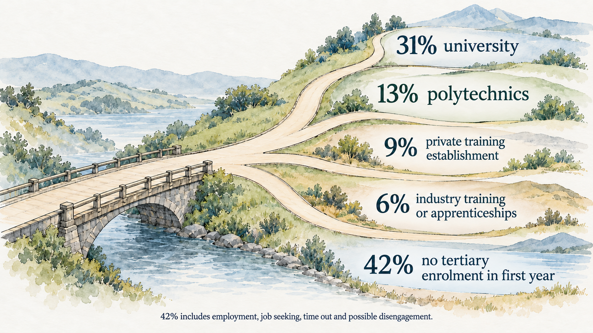
The destination picture is more diverse than university or an apprenticeship.
Most young people need more than a single, linear pathway after school.

Slide 5
The changing architecture
What works now | What is proposed | What must not be lost
Mix standards, providers and learning settings | Achievement through whole, graded subjects | Recognition for smaller, practical and workplace learning
Shape programmes around learners, community and employers | National and industry-led subjects designed for greater consistency | Local responsiveness and flexible pathways
Place workplace learning and short credentials alongside school | Coursework plus at least one external assessment | Accessible assessment for applied learners
Give learners time to explore before committing | Broad, full-year, sector-linked subjects | Exploration, readiness and foundational employability

Slide 6
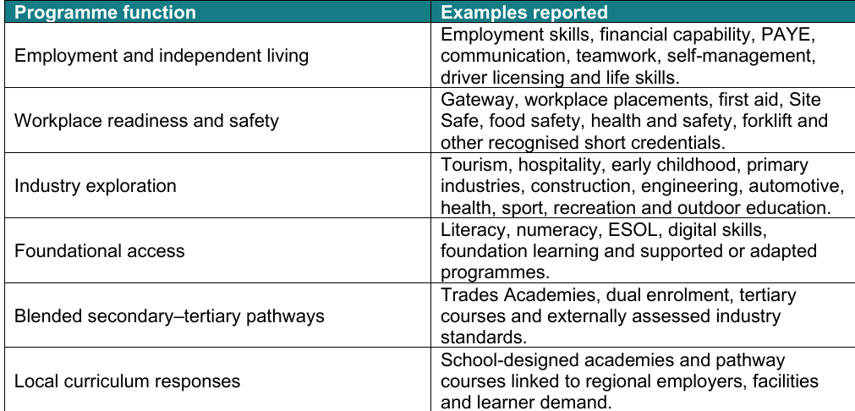

What schools currently provide

Slide 7
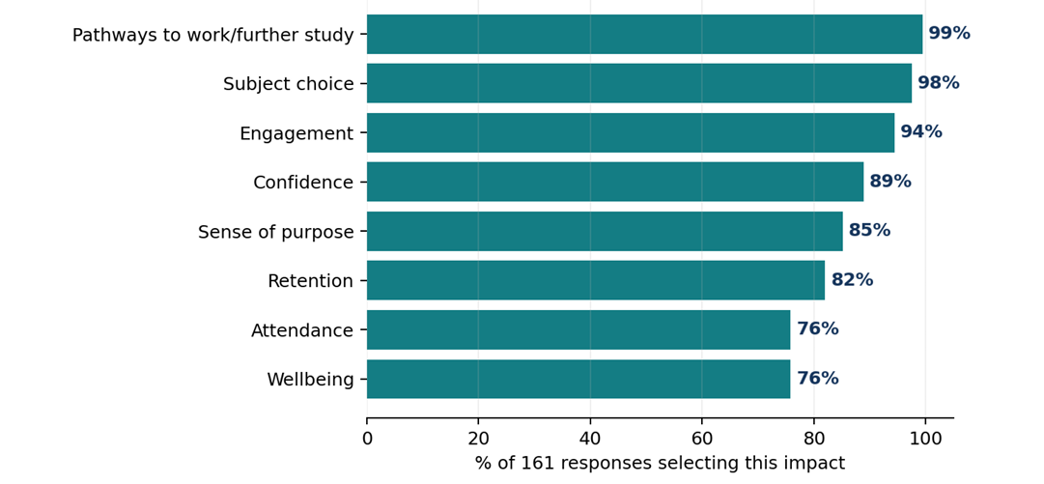

How these courses support learner success.
Schools report that flexible provision supports both achievement and the conditions that make achievement possible.

Slide 8



Who are these learners—and will the future system meet their needs?

Slide 9
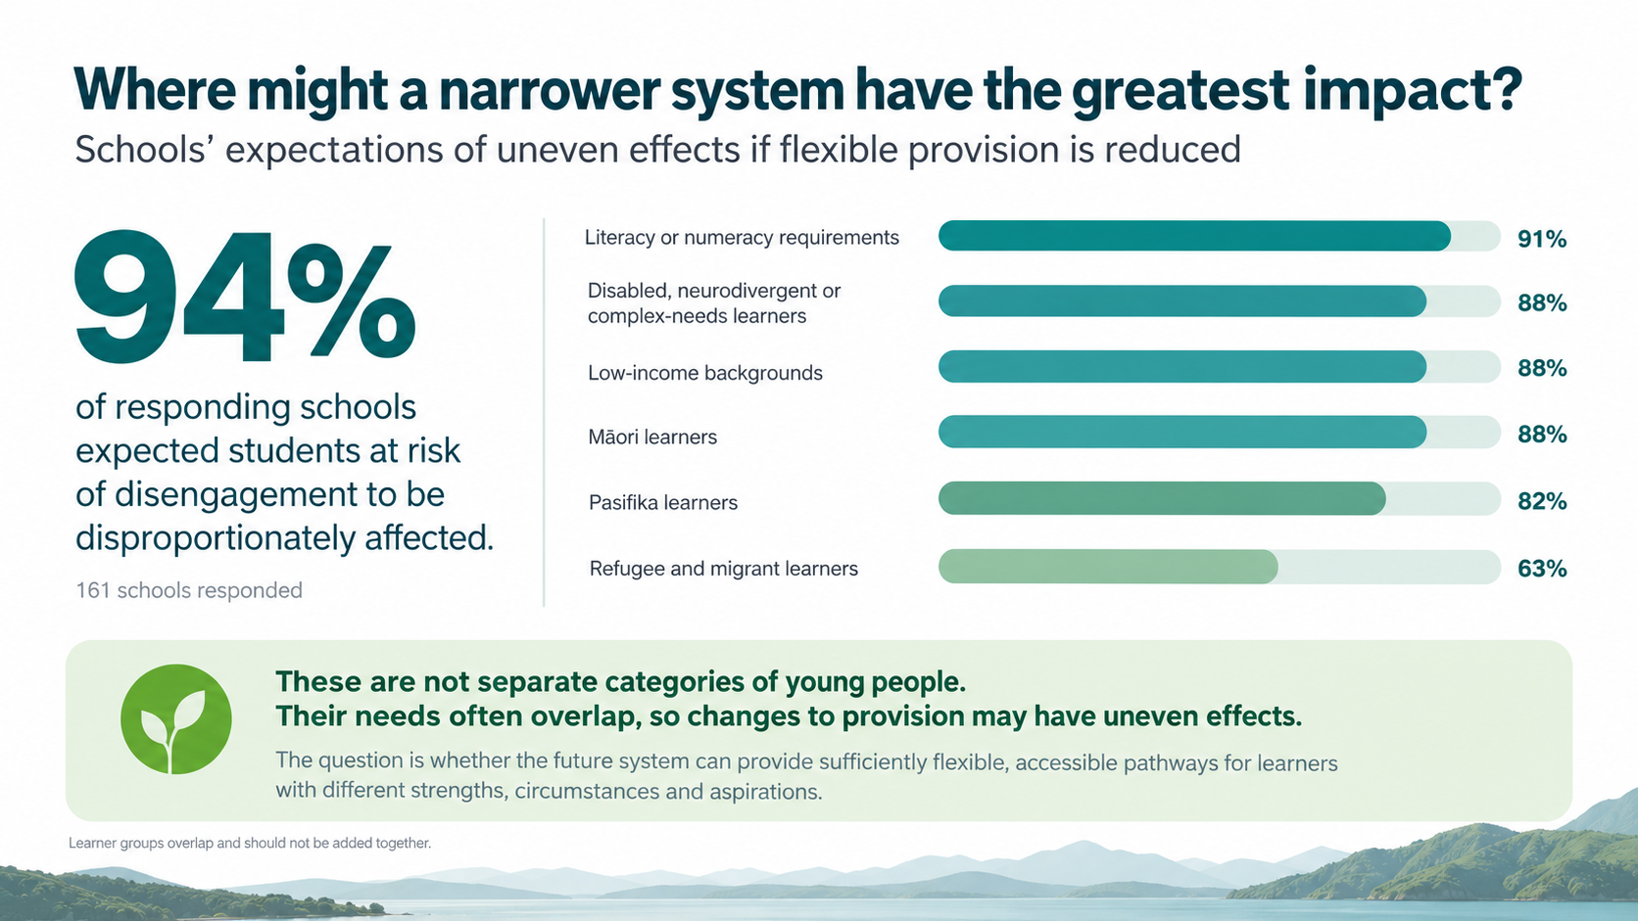

Slide 10
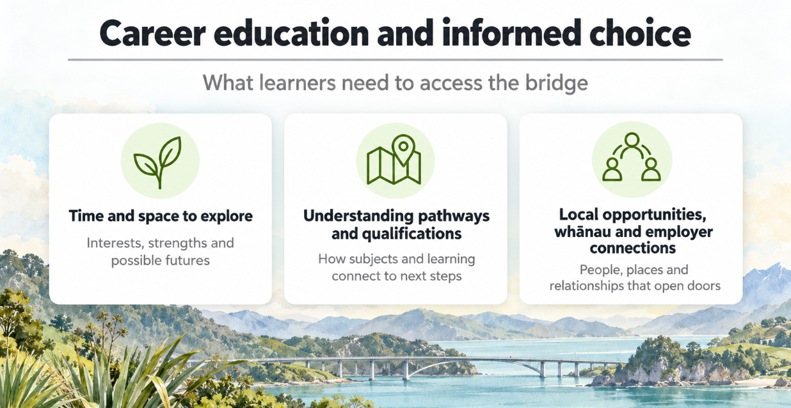

Slide 11
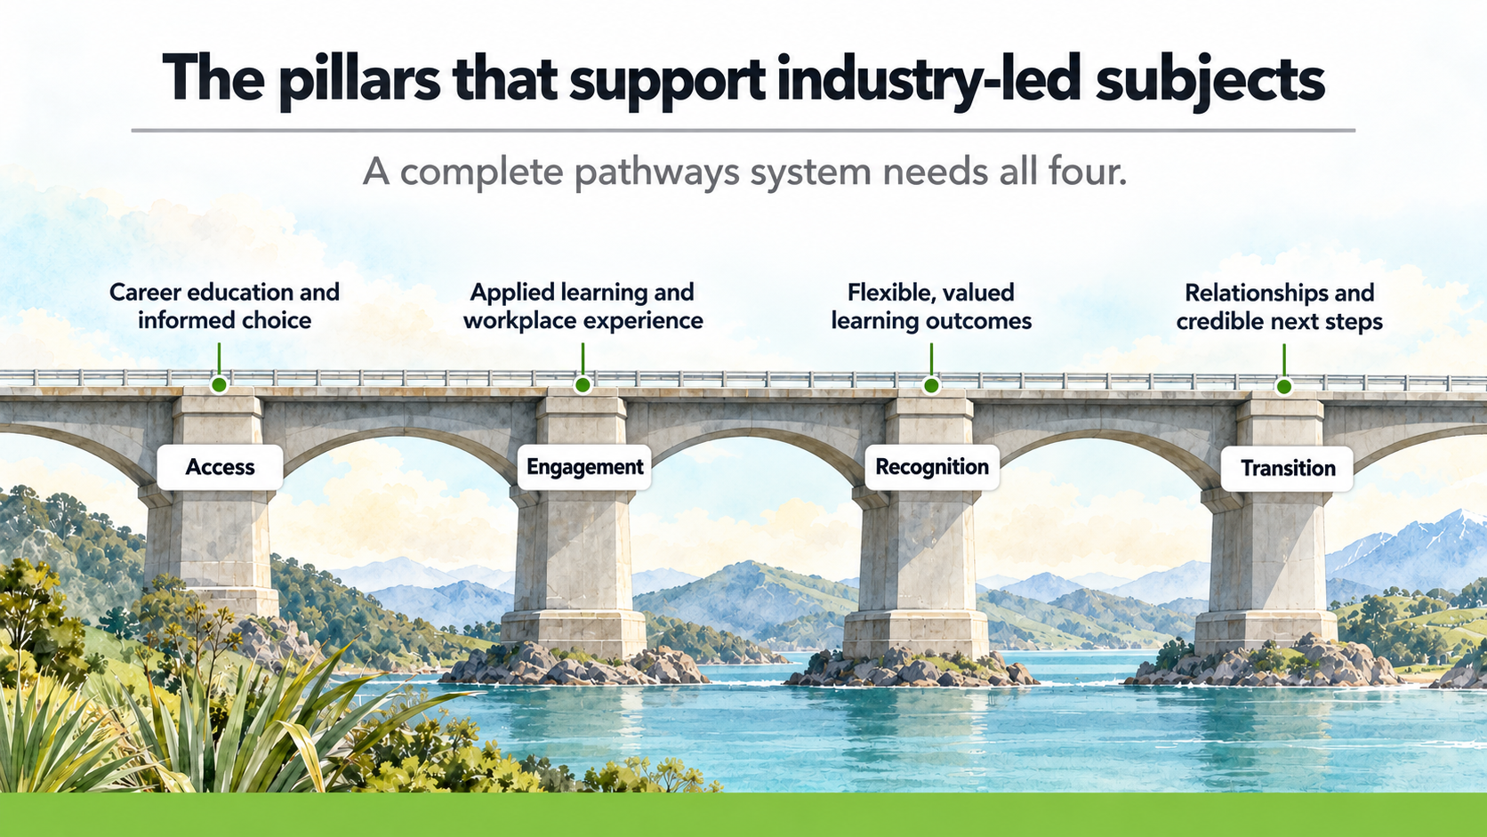

Slide 12
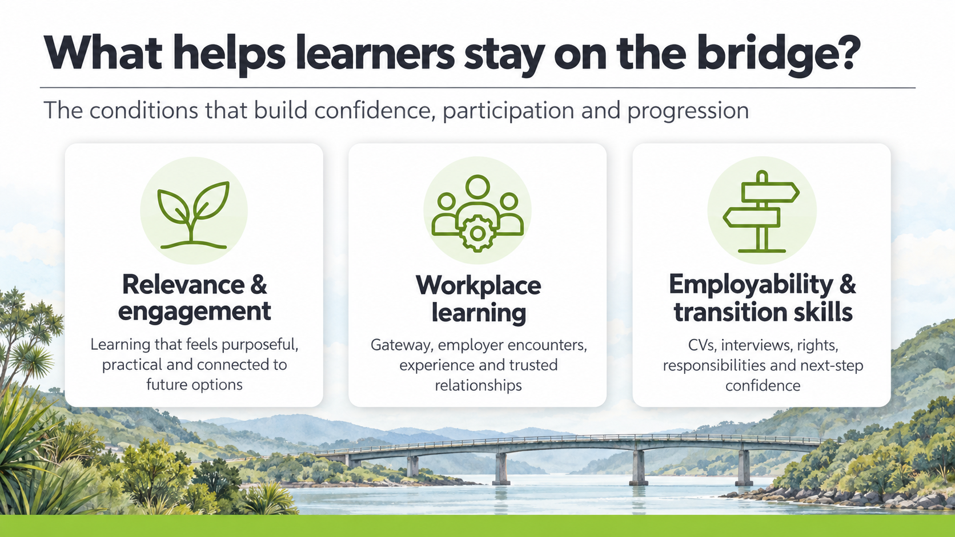


Slide 13
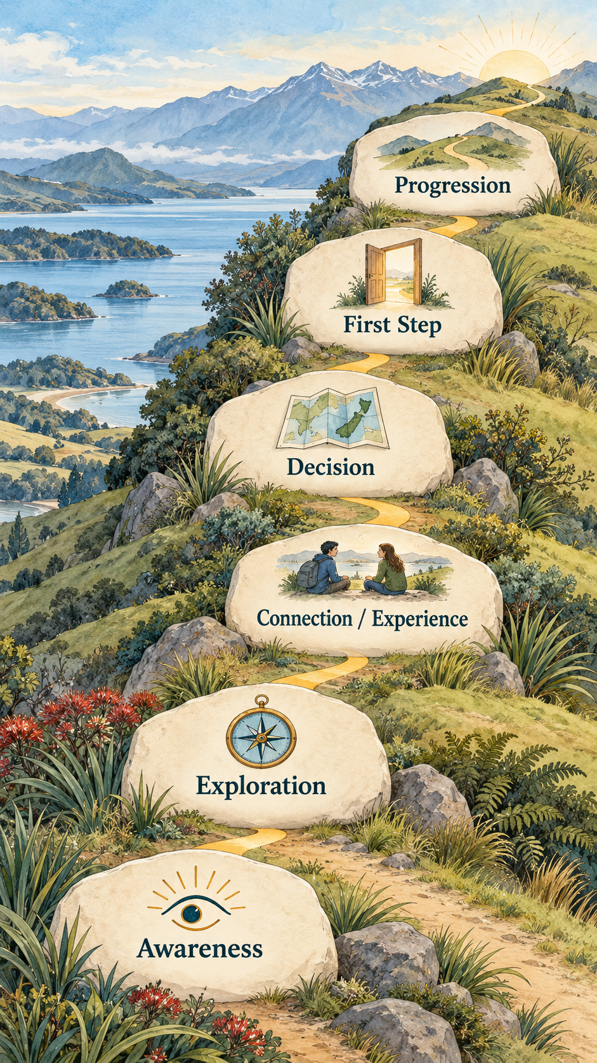
What do we need to guide them safely off the bridge?
Every learner needs:
time and space in the curriculum to develop thinking trusted relationships
connections to workplaces and employers
to understand training and tertiary options
transition support that continues when plans change.
Build and test the complete pathways system before withdrawing the flexible supports many learners currently rely on.

Slide 14

Recognition must reflect the full range of learning.
A learner’s record should show learning across school, workplace and provider settings—not only full-subject passes. It should make visible industry-led subjects, Gateway, short credentials, licences, practical skills and employability capabilities, so employers and tertiary providers can see what learners have done and can do.
The system must also enable equitable access for rural, disabled and neurodivergent learners, and those facing transport, cost, work or whānau responsibilities.

Slide 15

Industry-led subjects will create valuable opportunities for students to explore unfamiliar industries and help build workforce pipelines.
But they are only part of the picture.
Flexible provision must remain until the new system can demonstrate that every learner has:
Recognised learning — including practical, workplace and smaller achievements
Meaningful progression — into work, training, tertiary study or another pathway over time
A credible next step — with the relationships, access and support to begin and continue

Slide 16
