Slide 1
From Future Skills
to Future Capabilities: Anticipating the
Adaptable Professional
    Dr Mark Bradford | Skills institute
    NZVETRF2026 | 13/10/26
Notes:
Vocational education in Aotearoa New Zealand is being reshaped as work, technology and industry expectations change rapidly.

Slide 2
Are we preparing learners for current skills, or the capability to keep adapting as work changes?
    NZVETRF2026 | 13/10/26
Notes:
This SITUATION raises a question at the education<>industry interface:
Are we preparing learners for current skills, or the capability to keep adapting as work changes?

Slide 3
  Three challenges
  Keeping education connected to changing work
  Translating industry demand for “skills’ into transferable capability
  Enabling learners to apply disciplinary knowledge and judgement across uncertain, digital and culturally diverse contexts
    NZVETRF2026 | 13/10/26
Notes:
Three challenges frame this workshop:
Keeping education connected to changing work
Translating industry demand for "skills" into transferable capability
Enabling learners to apply disciplinary knowledge and judgement across uncertain, digital and culturally diverse contexts.

Slide 4
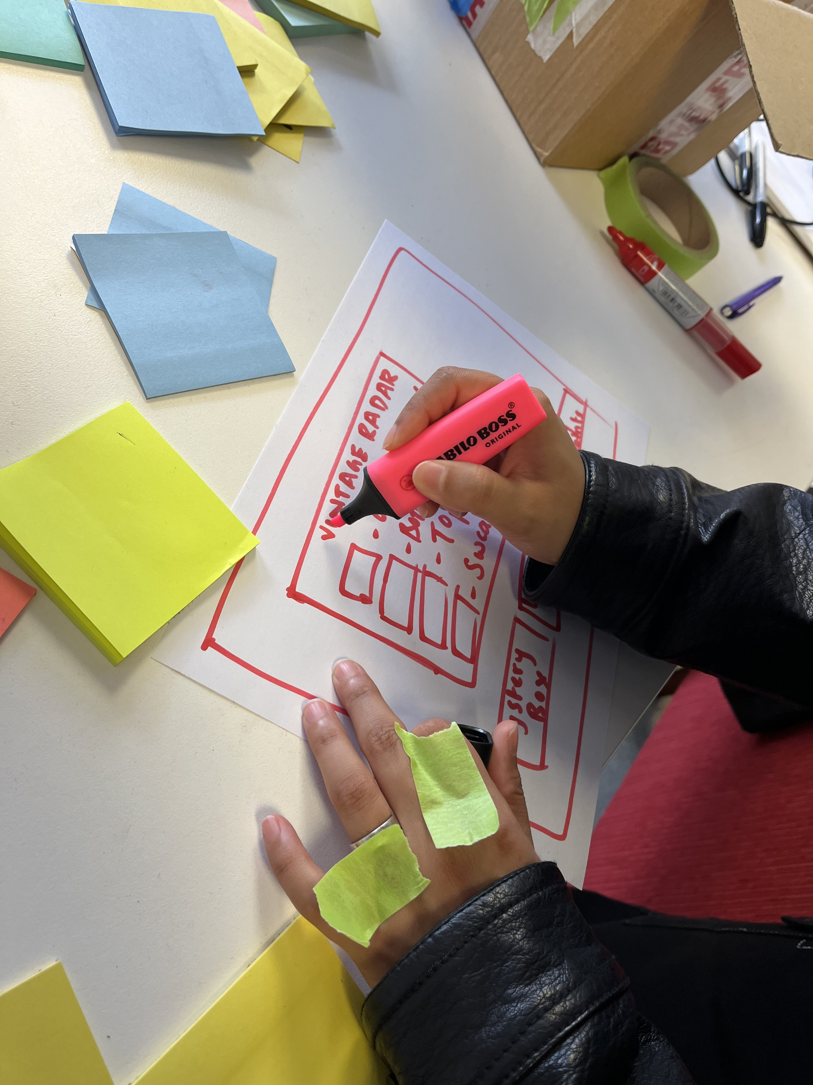
Education←→Industry
    NZVETRF2026 | 13/10/26
Notes:
Building bridges between Education <--> Industry therefore requires shared ways of anticipating what RESPONSES could be needed next.

Slide 5
Adaptable Professionals
    NZVETRF2026 | 13/10/26
Notes:
This workshop explores a proposition:
the bridge between future skills and future capabilities is the adaptable professional.
---Adaptability does not mean generalism or shallow knowledge, but the ability to apply and extend knowledge in changing conditions.
---Rather than treating future readiness as prediction, the workshop approaches anticipation as a participatory practice that
creates space to imagine alternatives, engage diverse perspectives and allow possibilities to emerge.

Slide 6
  Workshop Question
How might education and industry co-design
the capabilities that enable graduates to adapt
as work changes?
    NZVETRF2026 | 13/10/26
Notes:
Participants will investigate the following question:

Slide 7
40
    NZVETRF2026 | 13/10/26
Notes:
We’ll have 40-minutes
The workshop is an interactive, experiential, kinetic working session

Slide 8
2
    NZVETRF2026 | 13/10/26
Notes:
We’ll move through two stages:
---Projective Technique
---Design Thinking Drill call Deflection Point
Let’s start.

Slide 9
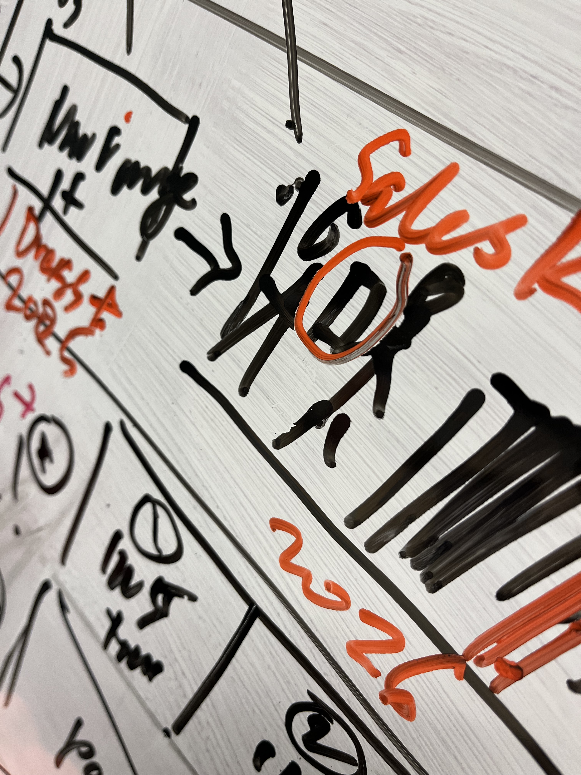
In a quick sketch,
show how you see the relationship between education and industry.
    NZVETRF2026 | 13/10/26
Notes:
At each table you’ll find paper and drawing equipment.
Projective Technique:
---1 minute.
---No talking.
In a quick sketch, show how you see the relationship between education and industry. No artistic skill needed ☺

Slide 10
Stage 1
  Divergent thinking to surface perspectives and possible futures across education and industry
    NZVETRF2026 | 13/10/26
Notes:
Deflection Point Drill:
Divergent thinking to surface perspectives and possible futures across/between education and industry
[Organise participants. Blue tape]
prepare a long horizontal line on a desk. Label it the Predictable Path.
Place your sketches under the line.
Create a new line, coming off the Predictable Path at a 45° angle, and label it the Bold Path

Slide 11
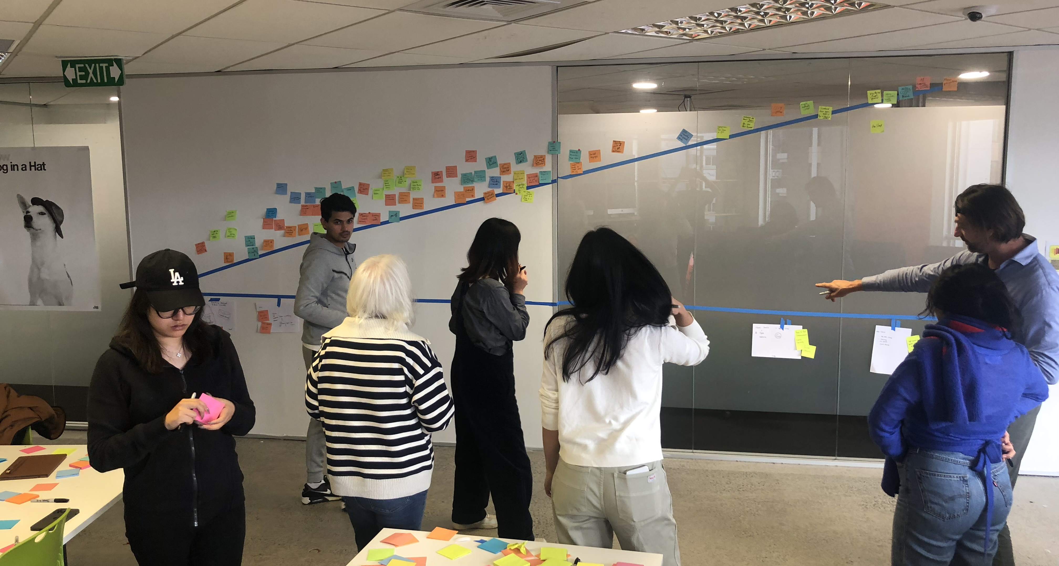
Shifting from the way things are to how they might be.
    NZVETRF2026 | 13/10/26
Notes:
---Insights into the current state: Briefly explain your sketch to the person next to you (describe the current state of things (the good, the bad, and the ugly)) … be as honest as you can.
---We want you to create a bold path that deflects from the “status quo” — shifting from the way things are to how they might be.
---Place your Post-its above the Bold Path line.

Slide 12
  Workshop Question
How might education and industry co-design
the capabilities that enable graduates to adapt
as work changes?
    NZVETRF2026 | 13/10/26
Notes:
It’s about encouraging you to:
be as aspirational as possible about the bold path. … a future state. Be Bold!

Slide 13
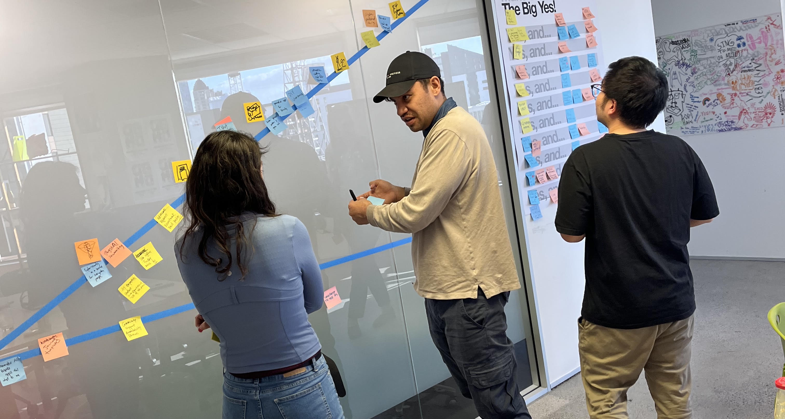
What
if?
    NZVETRF2026 | 13/10/26
Notes:
Divergent thinking
---Use "What if?" as a prompt to surface perspectives and possible futures across/between education and industry

Slide 14
Stage 2
  Convergent thinking to negotiate priorities
  and identify key responses
    NZVETRF2026 | 13/10/26
Notes:
Then, convergent t:
[Organise participants. Blue tape]
---Create a new line, coming off the Predictable Path at a 22° angle
---Collect your most compelling aspirations from the Bold Path that respond to the research question.

Slide 15
  Workshop Question
How might education and industry co-design
the capabilities that enable graduates to adapt
as work changes?
    NZVETRF2026 | 13/10/26
Notes:
It’s about encouraging you to:
be as aspirational as possible about the bold path. … a future state. Be Bold!

Slide 16
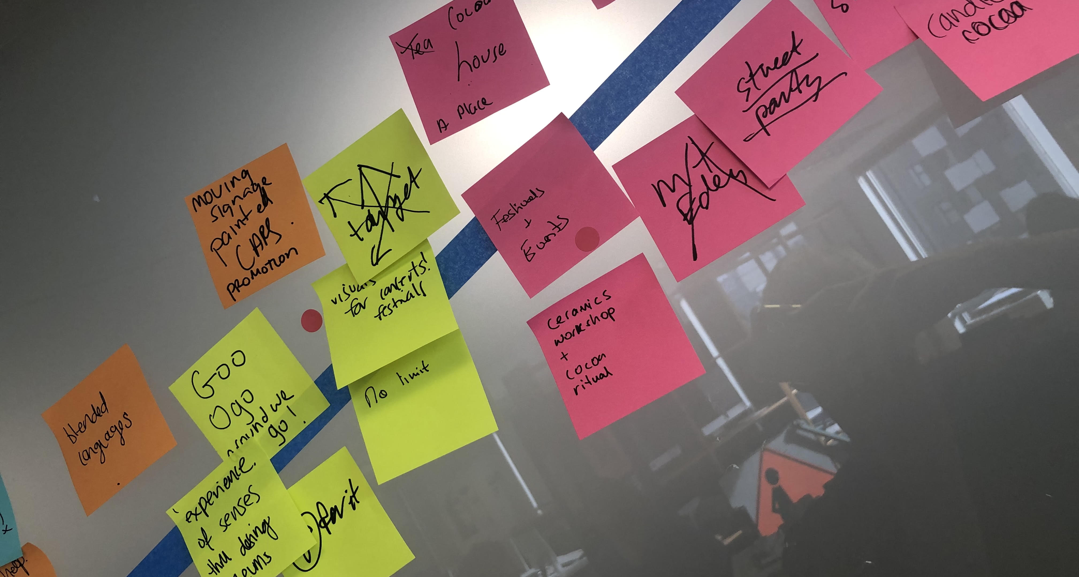
What could be?
Full page image with pull detail zone
    NZVETRF2026 | 13/10/26
Notes:
It’s about a shared understanding and enthusiasm for change …
Tangible possibilities for developing adaptable professionals and a transferable process for bringing "what could be?" into your present educational and industry practice.

Slide 17
vote
Full page image with pull detail zone
    NZVETRF2026 | 13/10/26
Notes:
Vote on the three most compelling aspirations.
[If time] invite some participants to briefly explain each of these to the group.

Slide 18
😊
Full page image with pull detail zone
    NZVETRF2026 | 13/10/26
Notes:
Thanks

Slide 19
  Dr Mark Bradford
  Skills Institute
  mark.bradford@skillsinstitute.co.nz
  0210514498
Full page image with pull detail zone
    NZVETRF2026 | 13/10/26
Notes:
Thanks

