Slide 1

From Industry Voice to Industry Ownership
Building Bridges in Vocational Education
Stronger people.
Stronger industries.
Brighter futures.

Slide 2
The question that shaped the journey
“
What happens when an industry decides that improving vocational education requires it to move beyond advocating for change and take greater responsibility for delivering it?
“
A question about capability, accountability and outcomes.

Slide 3
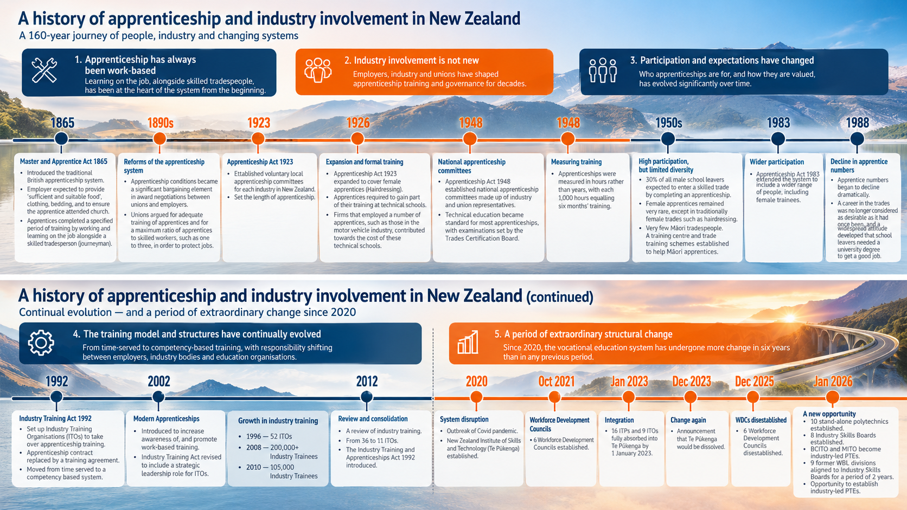

Slide 4
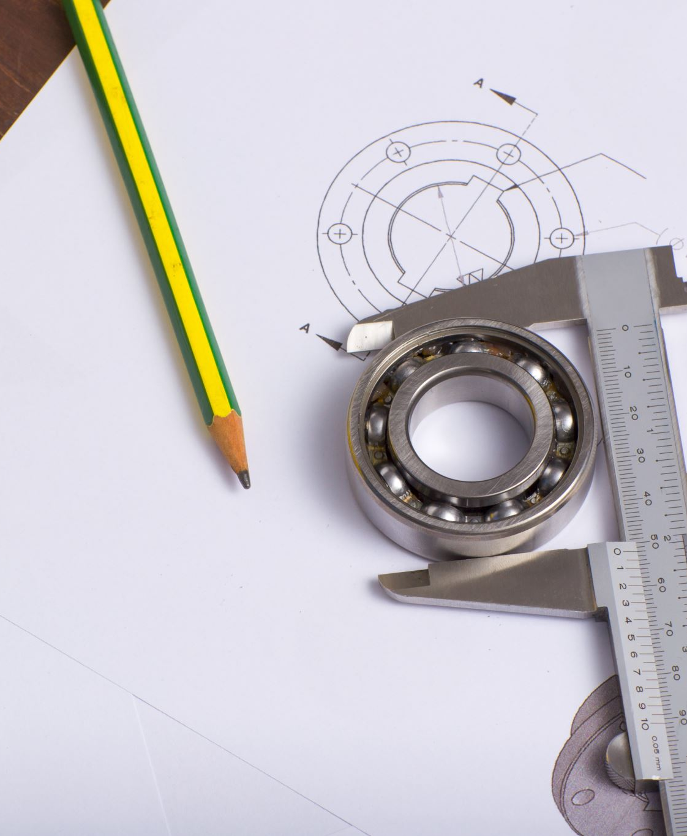
Question
So, after looking at that history — what does the term ‘industry’ actually mean to you?
Discuss at your tables
Notes:
One of our early learnings was that being industry-led doesn't mean listening to one industry voice. Industry is an ecosystem.

Slide 5
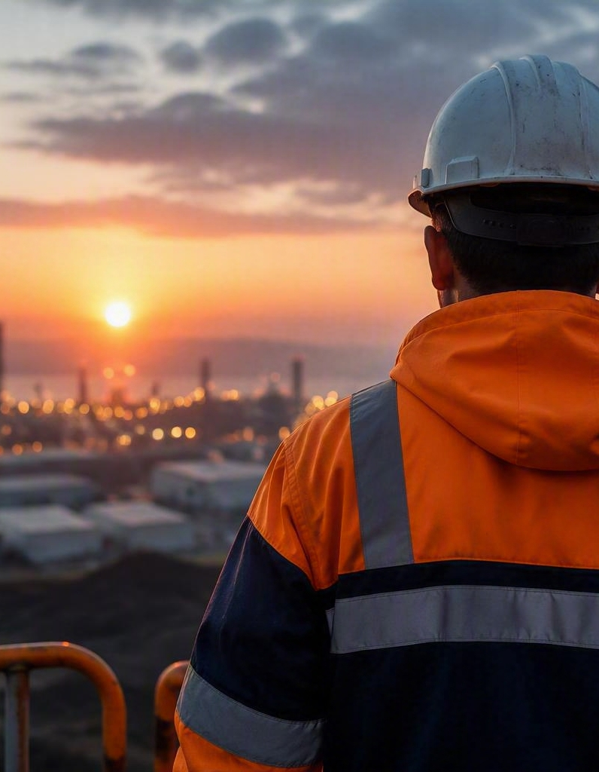


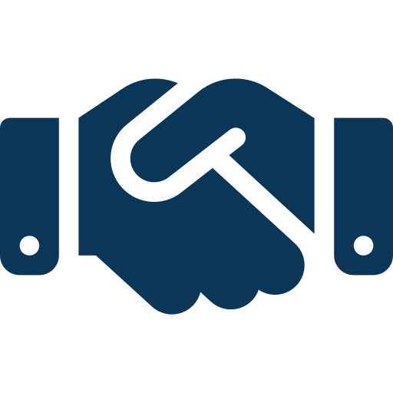
Why change was needed
Longstanding concerns about training consistency, responsiveness and effectiveness.
A capable workforce is critical to our industry and communities.
Employers wanted a stronger connection to the education of their future workforce.

Slide 6
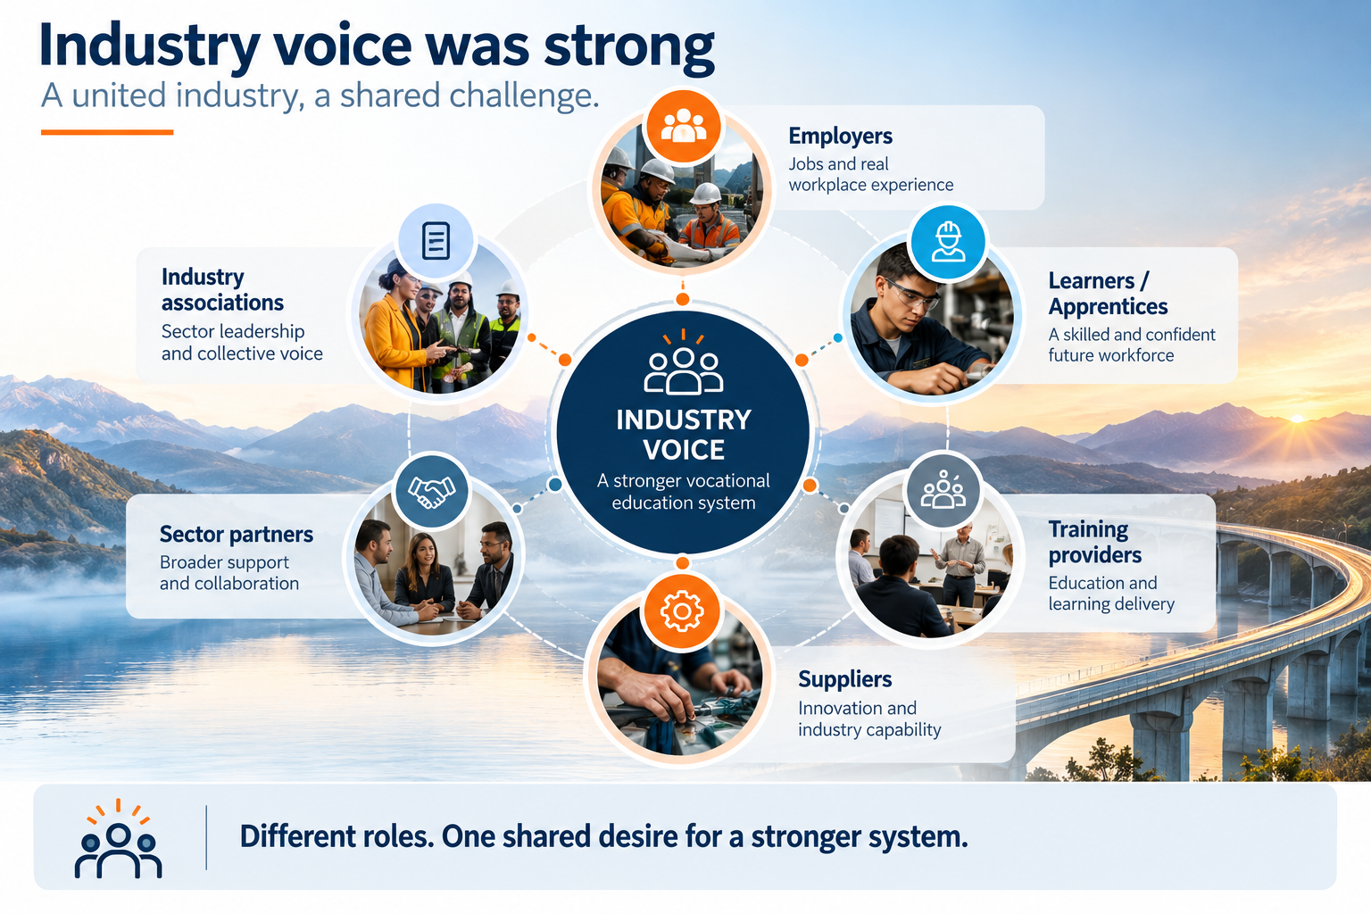

Slide 7
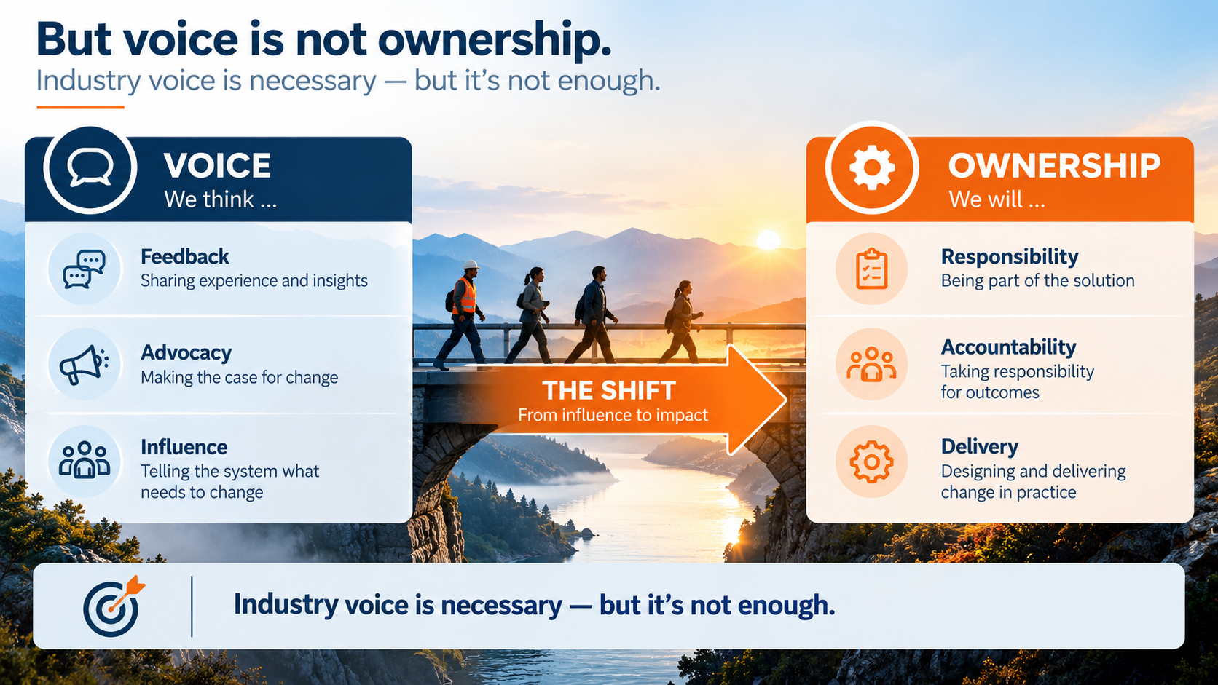

Slide 8
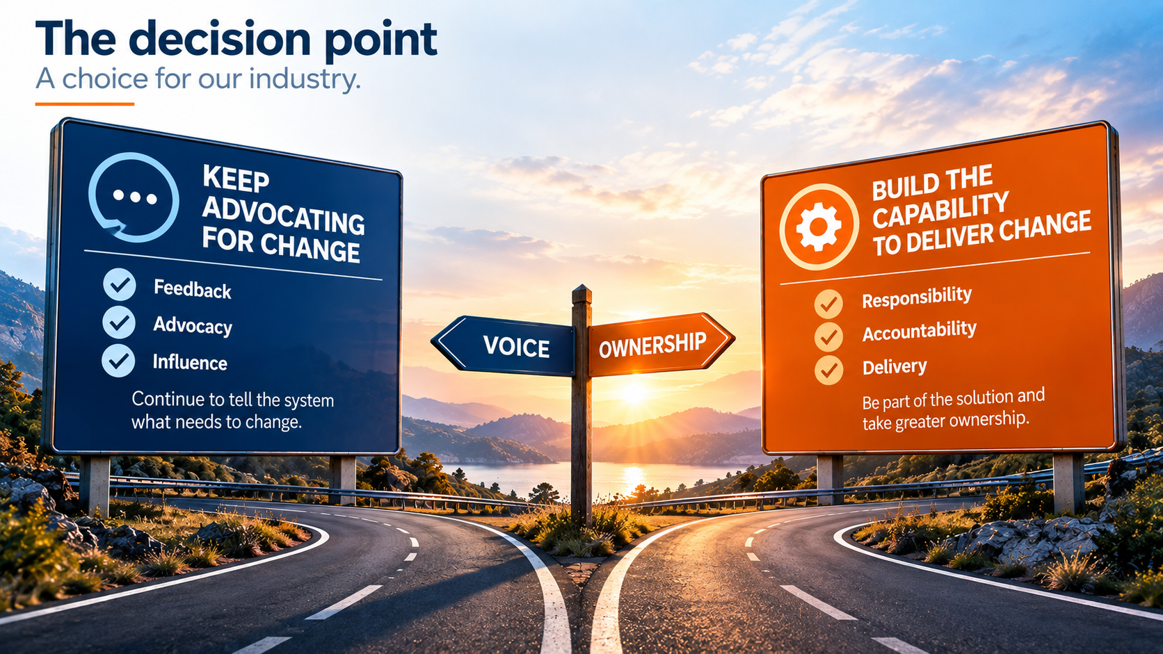

Slide 9

Question
What changes when industry moves from influencing training to actually being responsible for delivering it?
Think about accountability, learners, quality, capability and risk.
Discuss at your tables

Slide 10
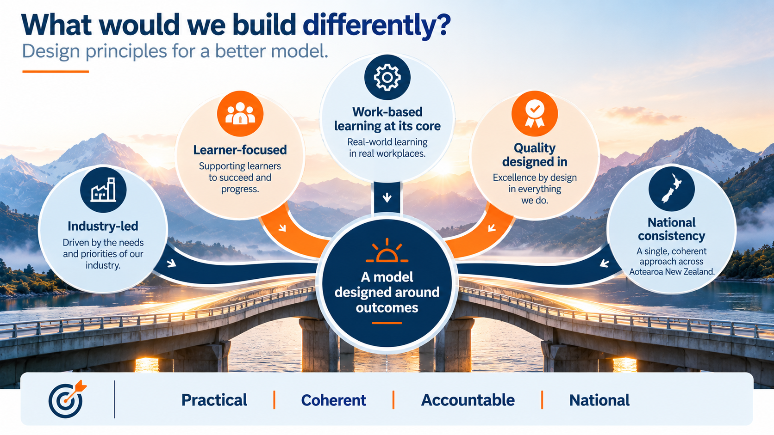

Slide 11
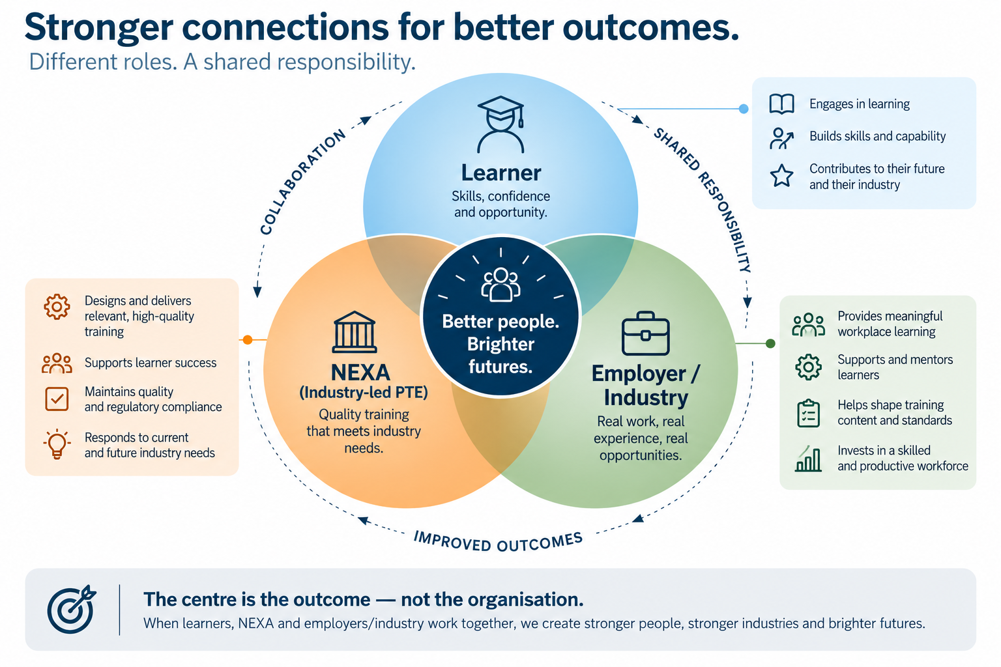
Notes:
The relationship model matters

Slide 12
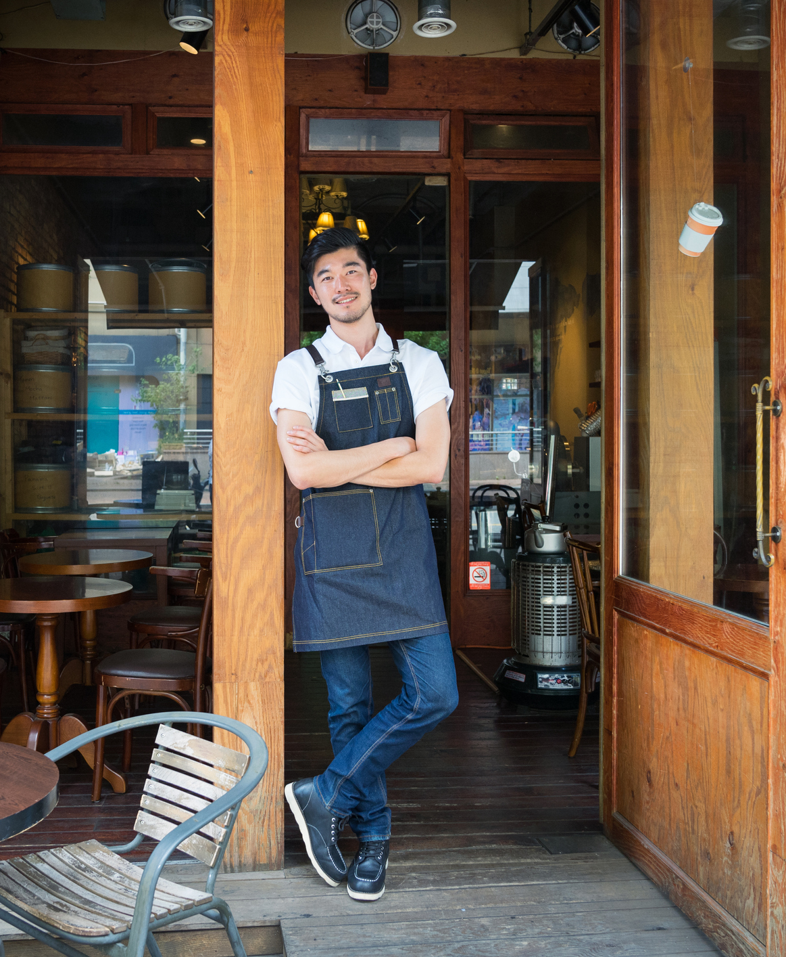
Question
Who actually owns the learner outcome?
Discuss at your tables

Slide 13
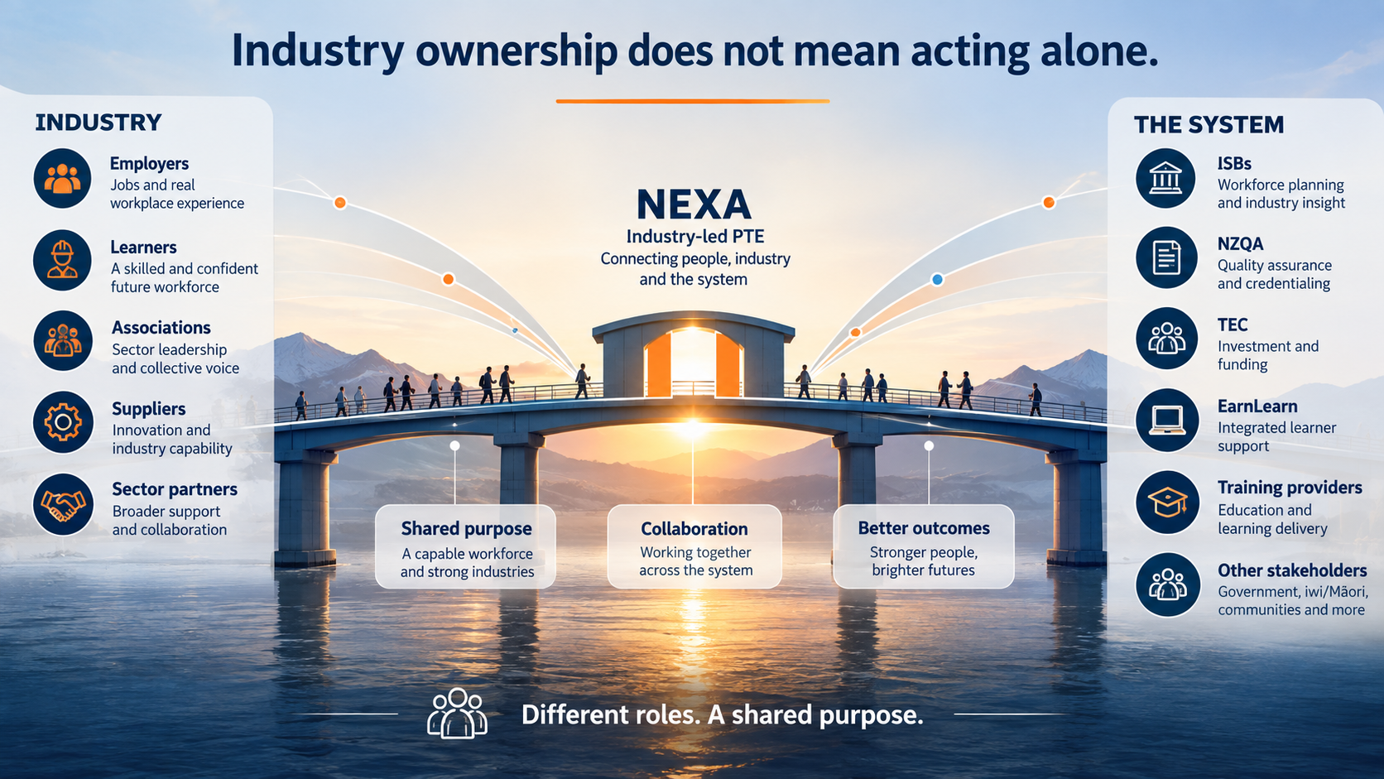

Slide 14

You are now in our shoes
The scenario:
Strong industry support for change.
A proposed new industry-led provider.
Regulatory approval takes time.
Funding approval follows a different process.
Learners cannot be put at risk.
Employers need certainty.
The incumbent provider must continue operating.
Multiple organisations hold different pieces of the transition.
What would you prioritise?
Notes:
Follow up question: Which of those priorities would you be prepared to compromise?

Slide 15
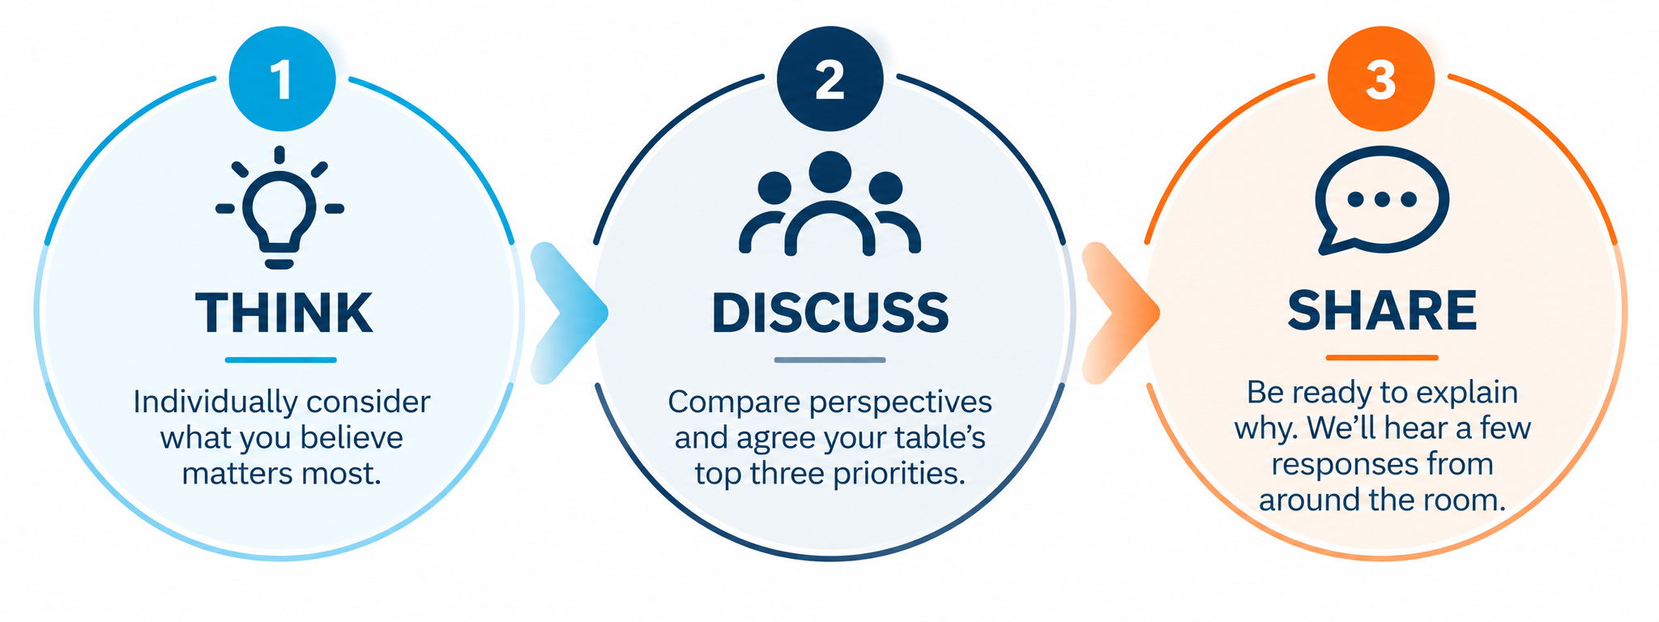
Table discussion: What are your top three priorities
3–4 minutes

Slide 16
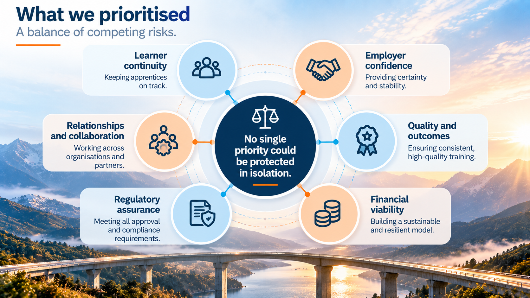
Notes:
Which of those priorities would you have been prepared to compromise?

Slide 17
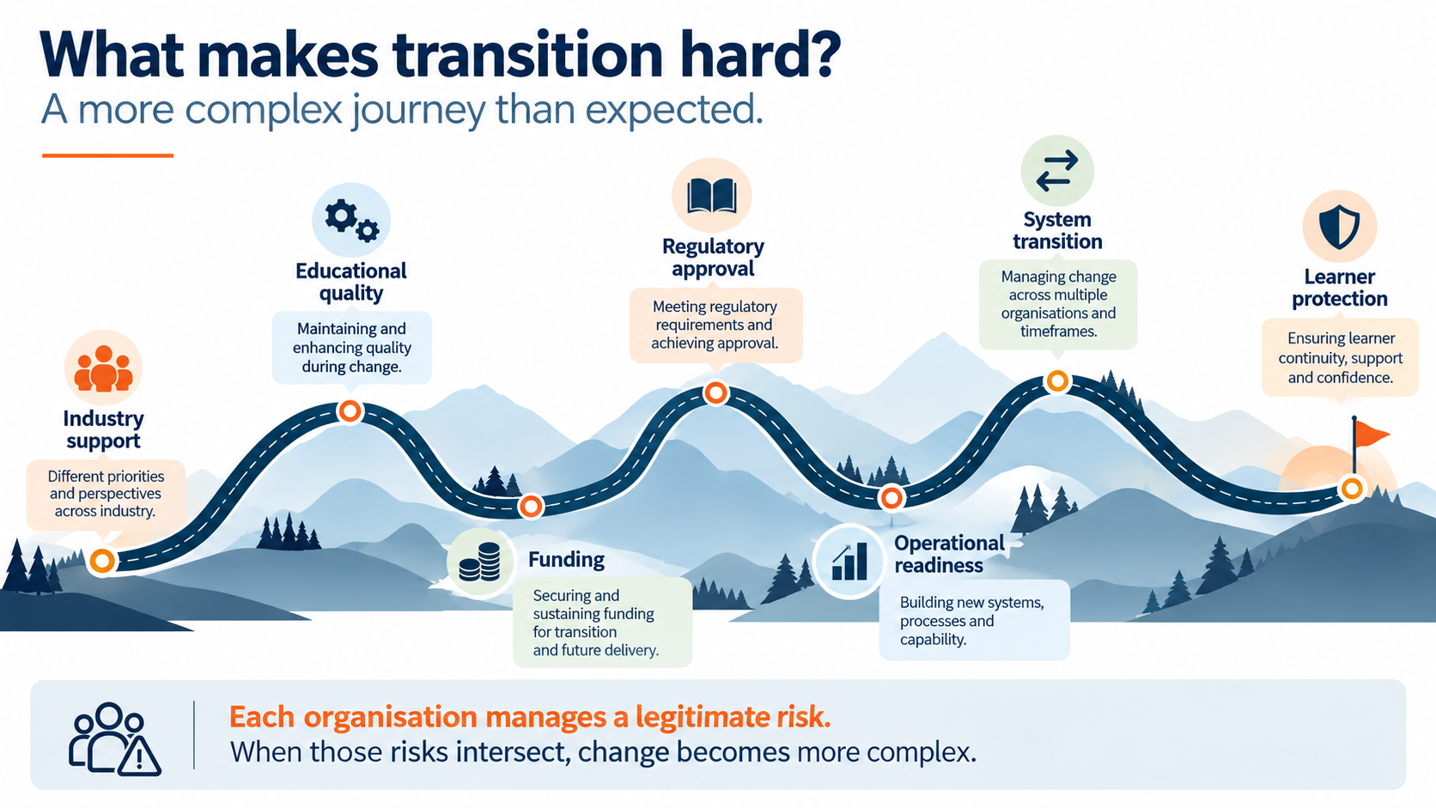

Slide 18
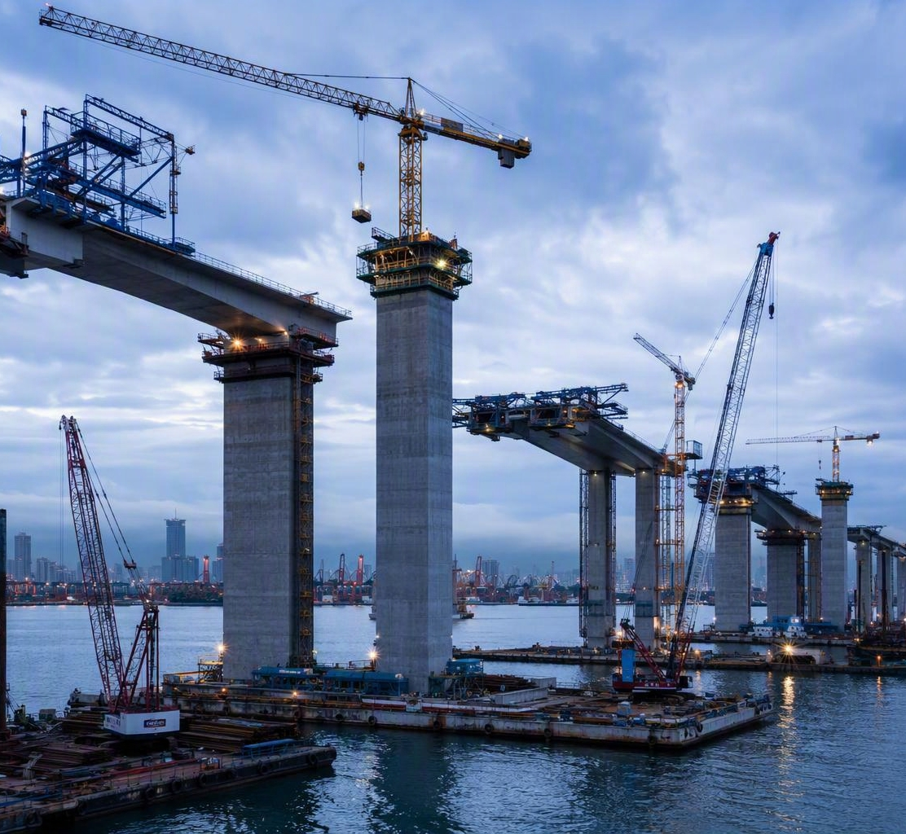
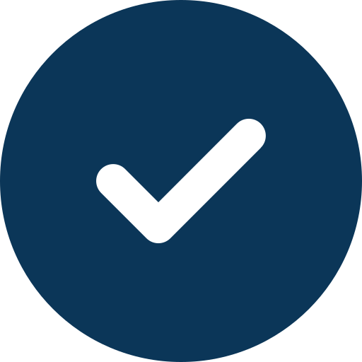
When change takes longer than expected
Keeping people with us on the journey.
Maintain confidence
Communicate clearly
Sustain collaboration
Keep the learner at the centre
“The destination is clear —
but the timing keeps moving.”
Confidence is sustained through clarity, continuity and visible progress.
Notes:
A delayed destination does not necessarily mean an absence of progress.

Slide 19

Lesson 1: Leadership means responsibility
Industry leadership is more than influence.
Includes accountability for quality
Shares accountability for learner outcomes
Builds capability and sustainability
A stronger voice brings a greater responsibility.

Slide 20

Lesson 2: Start with the problem
Don’t build an organisation for its own sake.
Start with the workforce and industry need.
Design the solution to solve the problem.
Be open to what form that solution takes.
It’s about better outcomes, not just a new organisation.

Slide 21

Lesson 3: Partnership is harder than consultation
True partnership requires more than agreement.
Consultation seeks views.
Partnership aligns responsibilities, risks and decisions.
It takes time, trust and a shared commitment through complexity.
Move from conversation to collaboration.

Slide 22

Lesson 4: Protect learners while redesigning
The learner cannot become collateral damage.
Maintain continuity of learning.
Support learner confidence through transition.
Keep the learner at the center of every decision.
Real people. Real futures.

Slide 23

Lesson 5: Ownership still requires bridges
Industry-led does not mean industry-alone.
Strengthen connections with those who educate, regulate, employ and learn.
Bridges create a more responsive vocational education system.
We are stronger when we work together.
Different roles. A stronger system.

Slide 24
Final question to the room
“If industry wants a stronger voice in vocational education, what responsibility should it be prepared to accept in return?"

Slide 25


Industry ownership is harder
than advocacy — but it may be
far more powerful.
Industry voice
Industry ownership
Through partnership
Stronger people. Stronger industries. Brighter futures.

Slide 26
Thank you
Let’s keep building the bridges.

