Slide 1
Being a regulator when the world is moving
Emily Fabling, DCE Quality Assurance
Stacey Rees, Manager Monitoring & Risk

Slide 2


Slide 3

Our job is to keep a New Zealand qualification worth trusting
DIFFERENT ROLES | DIFFERENT RESPONSIBILITIES
SHARED INTEREST IN A TRUSTED SYSTEM

Slide 4
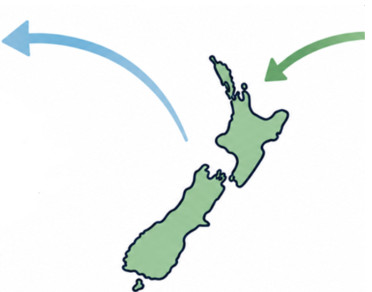







People and qualifications are crossing borders in record numbers
60,800
Citizens of other countries arrived in the year to March 2026
36,500
New Zealand citizens left for overseas in the year to March 2026.
India
China
Philippines
Sri Lanka
Mostly to Australia
International student numbers to grow from 83,000 to 119,000 in 2024 by 2034 | Sector value to double to $7.2 billion by 2034 | Australia has capped new international enrolments | The United States has tightened student visas

Slide 5


Slide 6
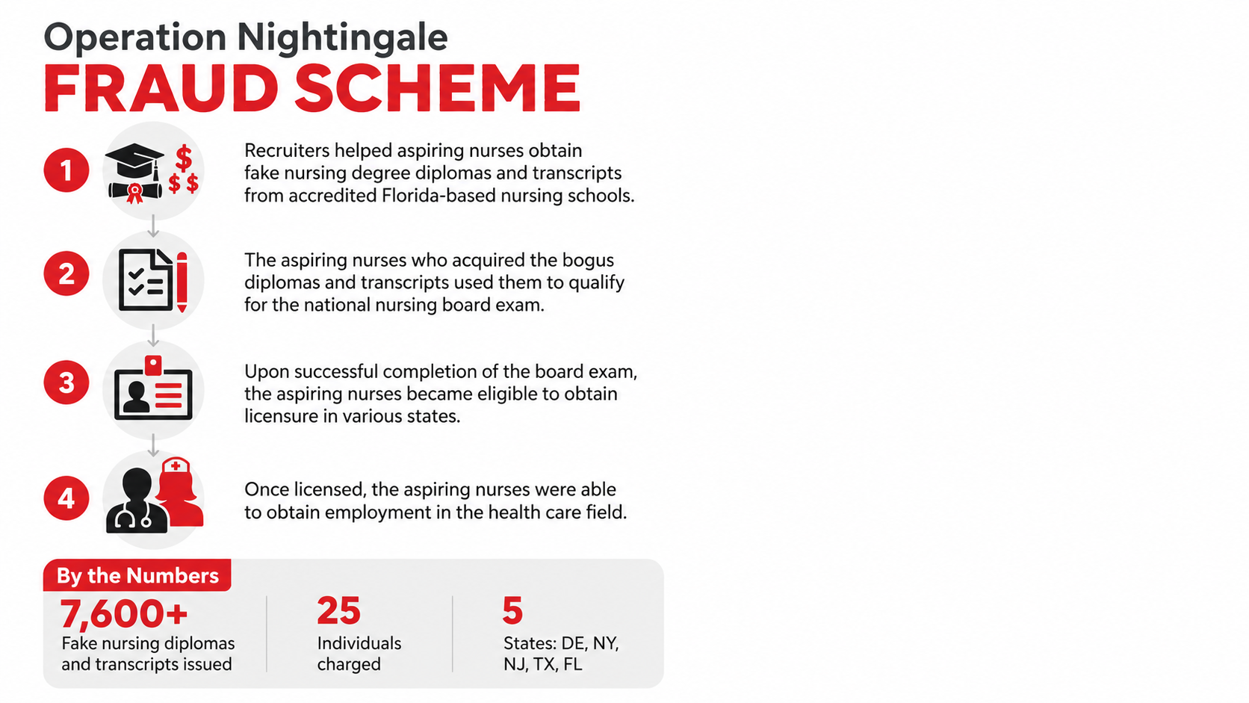

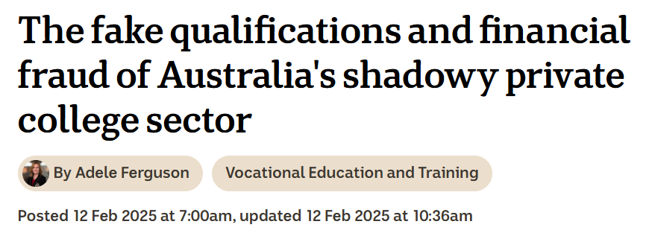

Slide 7


Slide 8


NZQA is exploring how Artificial Intelligence (AI) can help us deliver better, faster, and more consistent public and regulatory services - always with a strong focus on ethical and responsible use.
Some of the tools we’re already using or testing are:
An AI-powered website chatbot
Document recognition to speed up International Qualifications Assessments, approvals and accreditation
Automated text scoring, successfully used to mark more than 55,000 school writing assessments in 2025, quality assured by human check-marking
Notes:
[Sources]
Content provided by user.

Slide 9
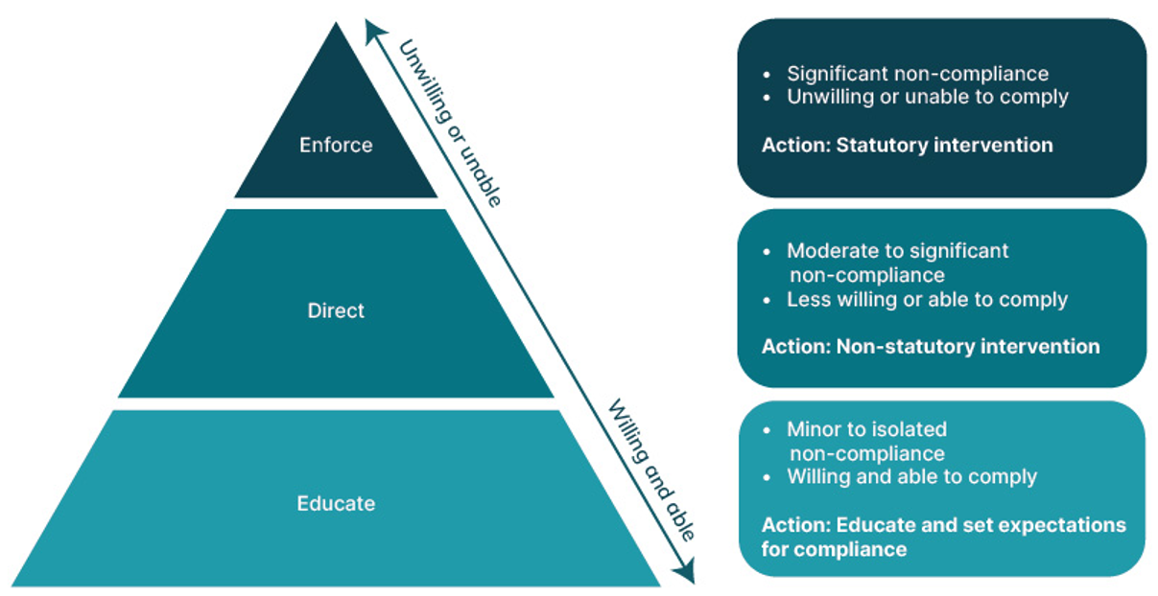
Our Regulatory Framework
There are three tiers for managing TEO non-compliance: Educate, Direct, and Enforce
We want regulation to be applied at the right time and with the right touch.
Our actions will address the nature and severity of the issue
The extent of our interventions will depend on the severity of the issue, whether it is repeated or a one-off, and the willingness and ability of the TEO to comply.
We expect that our proactive risk-informed practices and monitoring will identify most issues in a timely way and interventions will come mainly under the Educate and Direct tiers.
The risk-informed approach at TEO and system level - NZQA

Slide 10
Risk-informed regulation: putting regulatory attention where the risk of harm is greatest, responding in a way that is proportionate to that risk.
How can risk inform our approach to QA?
Identify areas of concern proactively
Identify system-level patterns and trends
Maximise the impact of our limited resources
Design targeted sector guidance to uplift TEO capability
At the TEO level
At the system level
Make better approval decisions
Risk
Adapt our Rules to respond to emerging risks
Educate
Direct
Enforce

Slide 11
The NZQA Risk Framework
Identify
Assess
Verify
Intervene
indicators of risk and corresponding data sources
risk indicators across all TEOs
if issues exist
to manage issues in a fair and proportionate way
iQAF reflects our regulatory principles of being impact-led, anticipatory and adaptable.
replaces the EQAF that was initially based on two processes - entry controls, and external evaluation and review (every 4 years)​
risk-informed monitoring of providers to confirm they do not breach acceptable standards, and
ensuring providers have their own processes to assess and improve performance for their learners

Slide 12


Slide 13
Kia ora
Thank you
www.nzqa.govt.nz

