Slide 1


The Skills Dividend
NEW ZEALAND VOCATIONAL EDUCATION AND TRAINING RESEARCH FORUM 2026
How training can drive New Zealand’s economic growth
Katherine Rich
Chief Executive, BusinessNZ

Slide 2
Skills: a game changer for our economy
EXECUTIVE SUMMARY
1
Skills are our biggest untapped productivity lever
The OECD estimates matching skills to jobs at best practice is worth around 7% in productivity.
2
Employers want the system to work, but a third are not convinced
45.4% say graduates meet their skill needs. 32.7% say they do not.
3
Shift the focus from qualifications to skills
Employers need to trust that a certificate means competence on the job.
4
Business is investing, and needs the skills to match
1,752 businesses have used the R&D Tax Incentive. Mechatronics shows the training gap.
5
Global training and employment trends are here
Global war for talent
Sources: OECD ECO WP 1403 (2017); Election Survey 2026, Q4.3; Motu for MBIE (2025); Ministry of Education (Aug 2026).

Slide 3
THE PRODUCTIVITY COST OF DECLINING SKILLS
Falling foundations, a $32bn productivity opportunity
School achievement has weakened over two decades and measured adult skills have dropped. The OECD estimates better matching of skills to jobs could lift New Zealand productivity by around 7%.
NEW ZEALAND: THE LONG DECLINE
THE ECONOMIC PRIZE
PISA scores: early-cycle peak to 2025
7%
potential productivity gain
Reading
529
→
497
−32 pts
from matching New Zealand skills to jobs at OECD best practice
Mathematics
523
→
480
−43 pts
≈ $32bn
Science
532
→
509
−23 pts
annual output equivalent
Adult skills: 2014 to 2023*
7% × NZ$456.8bn nominal GDP, year ended June 2026
Literacy
281 → 260
−21 pts
Numeracy
271 → 256
−15 pts
28% of NZ workers are skills-mismatched
*PIAAC comparison requires caution because New Zealand’s 2023 response rate was much lower than in 2014.
OECD estimate. The $32bn figure is an illustrative translation into current annual output, not a forecast.
Sources: Ministry of Education, PISA 2025 NZ summary; OECD Survey of Adult Skills 2023; OECD Skills mismatch, productivity and policies; RBNZ GDP M5.
BusinessNZ
›

Slide 4
THE LONG VIEW
Skills shortages have persisted through the economic cycle
The pressure peaked after COVID, then eased as migration recovered and demand softened. But access to skills remains employers’ leading employment issue.
73% net
30%
post-COVID peak
still hard to recruit
2018
QSBO: skilled labour becoming harder to find
BusinessNZ: hard or very hard to recruit skilled staff
Dec 2021
Mar 2023
Sep 2025
Sep 2026
71%
90%
37.1%
expect a shortage
struggling to fill roles
the No.1 issue
EMA members: “there is, or soon will be, a skill shortage”
EMA; 71% lacked technical skills
access to skills and talent
THE SHIFT
Acute labour scarcity eased, but structural skills gaps remained
QSBO skilled-labour difficulty fell to 38% net by Jun 2023, from 73% at the Dec 2021 peak.
In 2026, 69.3% said shortages constrained productivity or technology adoption to some degree.
Sources: EMA Employers Survey 2018; NZIER QSBO (Dec 2021 and Jun 2023); EMA Skills Shortage Survey 2023; BusinessNZ Business Sentiment Survey 2025; Deloitte–Chapman Tripp Election Survey conducted by BusinessNZ, 2026.

Slide 5
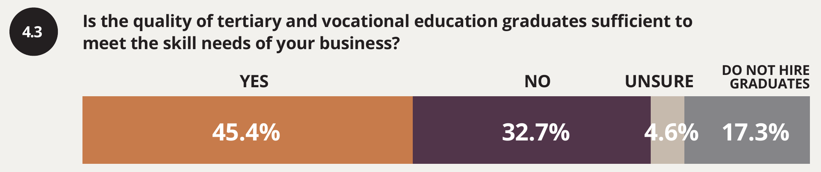
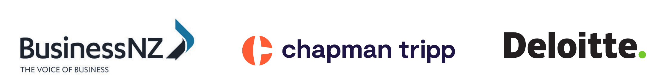
One in three employers says graduates are not meeting their skill needs
WHAT EMPLOYERS ARE TELLING US
32.7%
of employers say tertiary and vocational graduates do not meet their skill needs
A third of employers to win over
45.4% say graduates do meet their needs: the base to build on. A further 17.3% do not hire graduates at all.
Source: The Deloitte and Chapman Tripp Election Survey, conducted by BusinessNZ, Sept 2026, Q4.3 (p.40)

Slide 6
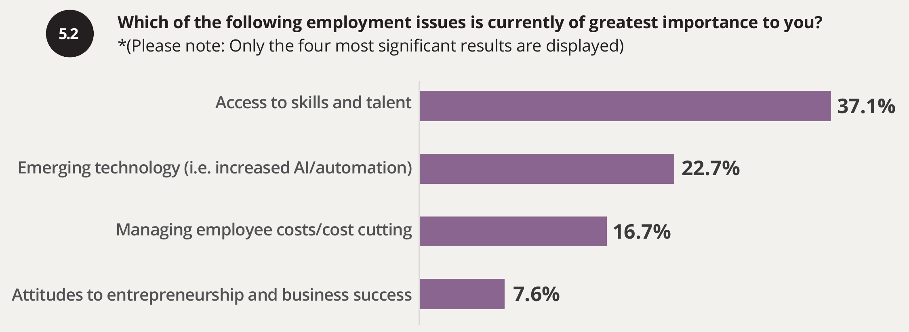
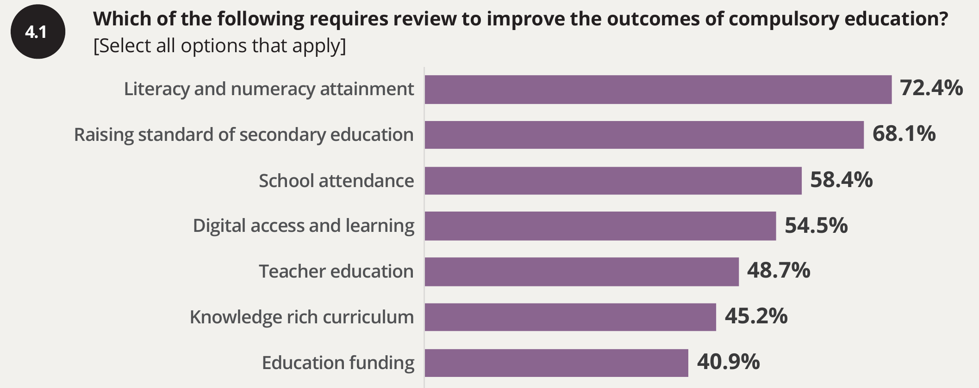
Access to skills is employers' number one employment issue
WHAT EMPLOYERS ARE TELLING US
37.1%
name access to skills and talent as their most important employment issue, ahead of technology and costs
72.4%
want literacy and numeracy attainment reviewed, the top education priority
Source: The Deloitte and Chapman Tripp Election Survey, conducted by BusinessNZ, Sept 2026, Q5.2 (p.42) and Q4.1 (p.38)

Slide 7





A certificate must mean competence
FROM QUALIFICATIONS TO SKILLS
Counting qualifications
Skills employers can trust
Built on real competencies for real jobs
Proven in the workplace
Results everyone can see
Raising the standards and the aspirations
Co-designed with industry, so qualifications map to the work people actually do.
Assessment that shows a learner can do the job, with real workplace experience.
Outcome data by qualification, so employers can see what a certificate delivers.
Vocational education provides a pipeline of skills and the next generation of business owners.
Source: BusinessNZ Election Priorities 2026, Education and Skills, pp.12 to 13

Slide 8
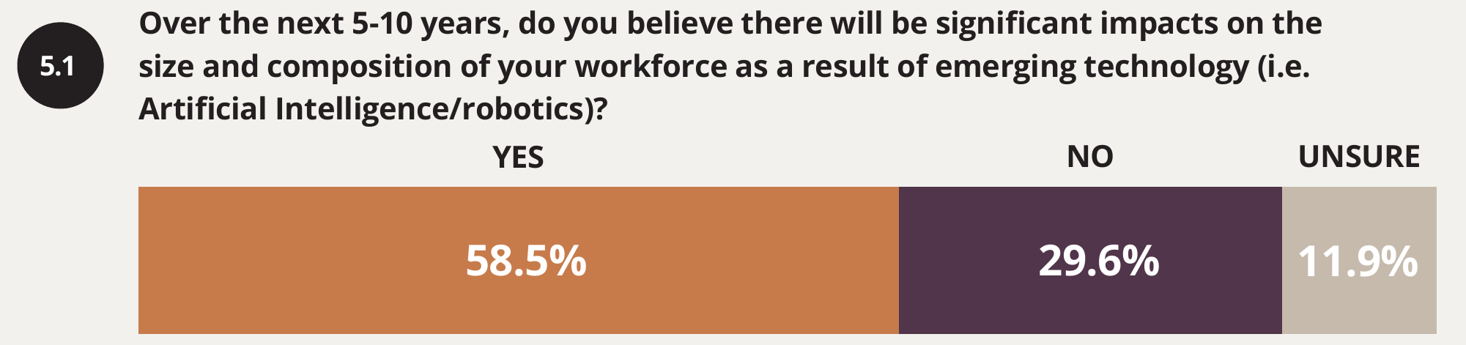
Most employers expect AI to reshape their workforce
BUSINESS IS INVESTING
1,752
businesses have used the R&D Tax Incentive to invest in research and development. Supported firms lifted their capital investment too.
23%
Every new machine needs someone who can run it and fix it
rank emerging technology as their most important employment issue, second only to access to skills
Sources: The Deloitte and Chapman Tripp Election Survey, conducted by BusinessNZ, Sept 2026, Q5.1 and Q5.2 (pp.41 to 42); Motu for MBIE (2025)

Slide 9
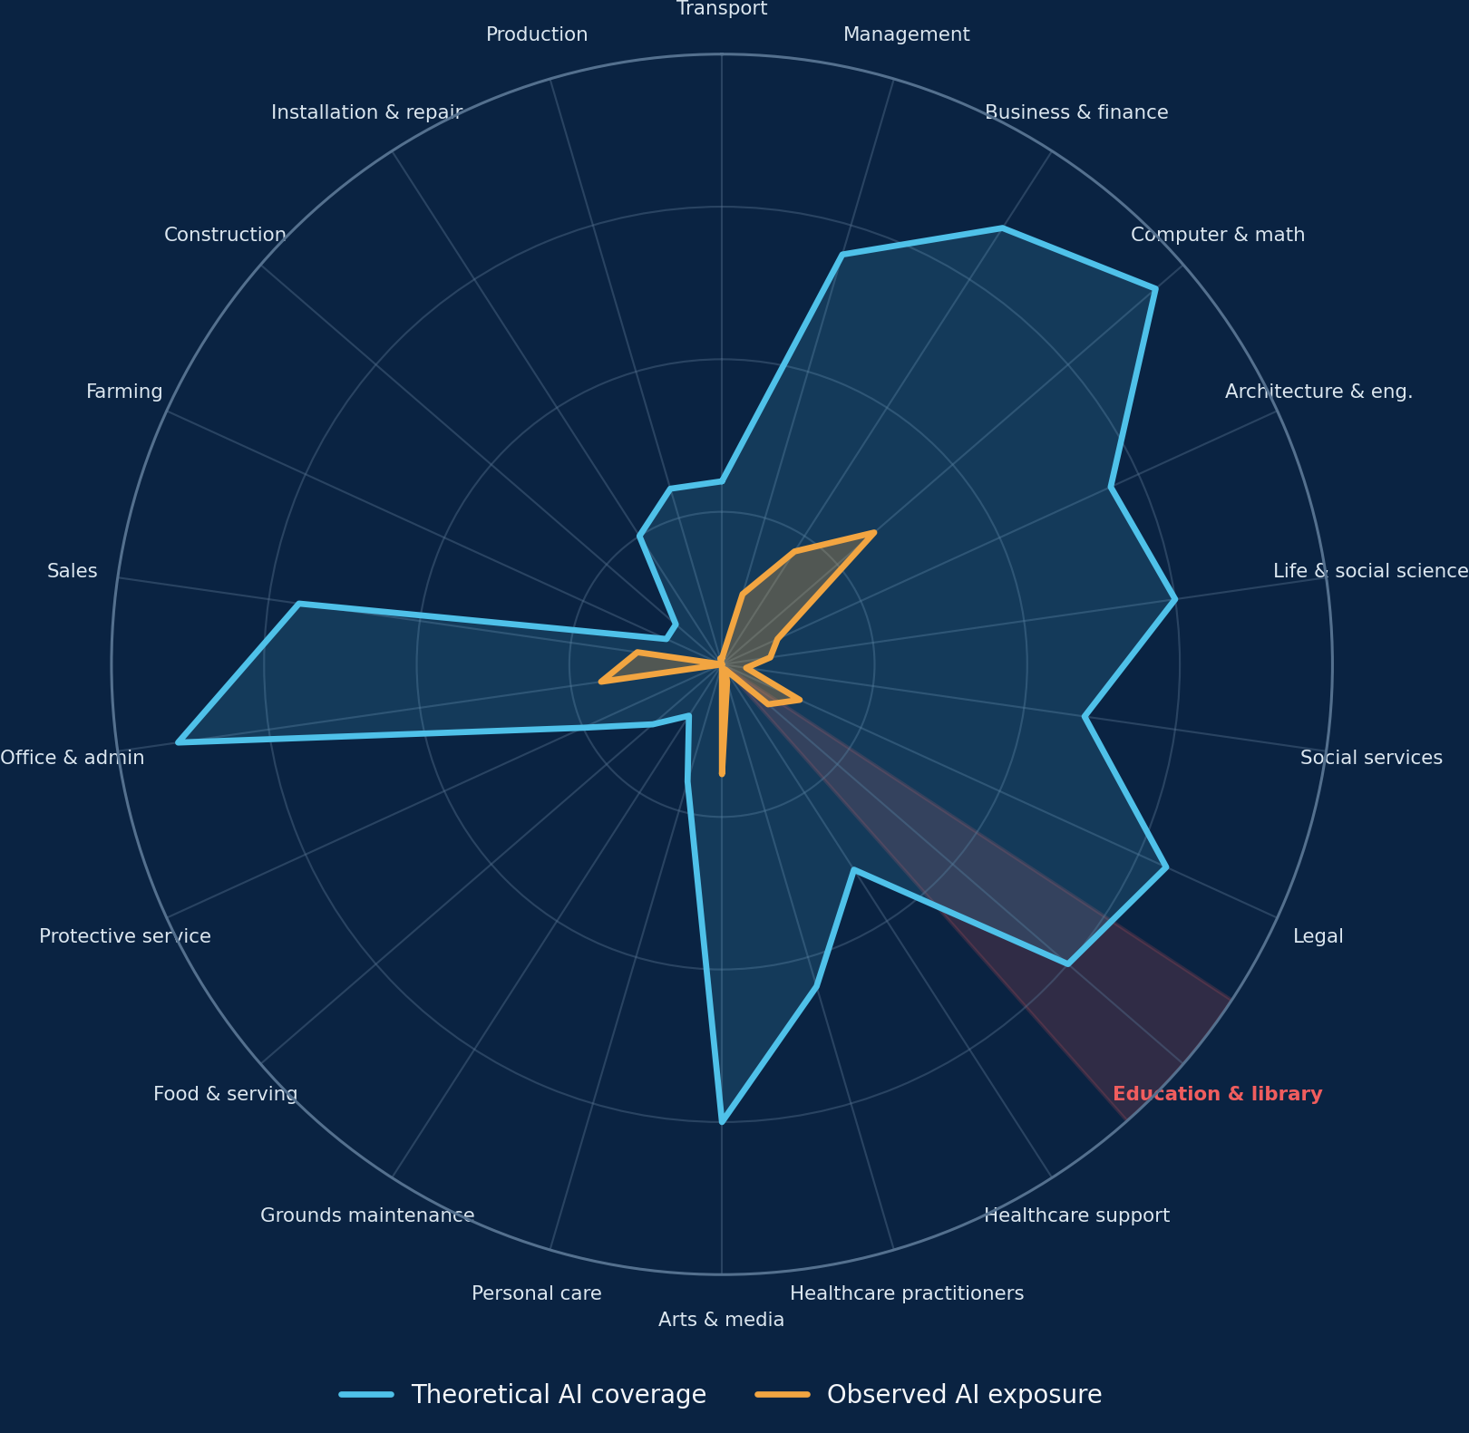
AI AND THE FUTURE OF WORK
AI is powerful, uneven, and only getting started
Current use is a fraction of what models can already do. The gap between capability and adoption is the opportunity, and the workforce challenge.
THE GAP IS THE STORY
94%
of computer and maths tasks are theoretically within LLM capability
33%
are covered in Anthropic’s observed professional usage measure today
“The companies or the countries that diffuse [AI] fastest are going to be the ultimate winners, not the technology creator.”
Satya Nadella, Microsoft CEO, World Economic Forum, January 2026
What it means for skills
• Education is exposed too: the red sector highlights teaching and library tasks.
• Exposure is concentrated in knowledge work, not spread evenly across the economy.
• Experienced users are more successful, consistent with learning-by-doing.
• Competitiveness will depend on diffusion, skills and organisational redesign, not model access alone.
Source: Anthropic, Labor market impacts of AI (5 Mar 2026); Economic Index: Learning curves (24 Mar 2026). Radar values are visually digitised and approximate except 94% and 33%. Quote: Satya Nadella at WEF 2026.
BusinessNZ
›

Slide 10


Our peers have trained mechatronics technicians on the job for decades. New Zealand has yet to start
CASE STUDY: MECHATRONICS
1997
1998
2010
2017
2026
Switzerland
Germany
United States
Australia
New Zealand
Automatiker apprenticeship, 4 years
Mechatroniker, a state-recognised 3.5 year apprenticeship
Toyota technician earn-and-learn, now FAME
Industry 4.0 higher apprenticeship pilot
Degree only. No apprenticeship or technician diploma
28 years
behind Germany at trade level. The new subjects and Skills Boards give us the means to close the gap fast.
Sources: BIBB (DE); berufsberatung.ch (CH, to verify); Toyota; Ai Group, Swinburne; NZQA quals 2612, 2714

Slide 11

Global trends are arriving in New Zealand
GLOBAL SKILLS TRENDS
GLOBAL TREND
ARRIVING IN NEW ZEALAND
Skills are changing faster than systems
37.1%
of NZ employers name access to skills as their top employment issue
Employers expect 39% of workers' core skills to change by 2030, and 63% say skills gaps are their biggest barrier to transformation (WEF).
New skills earn a premium
64%
of medium-sized NZ businesses already use AI
1 in 10 job ads in advanced economies asks for a new skill. Ads asking for four or more pay up to 15% more (IMF).
Skills are becoming the currency of work
1 in 3
NZ employers say graduates do not meet their skill needs
Employers are moving to skills-first hiring, shared skills languages and recognition of skills learned outside formal study (OECD, SkillLab).
Sources: WEF Future of Jobs 2025; IMF SDN/2026/001; OECD; SkillLab; MYOB Business Monitor (Aug 2026); Election Survey 2026

Slide 12




New Zealand businesses are responding
HOW BUSINESS IS RESPONDING
Seeking policy certainty
Managing financial pressure
Relying on immigration
Stepping back from the system
"Higher costs, skills shortages, global uncertainty and an accumulation of regulation have all tested confidence."
≈26%
1 in 4
−24%
rise in prices over five years. Business input costs rose 4.1% in the last year alone, led by fuel and power. Budgets are tightening across the board.
employers are not confident they can get the skills they need under current immigration settings. We import skills we don't train, and compete with the world for them.
fall in new apprentices starting training in 2025. Total workplace-based learners fell 12%.
Intervention, geopolitical instability and disruption chill investment.
Sources: BusinessNZ Election Priorities 2026, p.2; Stats NZ CPI, June 2021 to June 2026 (BusinessNZ calculation), and Business Price Indexes, June 2026 qtr; Election Survey 2026, Q4.2; Education Counts, workplace-based learners 2025

Slide 13






Building the skills bridge
OPPORTUNITIES FOR INDUSTRY AND EDUCATION
Clear school pathways
Stronger foundations
Speed to market
New secondary subjects need clear routes into jobs, apprenticeships and further training.
Use the curriculum to build knowledge and technical ability to a higher standard.
Get new training products to market quickly as industry and technology change.
Measure what matters
Benchmark to the best
Fund outcomes, not inputs
Link training to employment and economic outcomes, with faster feedback between industry and education.
Set industry standards to what our top-performing companies need.
Balanced regulation and compliance to drive efficiency. No new training levies.
Let's build the skills that lift New Zealand's growth and living standards, together, starting now
OUR CALL TO ACTION
Sources: BusinessNZ Election Priorities 2026, Education and Skills, pp.12 to 13; BusinessNZ proposals for discussion
Notes:
S

