Slide 1

Construction & training
VETRF
Wellington
12 October 2026
Shamubeel Eaqub, CFA
Chief Economist
shamubeel.eaqub@simplicity.kiwi

Slide 2
Disclaimer
This is Simplicity Research Hub’s independent expert commentary and thought leadership on economic trends and policies of interest to all New Zealanders.
This content is our opinions and is provided for general information only. It does not relate to your particular financial situation or goals and is not financial advice or recommendations.
Any external resources provided are accessed at your own risk and the Simplicity Research Hub takes no responsibility for third party content and does not approve, recommend, or endorse any external websites or the content they contain.
Simplicity NZ Limited is the issuer of the Simplicity KiwiSaver and Investment Funds schemes, for Product Disclosure Statements please visit our website simplicity.kiwi. For more information on our Responsible Investment approach please visit simplicity.kiwi/about-us/ethical-investments.

Slide 3
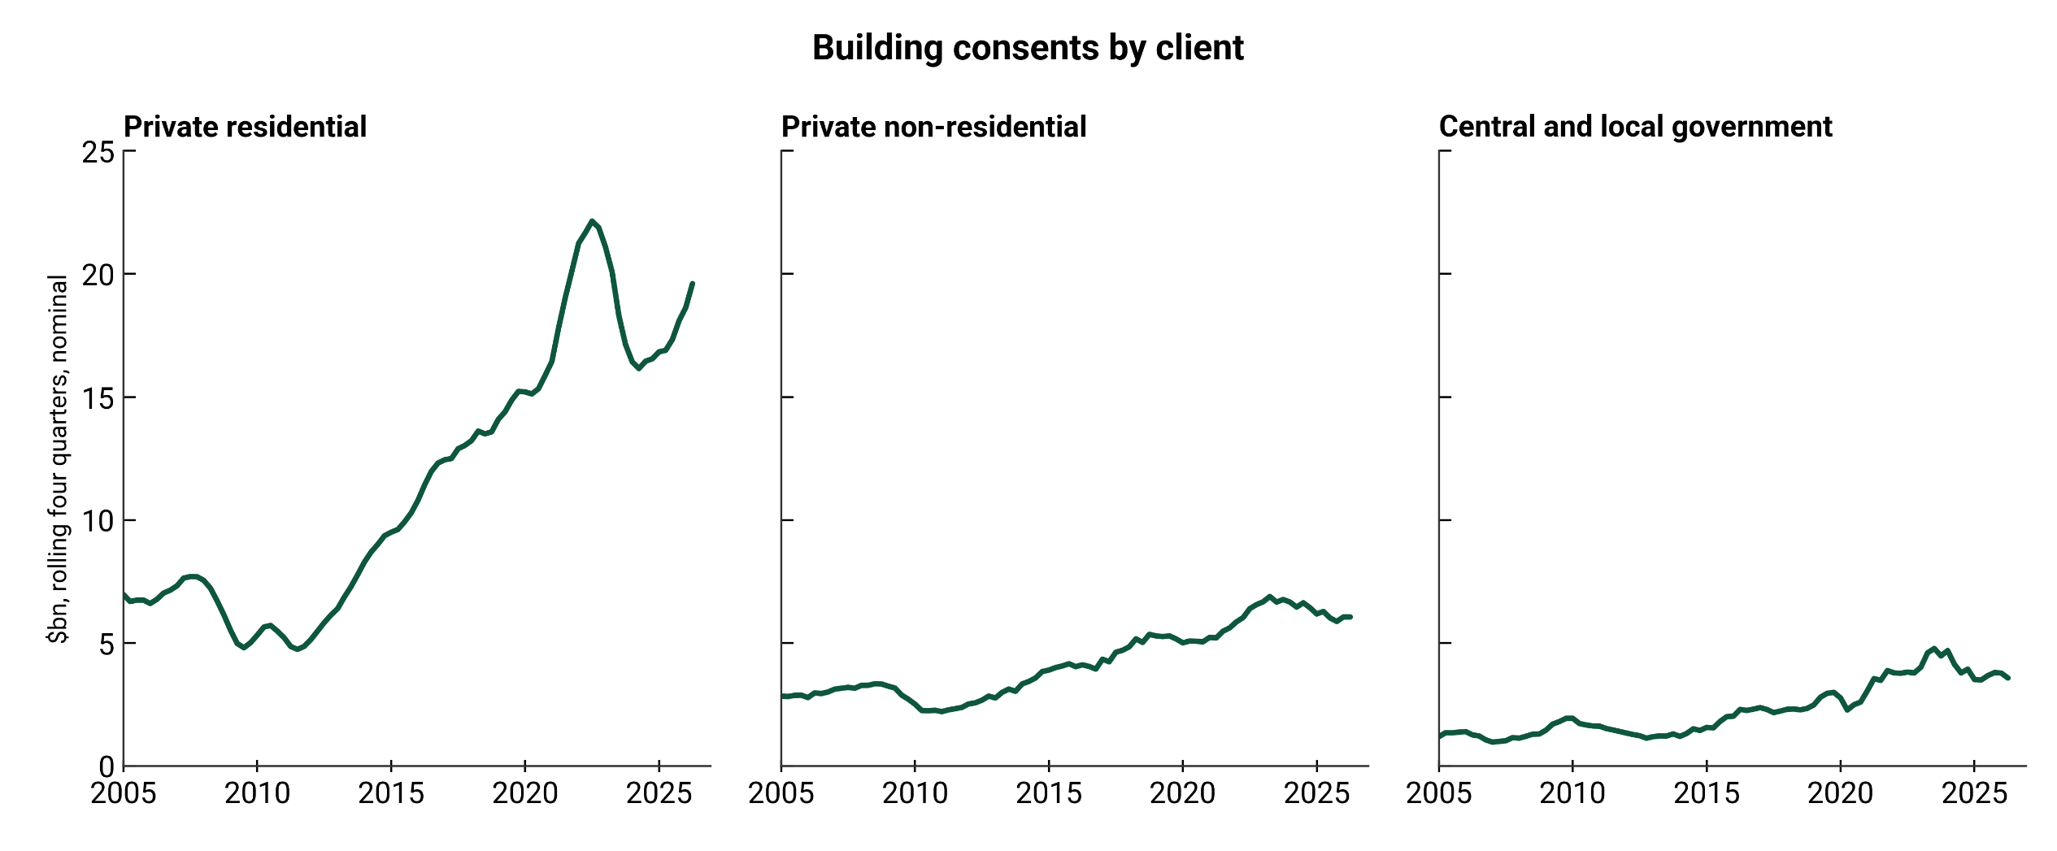
Cycles turn
Source: Statistics NZ, Simplicity Research Hub

Slide 4
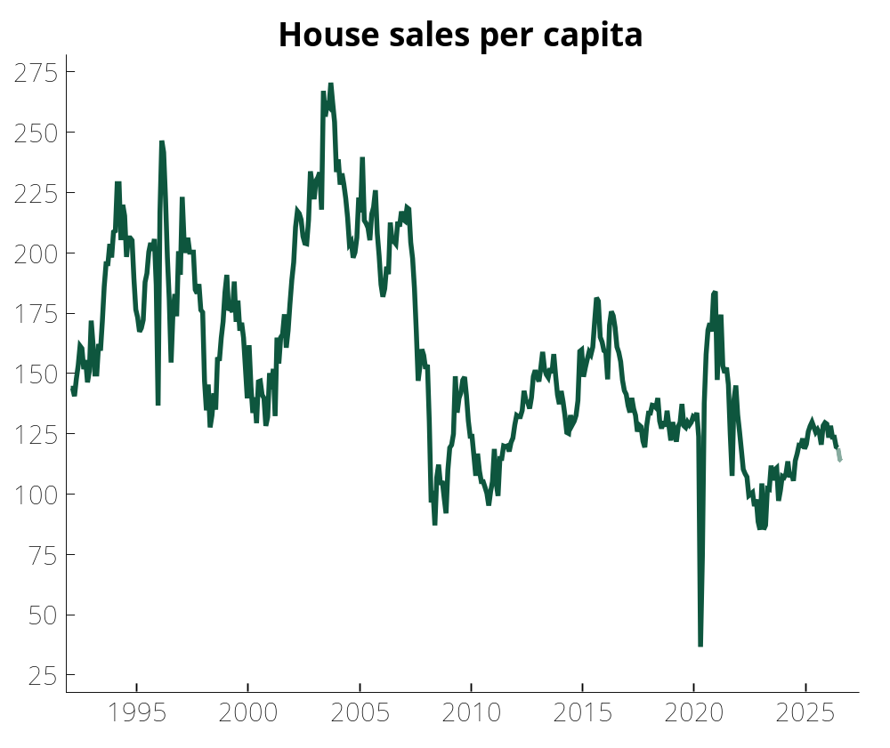
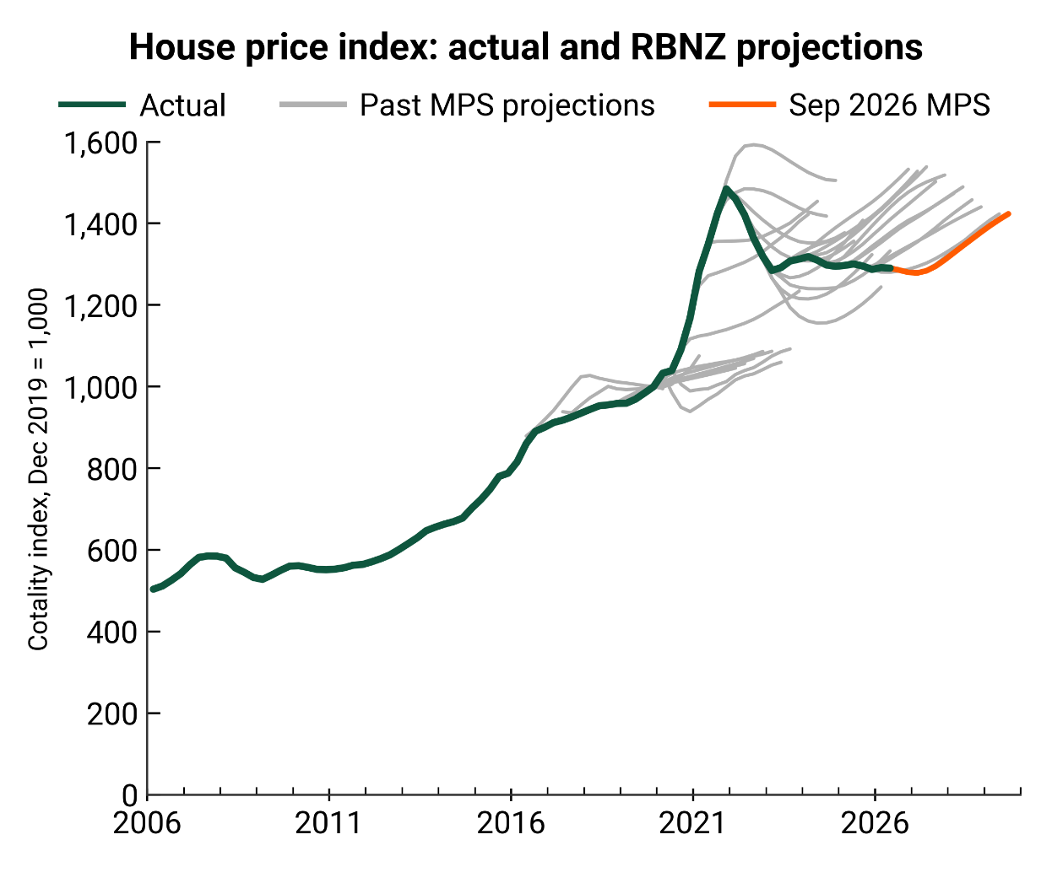
But a sluggish market
Source: REINZ, Simplicity Research Hub
Source: REINZ, Simplicity Research Hub

Slide 5
Not enough homes
Source: Statistics NZ, Simplicity Research Hub

Slide 6
Infrastructure deficit
Source: Statistics NZ, NZ Treasury, Simplicity Research Hub
Source: DIA, Statistics NZ, Simplicity Research Hub

Slide 7
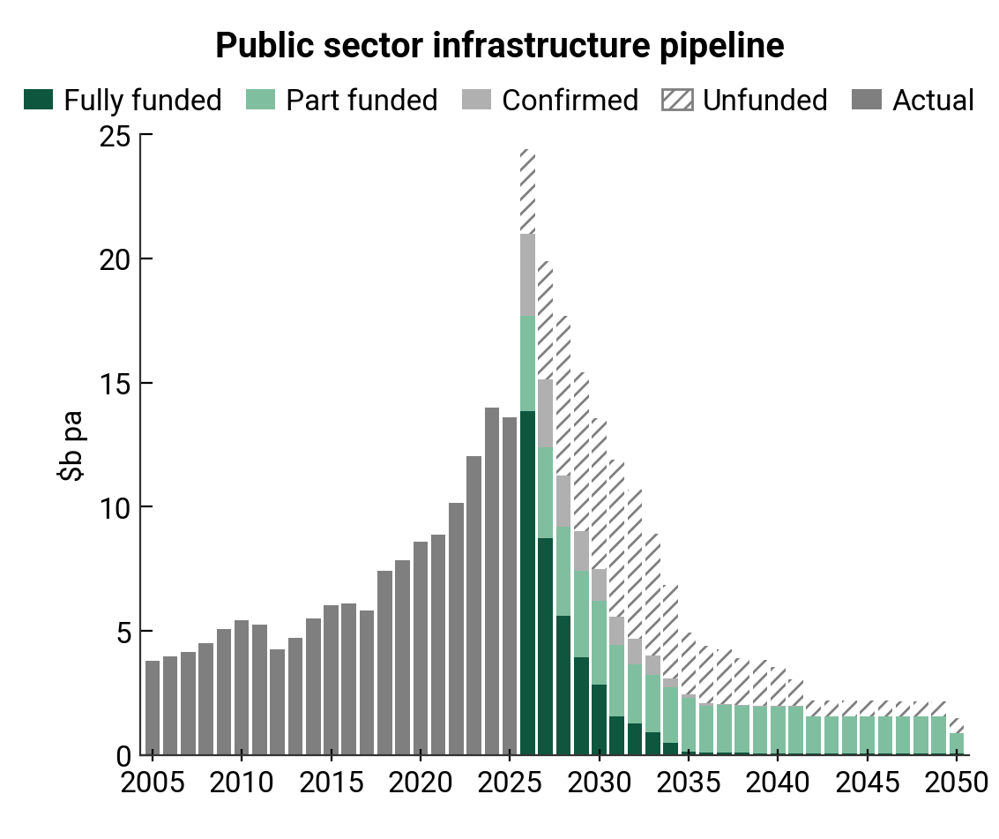
Planned vs funded
Source: Statistics NZ, Infrastructure Commission
Source: DIA, Simplicity Research Hub

Slide 8
Stop-start
Source: Statistics NZ, Simplicity Research Hub
Source: Eaqub (2026) “The Cost of Stopping”

Slide 9
Productivity = (wages + profit) / inputs
Source: Statistics NZ, Simplicity Research Hub

Slide 10
Business language of productivity
Outcomes | Profits |  | Wages
Inputs | Capital | Labour |  | Interaction
Causes |  |  |  |  | Lever
What’s available? | Endowments Technology | Demographics Immigration Job market |  | Credentials/ Qualifications | External
Do I have it? | Funding Financing | Pay Career progression Flexibility Job satisfaction |  | Attributes Training Learning by doing
Can I use it? | Leadership Management Culture |  |  |  | Internal

Slide 11
We recruit but don’t retain
Source: Statistics NZ, Simplicity Research Hub
Source: Statistics NZ, Simplicity Research Hub

Slide 12
Hiring & training
Source: ConCOVE Tūhura , Simplicity Research Hub
Source: ConCOVE Tūhura , Simplicity Research Hub

Slide 13
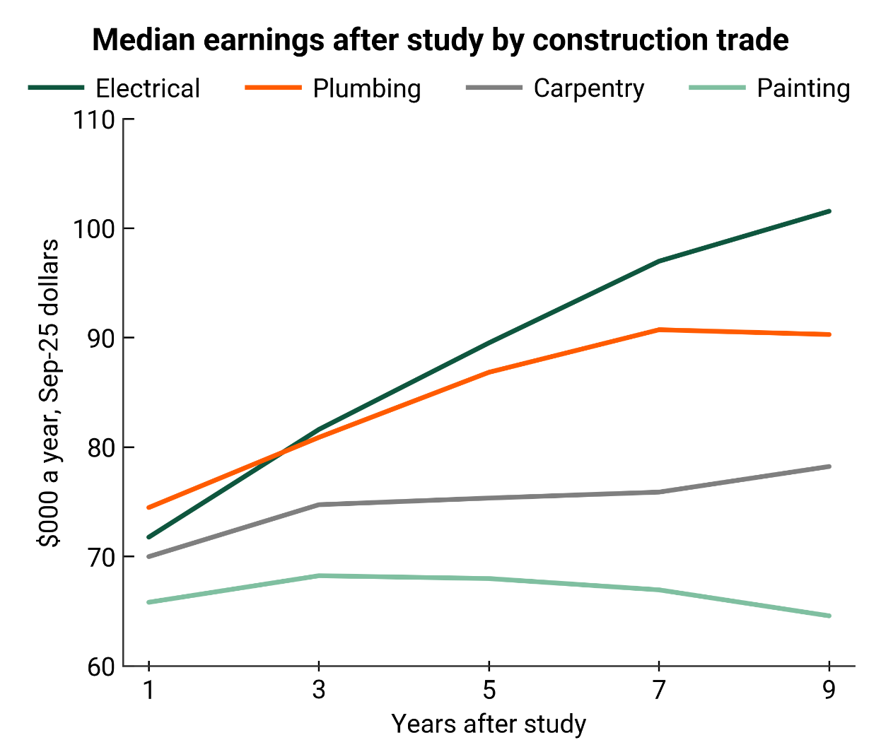
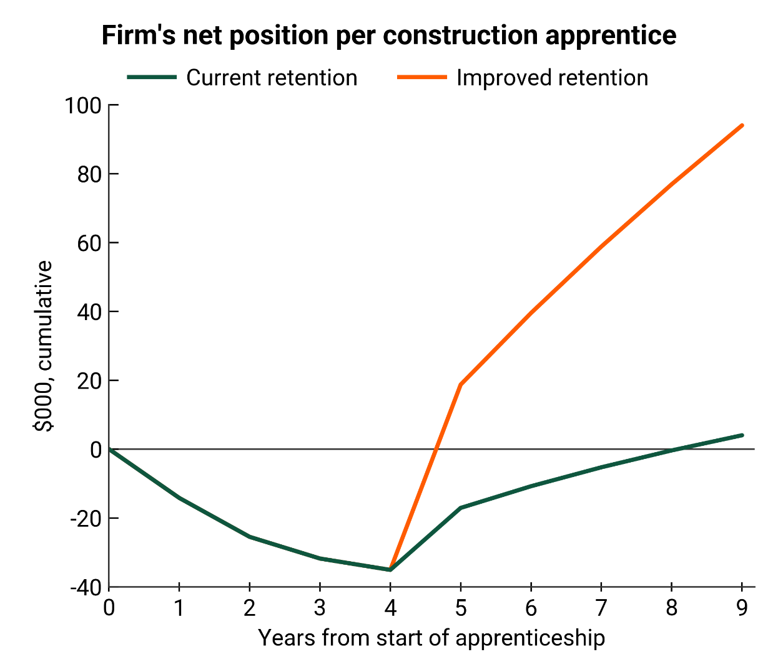
Dividend for whom
Source: TEC, Simplicity Research Hub
Source: NZCBIA (2026), Simplicity Research Hub

Slide 14
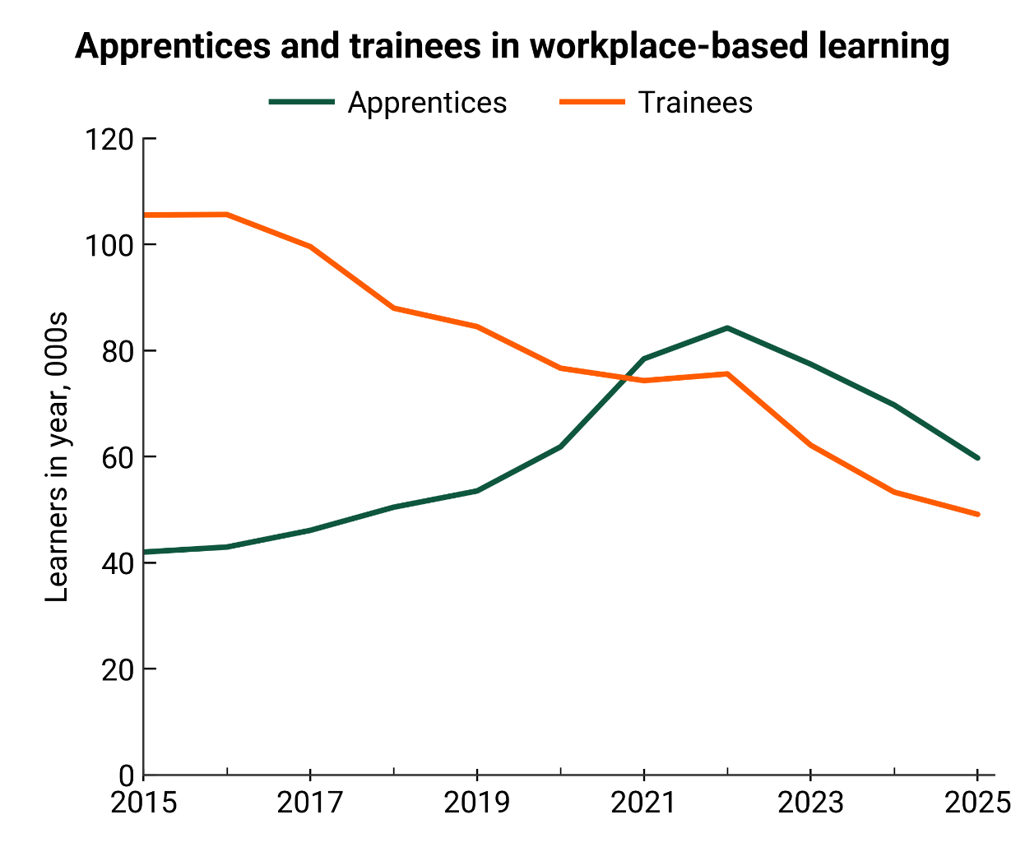
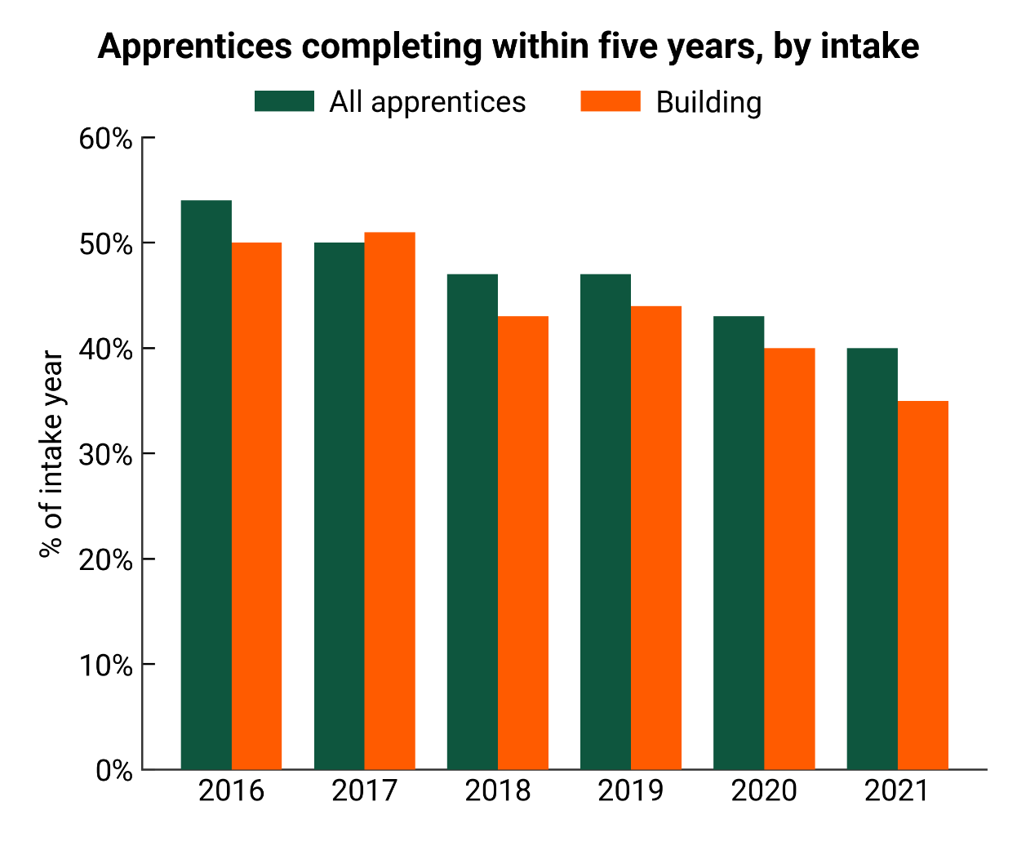
Entries vs completions
Source: Education Counts, Simplicity Research Hub
Source: Education Counts, Simplicity Research Hub

Slide 15
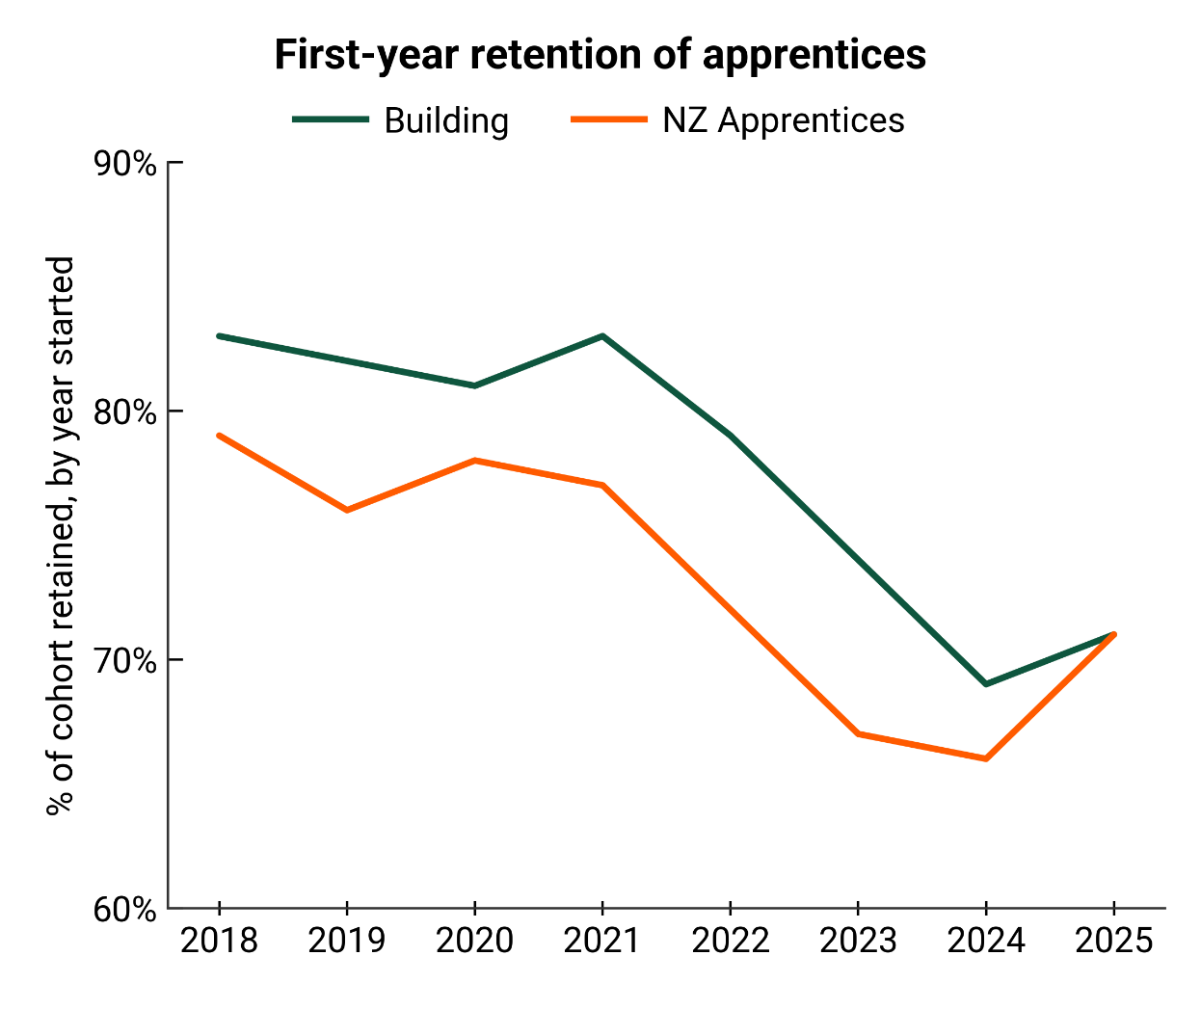
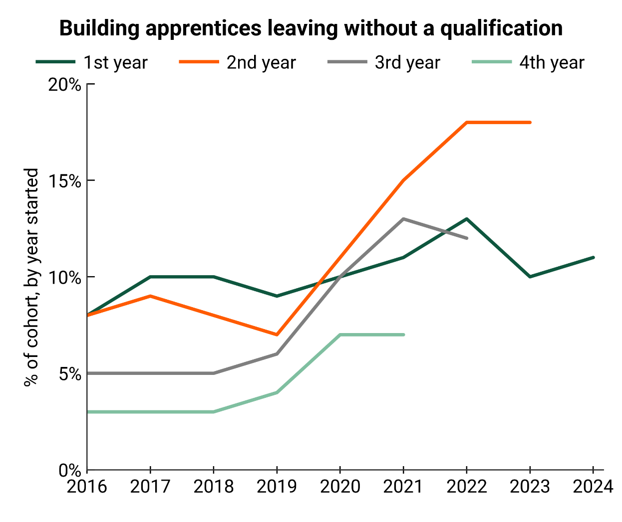
Retention & execution
Source: Education Counts, Simplicity Research Hub
Source: Education Counts, Simplicity Research Hub

Slide 16
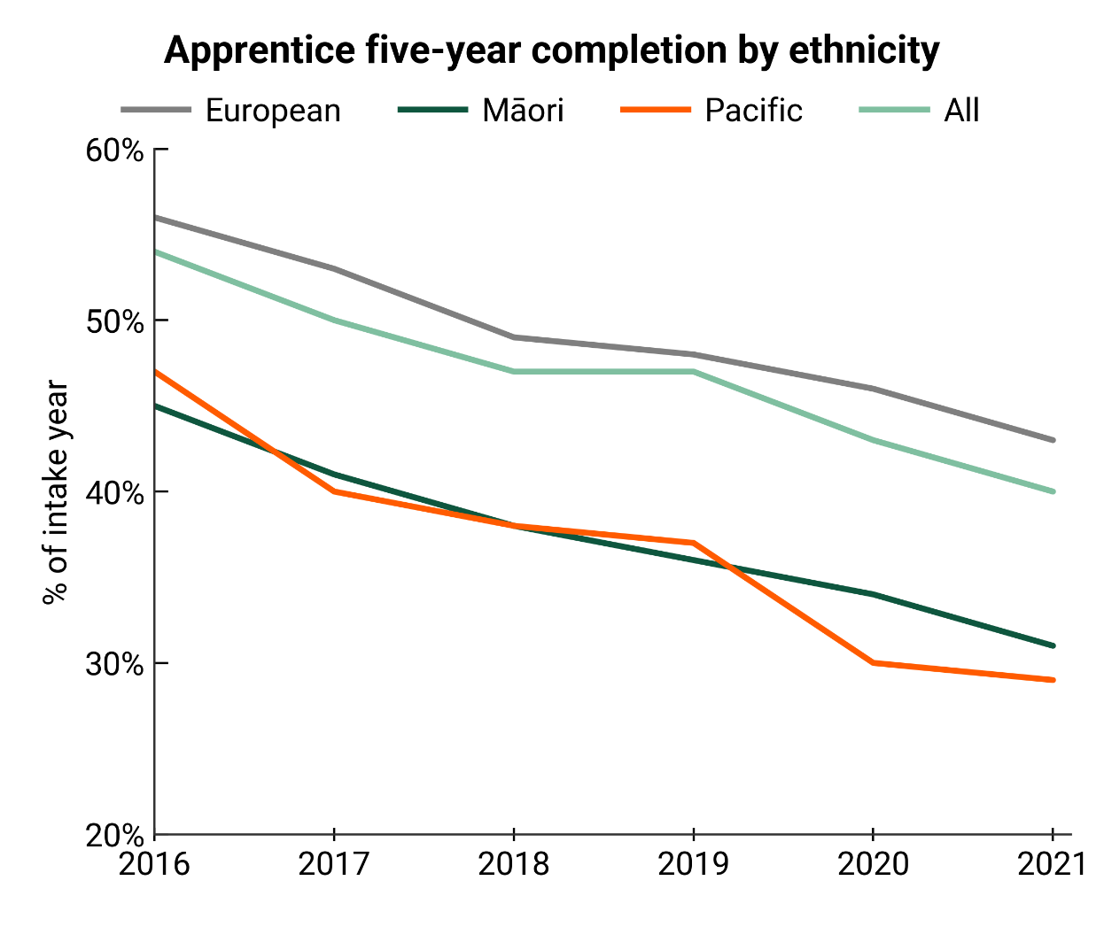
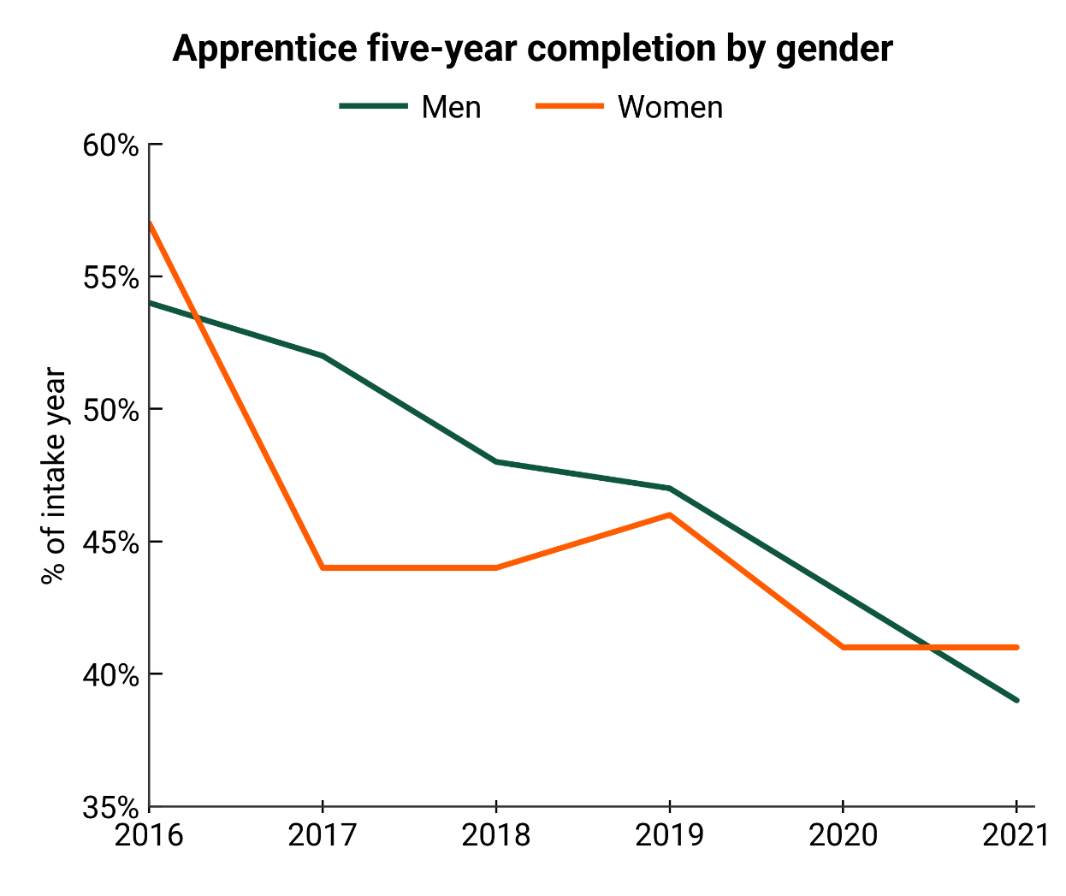
A broader issue
Source: Education Counts, Simplicity Research Hub
Source: Education Counts, Simplicity Research Hub

Slide 17
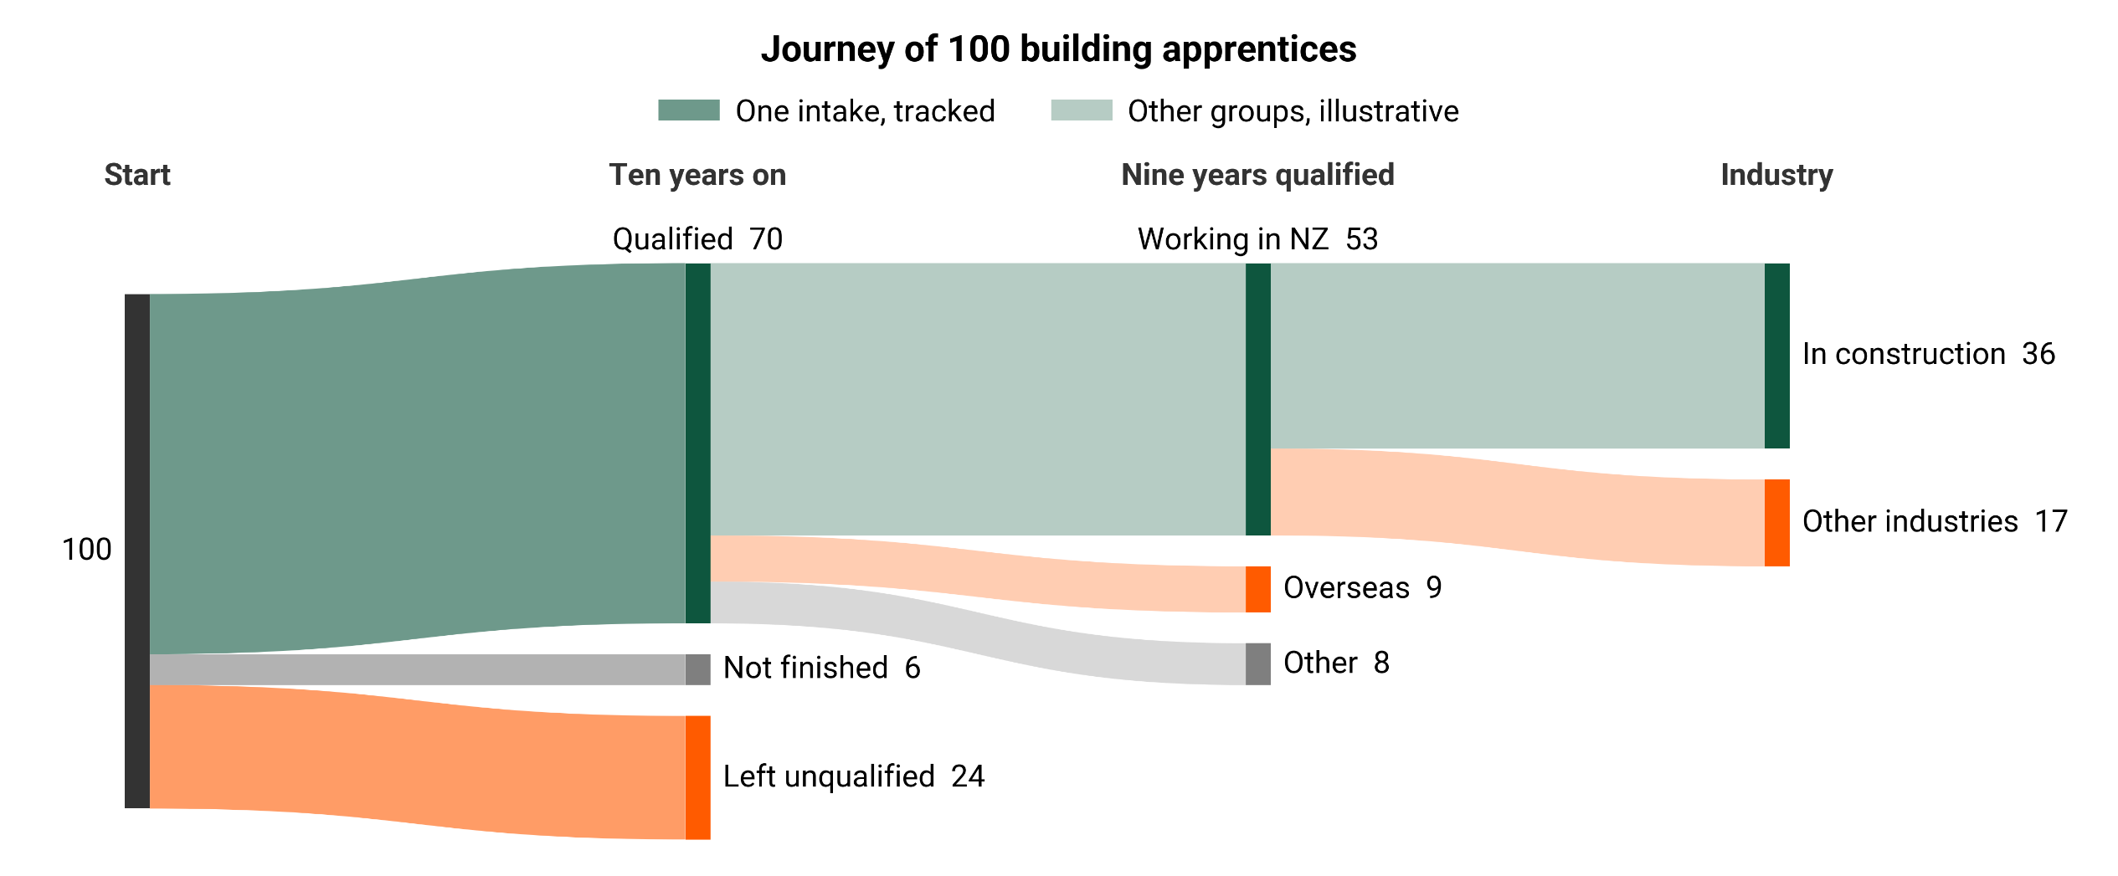
When we train, where do they end up?
Source: Education Counts, Statistics NZ, Simplicity Research Hub

Slide 18
Some ideas
Leadership
Stable funding envelope…
Culture
Invest in your people
Informal + formal training
Invest in you
Management
Broader settings
…for learning (not just qualifications)…
Recruit for attributes, not just qualifications and experience
Retention is critical
…skills (appropriate, useful and up to date)…
…delivered right (fit for purpose).
18

Slide 19


www.simplicity.kiwi

