Slide 1

Giving Effect to Te Tiriti
Institutes of Technology & Polytechnics
Dr Robin Tairāwhiti Fabish
Pouārahi | Executive Director Māori

Slide 2
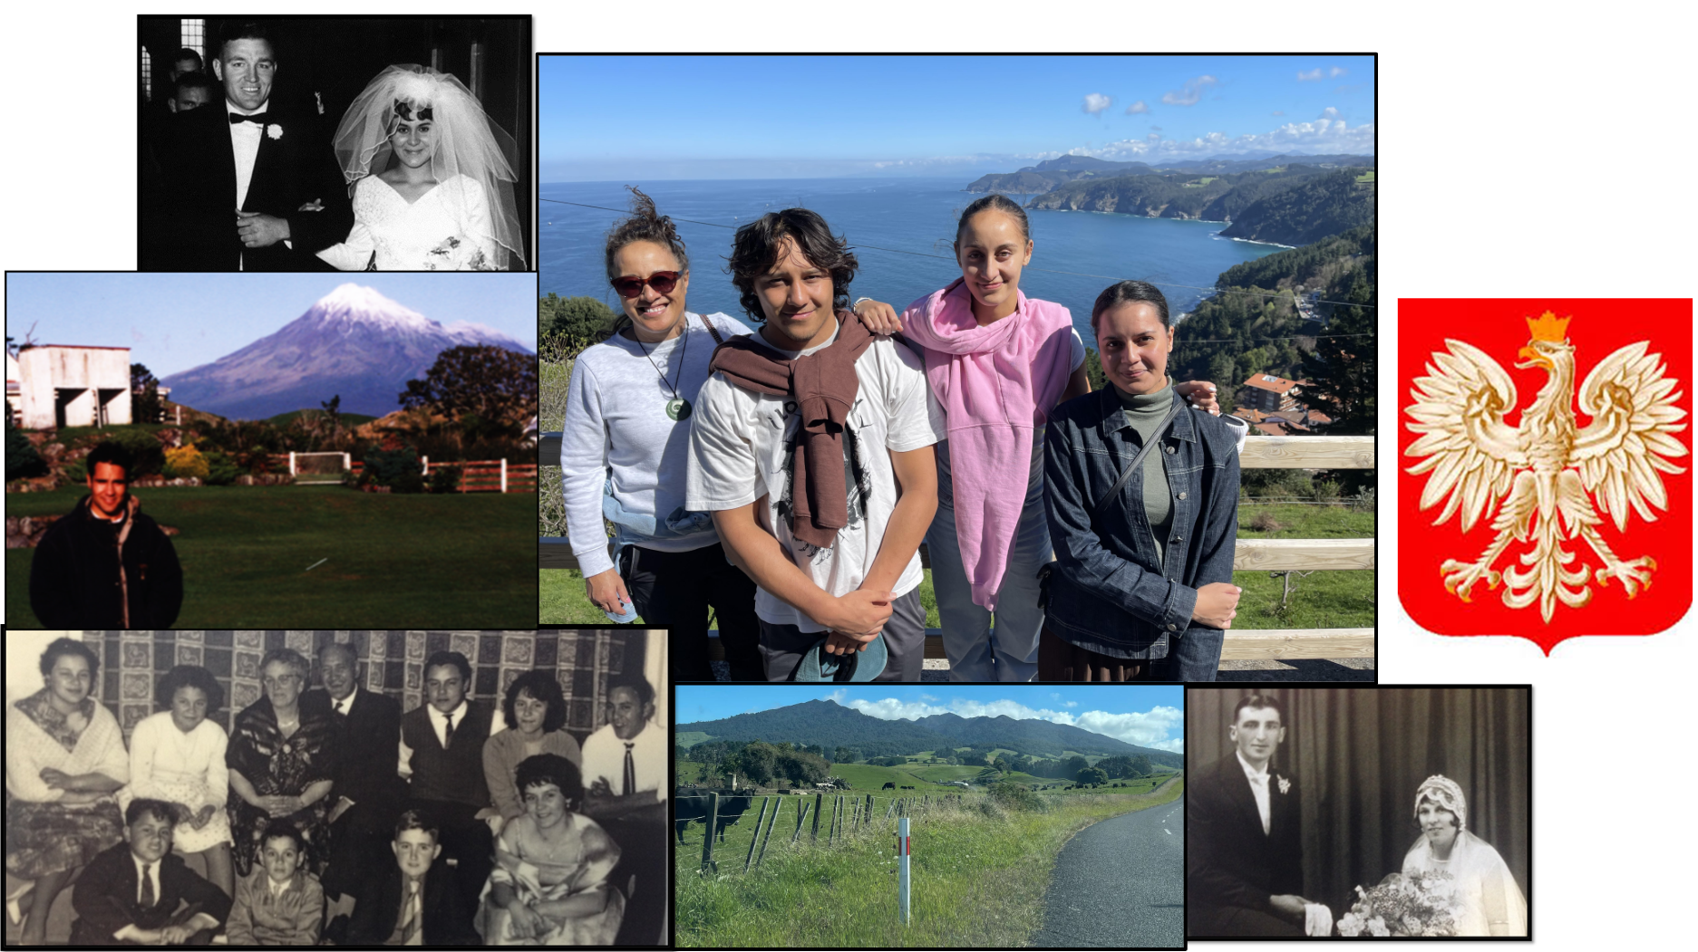

Slide 3


Ngā Tikanga o te Wānanga
Guidelines for our workshop - what’s important for our comfort?
Listen to understand
Open to learning
Respectful challenging
Be mindful of mic time

Slide 4

Whiria te mātauranga
Why is it important to give effect to Te Tiriti?
How do we do that?
What are you already doing?
Silver Bullet disclaimer!

Slide 5
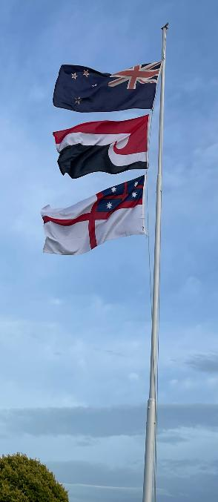
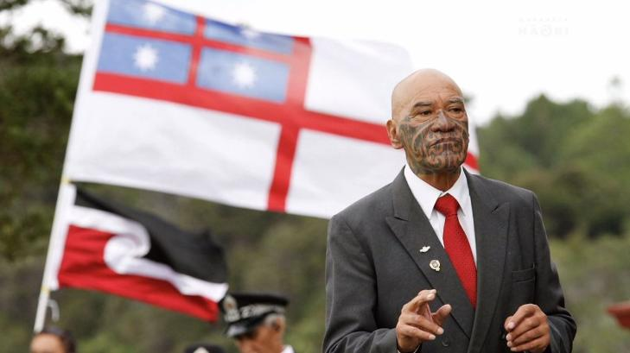
Why? He Whakaputanga - Dec of Independence
We’re the bosses and make the laws here.
1835
34 +18
Te Hāpuku
Potatau
Te Matua me te Tamaiti - Hone Sadler
Te Haki - Te Kara

Slide 6
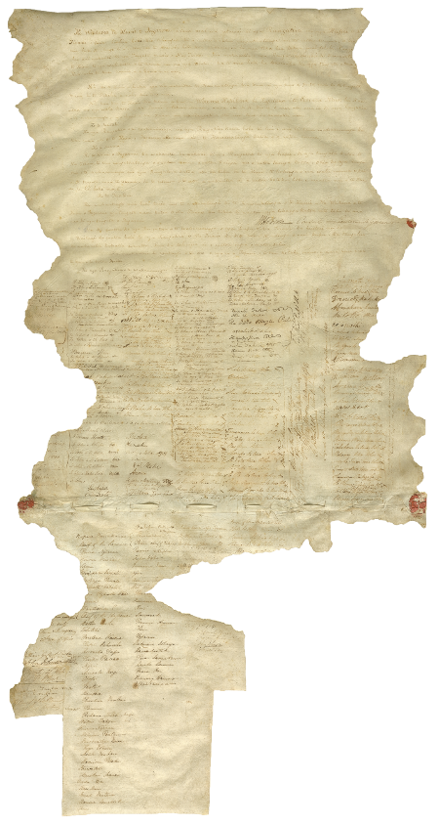
Why? Te Tiriti o Waitangi
What’s in it?
5 elements
Versions
Kāwanatanga (Governance) vs Sovereignty
Tino Rangatiratanga (Chieftainship) vs Exclusive & undisturbed possession
Tikanga rite tahi - same rights as British
Contra preferentem
international law principle
Ambiguity against drafter
500 vs 39 signatures

Slide 7

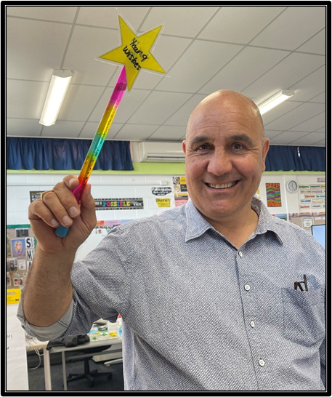
Our Responsibility
Ākonga @ EIT
2nd Highest
10% gap
Cert vs Degree
BERL Report
Give effect to Te Tiriti
Honour principles of Te Tiriti
What does that mean?
Tū kaha ki te ao Māori
  Confident and able to participate in the Māori world
Tū kaha ki te ao whānui
  Confident and able to participate in the wider world
Healthy and Prosperous

Slide 8
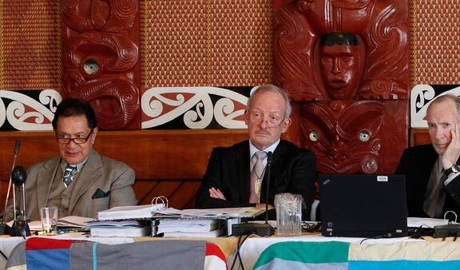
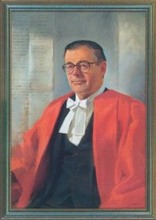
Key Principles
Principles embedded in Te Tiriti
Partnership
  The Treaty created a relationship between Māori and the Crown and both parties must act with the utmost good faith.
Participation
  The Crown will provide tāngata whenua with opportunities to engage with decision making processes at all levels.
Protection
  active protection of Māori interests, rights, taonga and rangatiratanga must be a government priority.
Notes:
Principles are different to the treaty and te tiriti o Waitangi
Developed by academics, lawyers, judges, government officials, politicians and tribunal experts. Picture of Lord Robin Cooke.
Attempt to define the treaty’s modern role in Aotearoa NZ
3 Ps are most well-known principles – ensure Māori input into decision-making and require govt, crown and entities to protect Māori authority
Partnership: the Treaty created a relationship between Māori and the Crown and both parties must act with the utmost good faith.
Participation: the Crown will provide tāngata whenua with opportunities to engage with decision making processes at all levels.
Protection: active protection of Māori interests, rights, taonga and rangatiratanga must be a government priority.
Government prefers principles because they don’t go as far as te tiriti text – allows them to work towards treaty obligations without granting full Māori sovereignty.
Kaumātua like Tīpene O’Regan are advocates for the principles.
Later generations of Māori reject principles because iwi and hapū were not part of their creation and don’t go far enough. Partnership is not mana Motuhake!
Hon David Seymour has undertaken to revisit and redefine the principles using edited language from the articles of Te Tiriti.

Slide 9
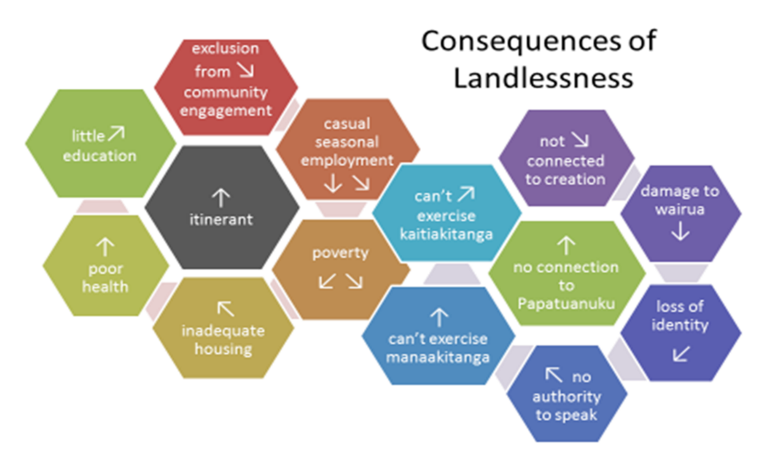
Why - Historical Significance
Iwi goals
Colonisation
Racism
Landlessness
Example
1865 Waikato feeding Auckland
Not selling land
Kingitanga
Waikato Invasion
British - Cameron
Concocted falsehood
Rangiriri
Maungatautari
Rangiaowhia
Orakau
Confiscated 1.2M acres

Slide 10
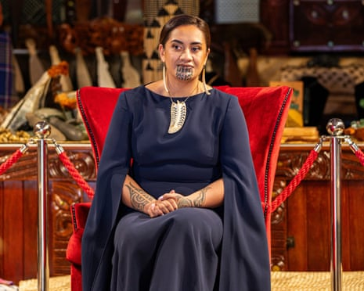
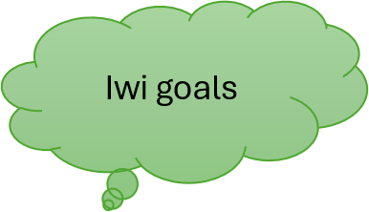
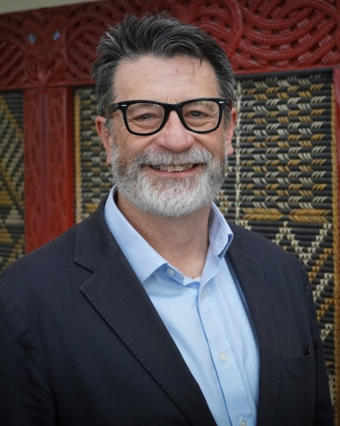
Why is it important?
Colonisation
Impact of landloss
Identity, culture and language
Implicit messages
  Curriculum
  Physical spaces
  Tikanga Practices
Biculturalism leading to multiculturalism
Equity
Raupatu to Rauora

Slide 11
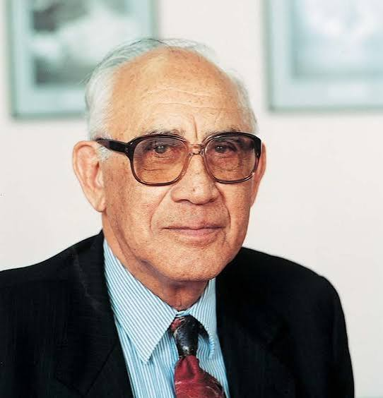
Mātauranga Māori
Post European Concept
  Rāwiri Taonui
Hirini Moko Mead
  Māori knowledge – some revived
    Eg. Art, karakia, technology, waka navigation, tā moko, kapa haka
  Some think only applies to pre-colonisation
  Cultural system of knowledge about everything important
  Fundamental to Māori identity
  Inclusive and allows for innovation - Tā moko traditional & modern
  Mātauranga ā iwi, Mātauranga ā hapū, mātauranga ā whānau
  Mātauranga Pākeha – Tuini Ngawai

Slide 12
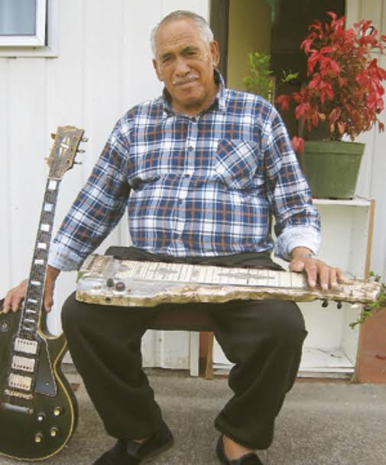

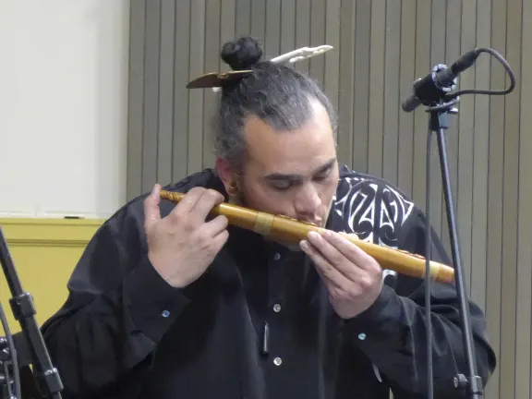
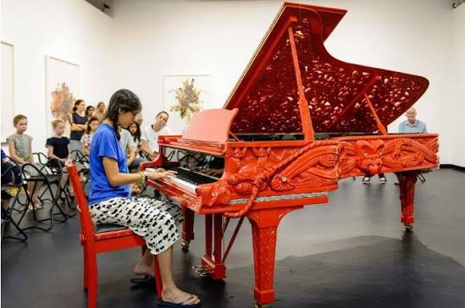
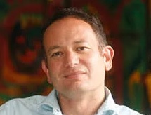
Mātauranga Māori - tauira
Anne Salmond
Horo Horomona
Charles Royal
Wilson Tawhiti
Cultural humility – tea!

Slide 13
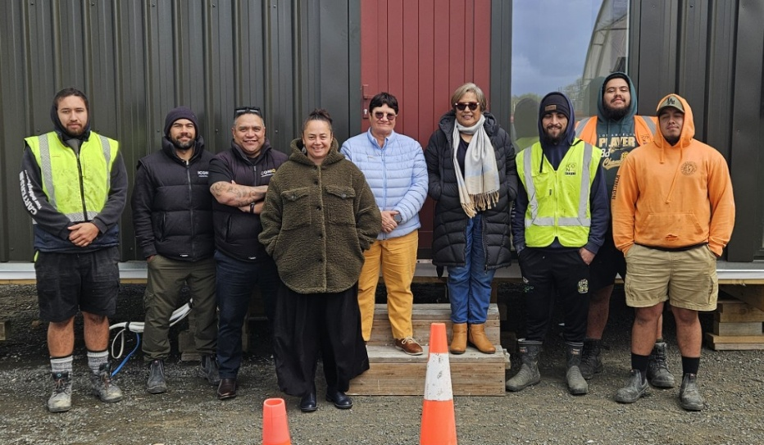
Examples of what we do at EIT
Toihoukura
Indigenomics, utu – reciprocity, tātou v me
Te Ata Māhina
Mahinga Kai programmes
Crayfish pots
Solar at the marae
Te Whare Tapa Whā
MPTT
BTP – Inquiry to grow Māori kaiako
He aha atu? What else?
What leadership can I show in this space?

Slide 14
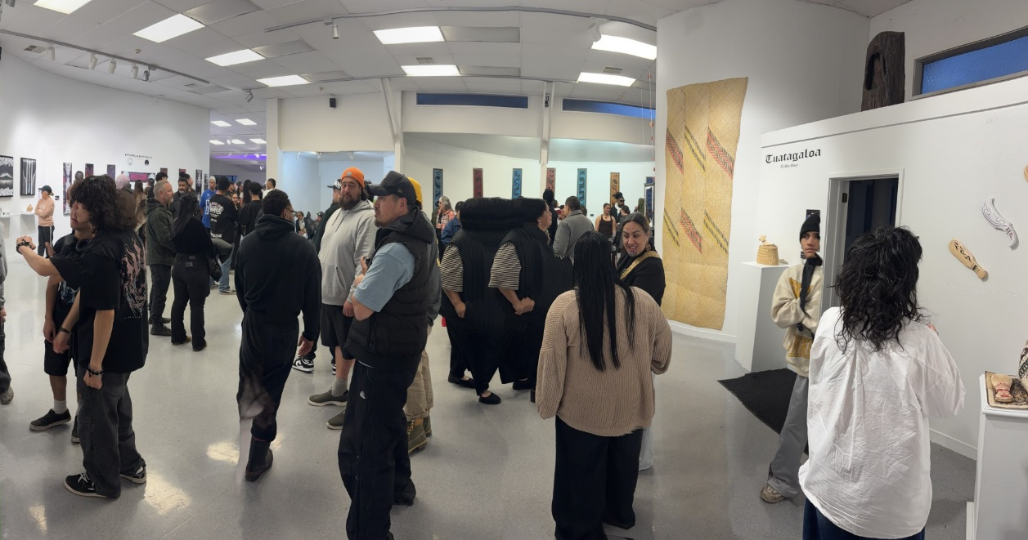
He Whakaaro Anō
Daily practices say mātauranga Māori is valued
Curriculum links
Local to national to global
Whānau links

Slide 15
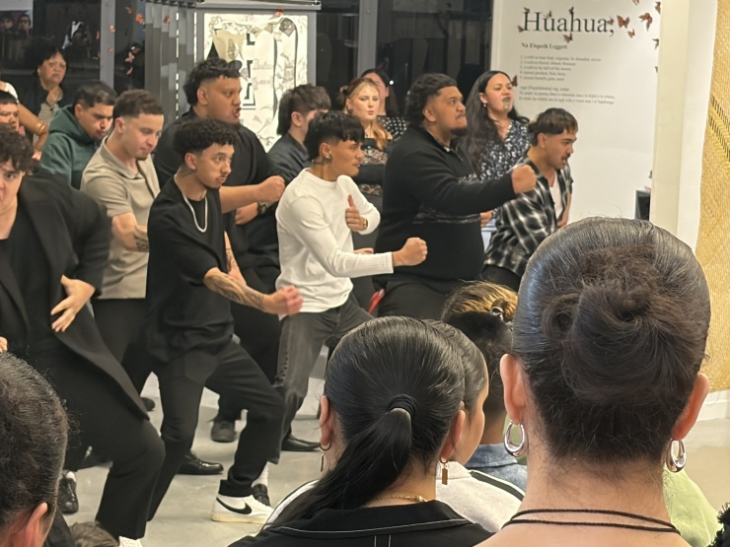
What else could it look like?
Consulting with whānau | Realising whānau goals | Building strong relationships
Help at marae | Matariki dinner | Waka ama, kapa haka, ki-ō-rahi
Te Reo for staff | Mātauranga Māori in curriculum | Marae based learning
Māori staff | Mana whenua access | Understanding Te Tiriti
Understanding Colonisation | Knowing our history | Localised curriculum – Pepehā
Tikanga Māori visible | Karakia | Pōwhiri
Bilingual Signage and Website | Whakaairo – carvings | Murals
Te Reo usage | Waiata | Planting with mana whenua
Environmental Kaupapa | Community Expertise – Rongoā | Bilingual newsletter
Correct pronunciation | Te Tiriti evident in Strat Planning | Matariki Hautapu
Community Kapa haka | Trips to wāhi tapu | Cleaning Pou at Atea-ā-rangi
Wānanga at Marae | Annual show using Pūrākau | Being visible at events

Slide 16
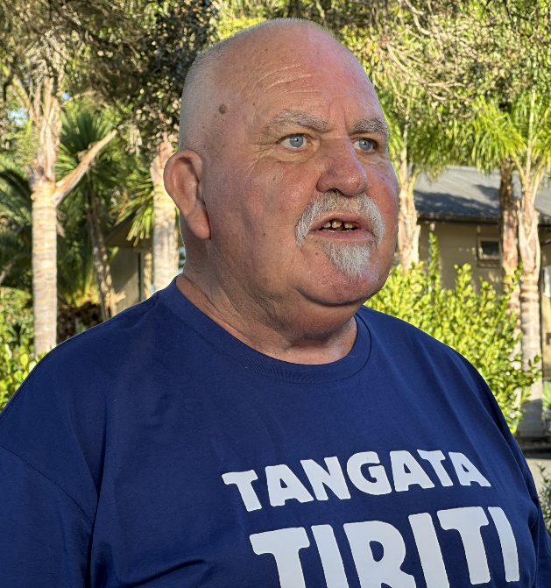
What can I do?
Learn - te reo, tikanga, local kōrero
Ensure correct pronunciation
Build relationships - family-like. Kai!
Start with prior knowledge - link learning
Explore curriculum links to mātauranga Māori
High expectations for learning - scaffold
Support Māori focused initiatives
Learn what it means to be a Tangata Tiriti

Slide 17
Future focii
To Develop courage, confidence and capability
Herea te rā – cultural capability and confidence (fear)
Programme review & development – Māori Directorate & EDC
  Mana Whenua approved consultant group
Culturally responsive and relational pedagogy
Learning mātauranga Māori content
Evaluating progress – trust in Allah

Slide 18

Whakakapi
One significant thing you’ve learned
Something that was challenging
One action you can take

Slide 19
Giving effect to Te Tiriti o Waitangi is something that many organisations endeavour to achieve. My research has shown that many educational leaders are motivated to be a good Te Tiriti partner and ensure equitable outcomes for ākonga Māori. The challenge is we aren't always confident in how to actually do that. This interactive workshop will explore why giving effect to Te Tiriti it is important (regardless of legislative requirements) but also how institutions are going about realising this goal. What are we doing to build iwi and hapū partnerships, how are we ensuring that mātauranga Māori is being woven into our programmes, how do we ensure that the pedgogy, androgogy and heutagogy is relational and culturally responsive, how are we developing cultural capability and how do we know how well we are doing?

