Slide 1

Personalised learning WITH AI: human-led cognitive apprenticeship
Selena Chan PhD
NZVET Research Forum 2026

Slide 2
Overview
What is personalised / individualise / differentiated learning ?
How can AI support self-directed personalised learning?

Slide 3
What is personalised learning?
Personalised – learner driven – drawing on learner’s identity, interest, needs.
Individualised – tailored learning to individual learner – content, level of learning, delivery method, learning rate etc.
Differentiated – generally applies to groups of learners, draws on diagnostic, formative analytics and is ‘teacher’ driven.

Slide 4
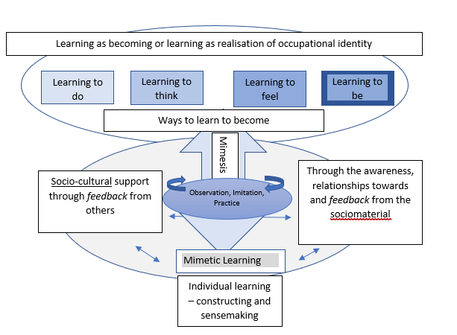
Learning as becoming and learning to become (Chan, 2021)

Slide 5
How is Gen AI useful for learning?
Cognitive apprenticeship – AI as ‘study buddy’ or ‘coach’
Thayer method – to teach is to learn (Connors, 2000)
Avoid ‘helicoptering’ to the solution – need to engage in ‘productive struggle’ (Brcic & Frljic, 2026) to avoid ‘metacognitive laziness) (Fan et al., 2025)
Brcic. M. & Frljic, S. (2026). The effortless trap: Productive struggle, AI, and the illusion of learning. https://arxiv.org/pdf/2606.26181
Collins, A., Brown, J. S., & Newman, S. E. (1989). Cognitive apprenticeship: Teaching the crafts of reading, writing and mathematics. In L. S. Resnick (Ed.), Knowing, learning and instructions: Essays in honor of Robert Glaser (pp. 453-494). Hillsdale, NJ.: Lawrence Erlbaum Associates.
Connors, E. (2000) The Thayer Method: Student Active Learning with Positive Results, Journal of Mathematics and Science: Collaborative Explorations: Vol. 4: No. 1, Article 11.
https://scholarscompass.vcu.edu/jmsce_vamsc/vol4/iss1/11
Fan, Y., Tang, L., Le, H., Shen, K., Tan, S., Zhao, Y., Shen, Y., Li, X., & Gašević, D. (2025). Beware of metacognitive laziness: Effects of generative artificial intelligence on learning motivation, processes, and performance. British Journal of Educational Technology, 56, 489–530. https://doi.org/10.1111/bjet.13544

Slide 6
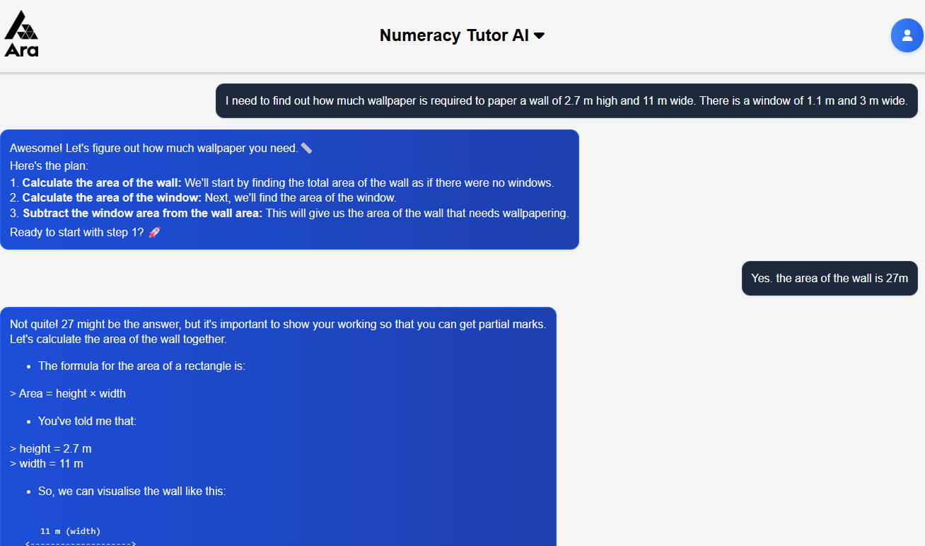
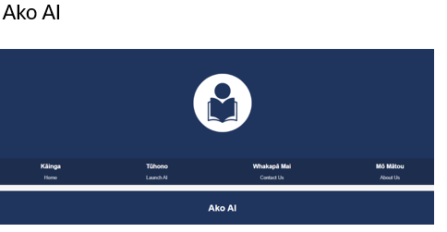
Role of Gen AI in supporting individualised learning
(examples from Ara projects)
Ako AI (funded by Ako Aotearoa) and Numeracy AI
Self-direction – Foundation courses – Cogniti
Cognitive apprenticeship – (observation, coaching and scaffolded support) (Collins, Brown & Newman, 1989)
Drawing on experience, expertise and knowledge (canonical and tacit)

Slide 7
Learning and AI
Learn ABOUT AI – AI literacy – more than what, how, when but HOW
Learn WITH AI – as a ‘study buddy’ or ‘thought partner’
Learn THROUGH AI – ‘exoskeleton’ (NOT crutch) extending ‘Google’; increasing volume/speed for comparative analysis; summarising; comparisons – ‘matching patterns’
Learn WITHOUT AI – salient/need to practice to learn – foundational skills, knowledge.
Learn AGAINST AI – critiquing and correcting AI
Dr. Leon Furze - https://leonfurze.com/2025/08/12/about-with-through-without-against-five-ways-to-learn-ai/

Slide 8
Learning about AI – ACTIVITY #1
How does Gen AI work?
Why is it Generative?
What can AI do?
What is Agentic AI (AIA)?

Slide 9
Learning WITH AI
“AI acts as a digital helper or tutor that adapts to each person's speed, answers questions, and tests skills”
(examples, quizzes, scaffolded steps)

Slide 10
Learning THROUGH AI
“AI as an adaptive digital tutor that fits lessons to individual pace, breaks down complex ideas, and provides instant feedback” (sets up study plan, tailors content to level of learning, revises concepts, provides formative feedback)

Slide 11
Learning WITHOUT AI
“Ensuring Information Literacies and Critical Thinking are not replaced by AI”
(protecting your cognitive engagement and avoiding cognitive debt- EFFORT preserving module –elicit, formulate, feedback, organise, reflect, transfer
(Liubertaitė, 2026)
Liubertaitė A.D. (2026) EFFORT-AI: an effort-preserving module for cognitively aligned human-AI learning. Frontier of Education. 11:1849821. doi: 10.3389/feduc.2026.1849821

Slide 12
Learning AGAINST AI
“AI threatens true education by short-circuiting deep thinking, replacing cognitive effort with immediate answers, and fostering dangerous intellectual passivity”
(assuring productive struggle, deliberate practice, critical thinking)
https://thedecisionlab.com/biases
https://pz.harvard.edu/thinking-routines

Slide 13
Activity #2
How do you use AI to support your own learning?
Learn about AI -
Learn WITH AI -
learn THROUGH AI -
Learn WITHOUT AI -
Learn AGAINST AI -

Slide 14
Activity #3
Where to next?
My learning plan to use AI to support my learning

Slide 15


Slide 16
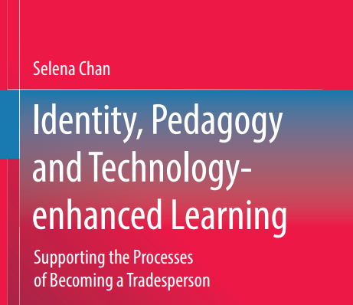
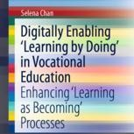


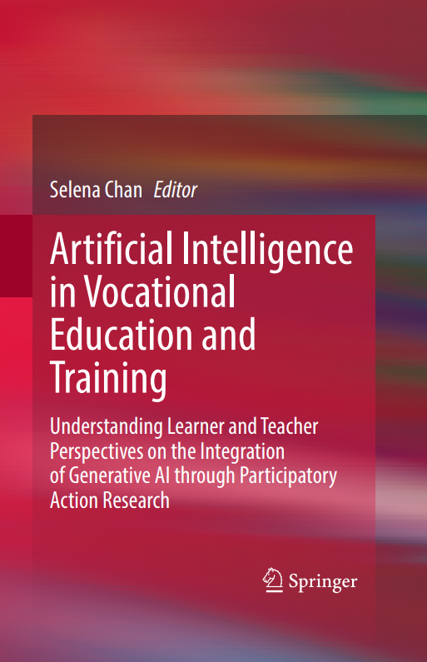

Ngā mihi
Dr. Selena Chan
Ara Institute of Canterbury
Selena.Chan@ara.ac.nz
blogging at:- http://mportfolios.blogspot.com
Edited by Selena Chan and Teressa Schmidt

