Slide 1


FROM LEARNER VOICE TO PRACTICE
Mapping diverse learner journeys to strengthen vocational education and employment pathways
Dr Waruni Hewage · NZVETRF 2026
Co-Authors – Dr Asanthika Imbulpitiya and Dr Edwin Rajah

Slide 2

Why map the learner journey?
Learner experience changes across stages of study
A single measure of satisfaction or completion can miss where support was needed.
The project asked learners about barriers, enablers and support at key points in their journey.

Slide 3
Project purpose
Understanding diverse journeys
Informing decisions
Identify barriers, enablers and support needs across stages of vocational study.
Develop personas and journey maps to guide educational services and learner support.
Guiding question: What would help different learners progress and move towards work?

Slide 4
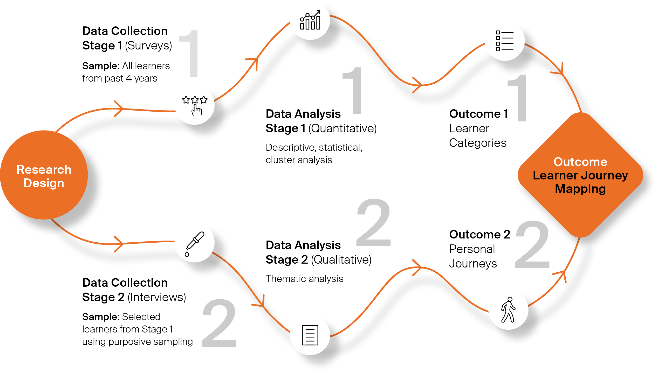
Research Design

Slide 5

Evidence and Analysis
684
Retained survey responses
Descriptive analysis
Principal component analysis Clustering
50
Follow-up interviews
Thematic analysis

Slide 6
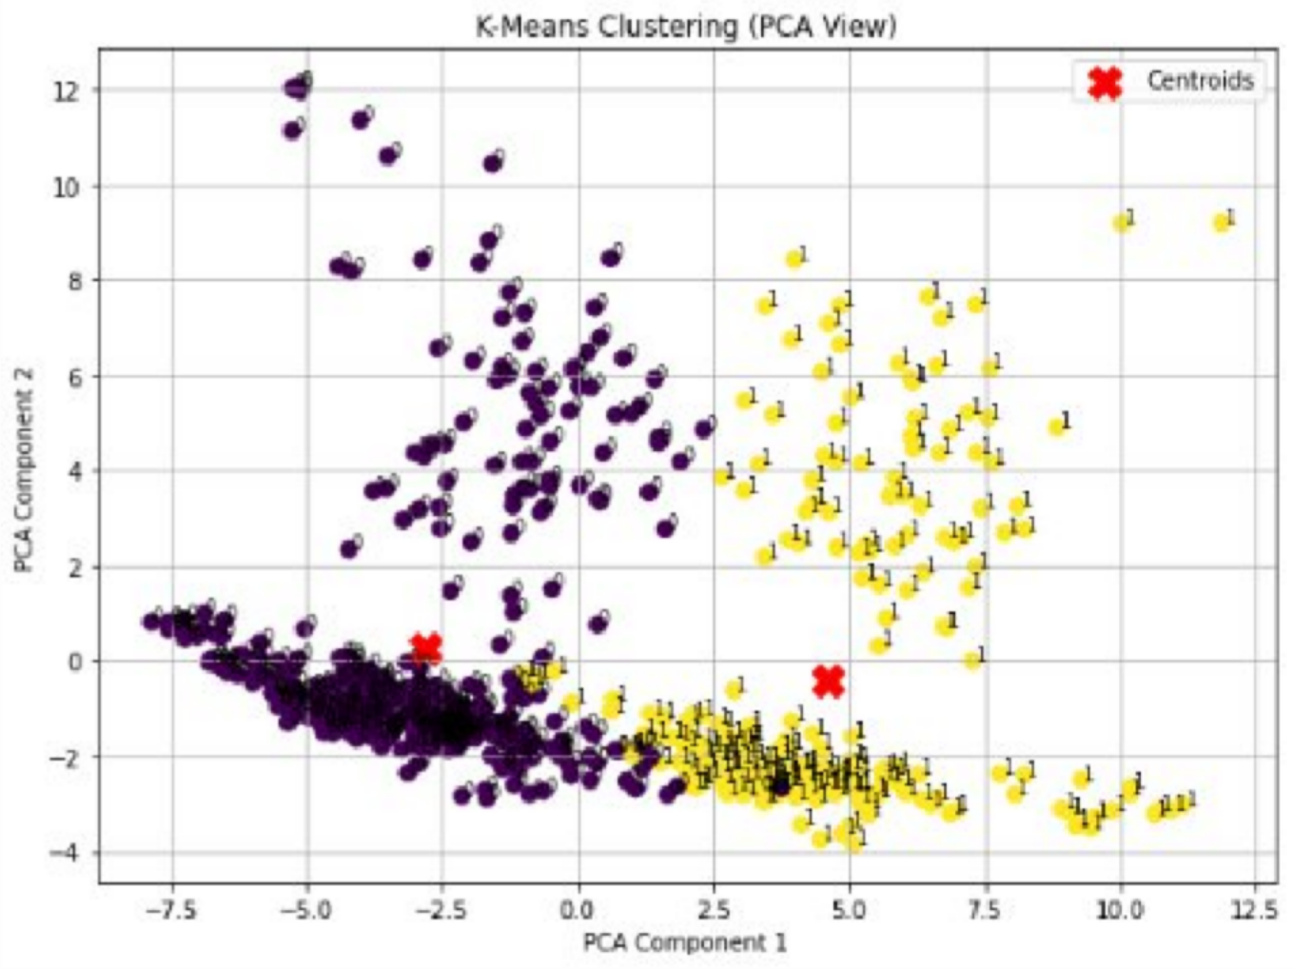
PCA Findings

Slide 7
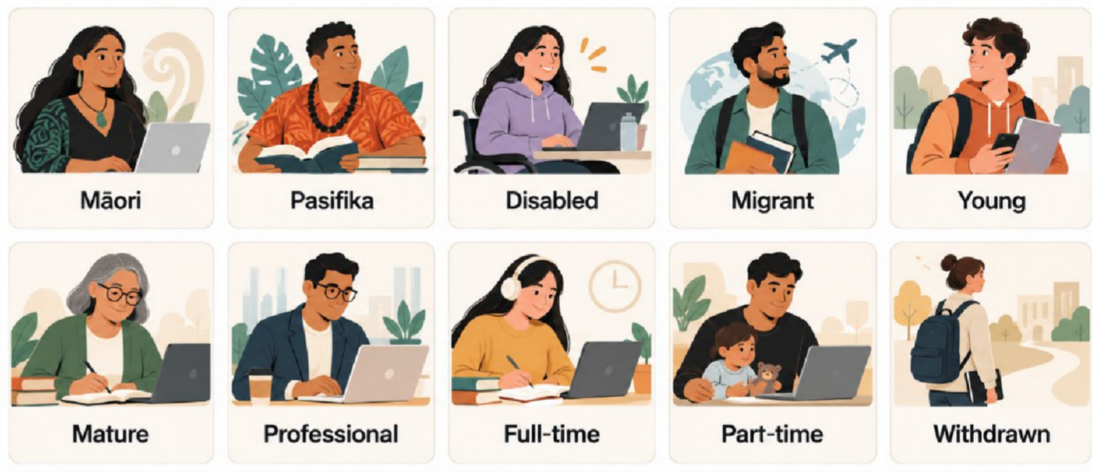
Ten learner groups Identified
These are overlapping lenses on experience. A learner may belong to several groups.

Slide 8
Journey map: where support matters
Enrolment and orientation
Learning and belonging
Completion
Transition to work
Readiness, clear information and a welcoming start
Tutor and peer support, resources and flexibility
Practical experience, industry exposure and career support
Continued academic and wellbeing support
Synthesis of reported themes; not an individual learner’s path

Slide 9

Finding 1: The beginning matters
Two early needs emerged
Clear, welcoming orientation
Readiness support, including digital skills and learning resources
Practice implication: identify support needs early

Slide 10
Finding 2: Support must continue
What enabled progress
Personal motivation, tutor and peer support, culturally responsive environments, and practical learning.
What created barriers
Work and family responsibilities, inflexible timetables, digital literacy gaps, and insufficient personalised support.

Slide 11

Learner Personas
11

Slide 12
Personas make needs visible
Professional learner
Māori learner
The project persona describes a need for timely academic advice and flexibility around work and family commitments.
The project persona highlights culturally responsive support, access to materials and flexibility.
A persona helps teams test a service. It does not define every learner in that group.
12

Slide 13
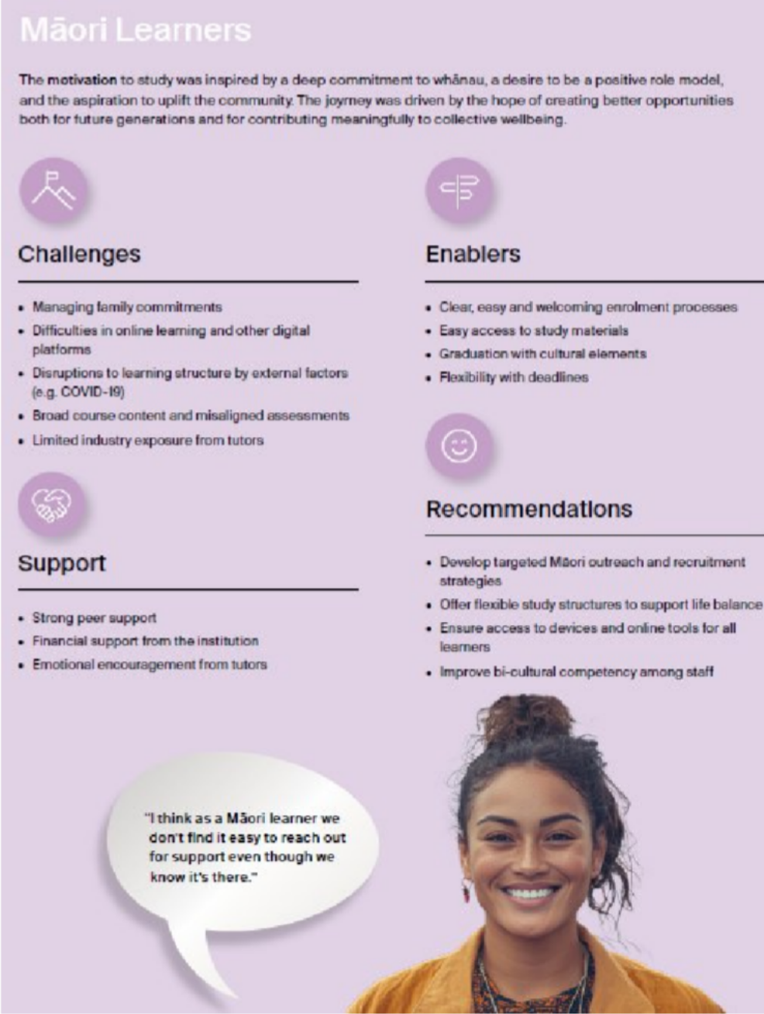
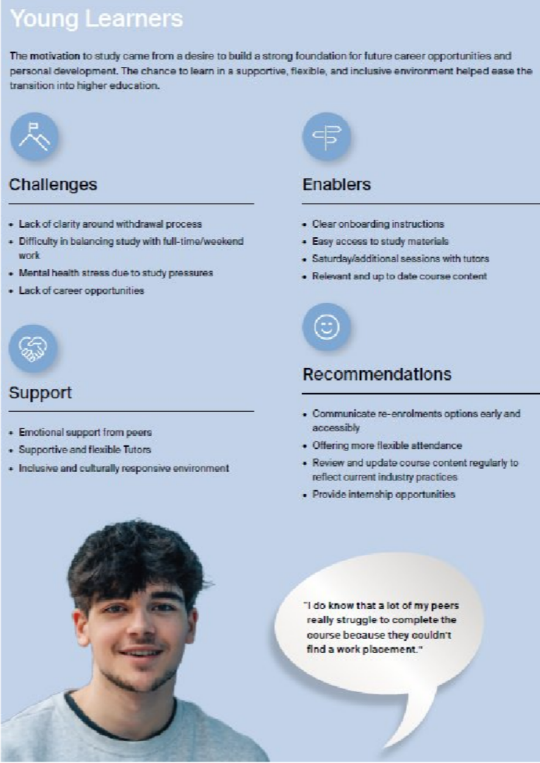
13

Slide 14
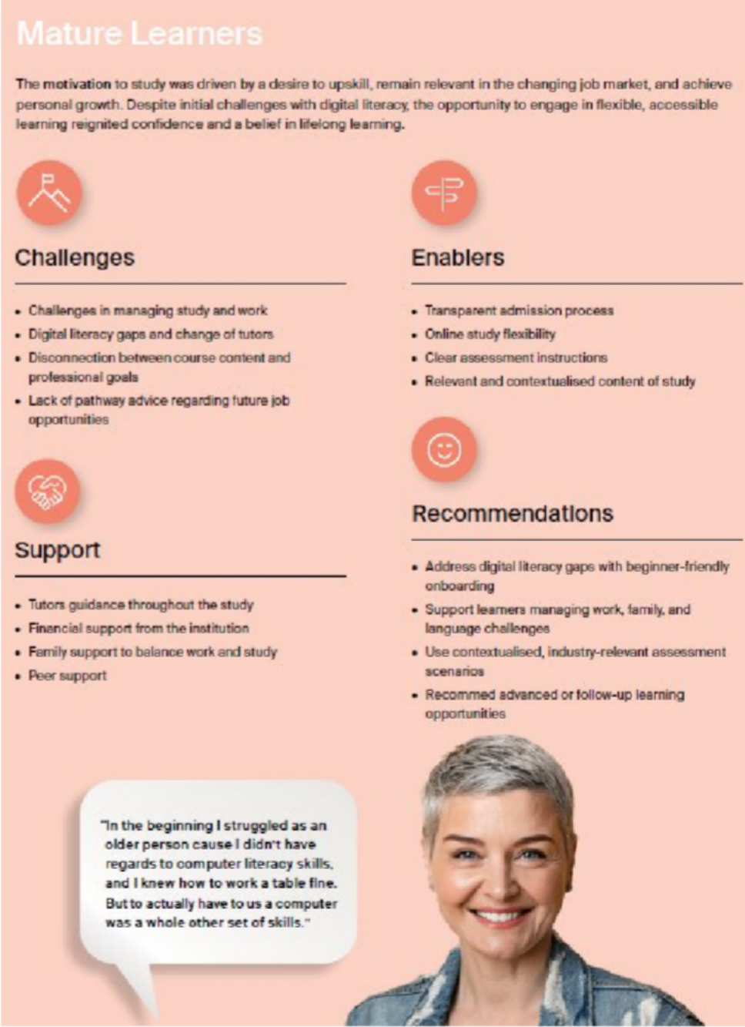
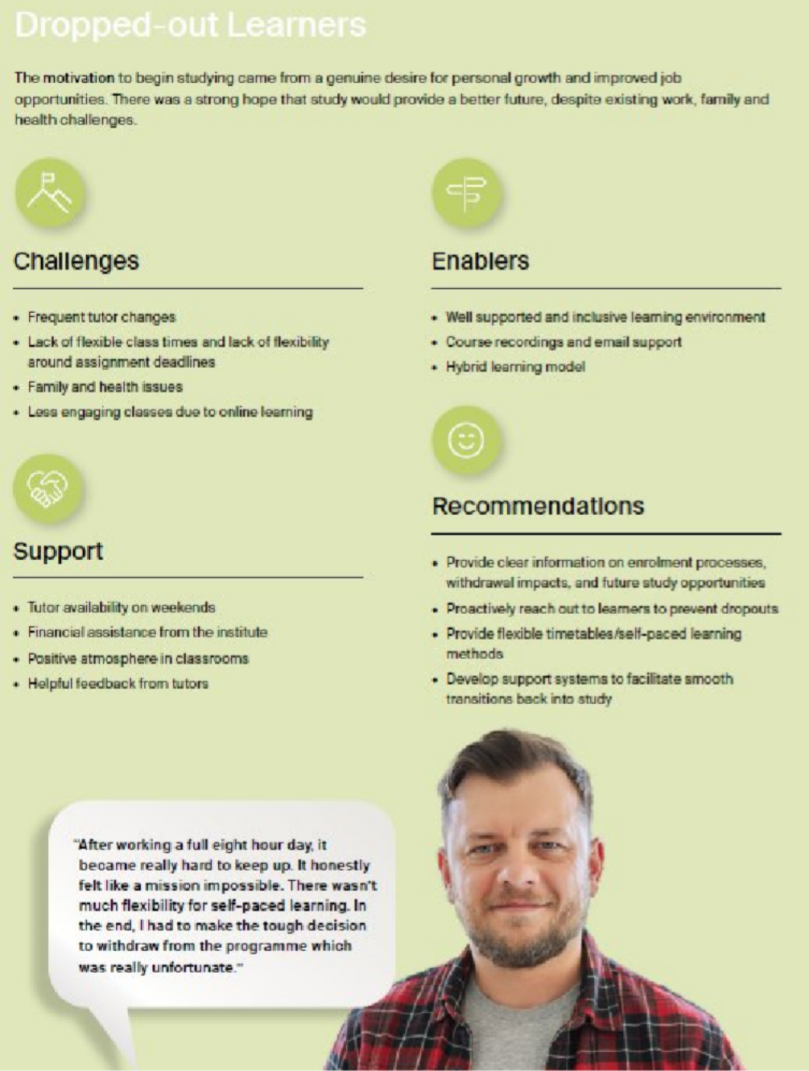

Slide 15

The transition into employment
Learners identified gaps beyond course completion

Slide 16
What the findings suggest for practice
At entry
Clearer onboarding and early digital support
During study
Flexible delivery, tutor contact and wellbeing support
Towards work
Practical projects, placements and industry links
These are research-informed recommendations; implementation and impact need separate evidence.

Slide 17
The Just-in-Time (JIT) App Extension
Earlier identification of potential learner support needs
Existing At-Risk App
JIT Extension
Responds to signals such as absenteeism, assessment performance and staff referrals.
Uses historical institutional data to generate support indicators at the application stage.
Purpose: help teams plan timely support before traditional warning signals appear.
Developed by the JIT project team within the wider TEC-funded learner-success programme.

Slide 18
Complementary approaches to early support
Learner Journey Mapping
JIT App
Learner experiences reveal barriers, enablers and the support people value.
Historical institutional data provides early support indicators at application and intake level.
Practical connection
Plan support earlier, then explore each learner’s needs through conversation.

Slide 19
Reported change in early withdrawals
Early withdrawal rate
6.1%
20.0%
15.7%
reduction
15.0%
9.6%
10.0%
Institutional change reported by the JIT project team
5.0%
0.0%
2024 2025
The comparison does not establish how much of the reduction resulted from JIT.

Slide 20
How this connects with employability
Progress through study
Early support
Transition into work
LJM identifies gaps in practical experience, placements and career support.
JIT identifies potential support needs before classes begin.
Support can help learners remain engaged and work towards completion.
Opportunity to address barriers to participation
Opportunity to continue developing skills
Opportunity to strengthen education–industry links

Slide 21
Discussion: Apply the journey map
Where do learners encounter the greatest gap in your setting?
Choose one stage: entry, study, completion or transition into work.
What evidence would help you understand it? What could your team change?

Slide 22
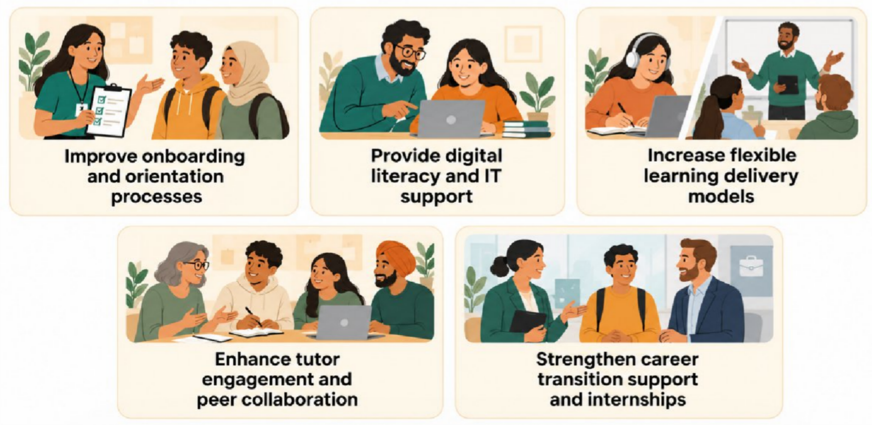
Recommendations

Slide 23
Dissemination
External Funding by Tertiary Education Commission:
Funded initiatives – Accelerating Learner Success Fund (Tūwhitia)
Sector wide Webinar:
https://www.tec.govt.nz/learner-success/learner-success-community-of-practice#AccordionItem10224
Published Report:
https://www.tec.govt.nz/assets/Publications-and-others/FS-DOM-Learner-Journey-Research-Report_v3_WEB.pdf

Slide 24

Thank you
Listen across the whole learner journey
Use personas to ask better questions about support
Connect learning with clearer routes into work
Auckland International Campus
24

